Slide 1
Antarctic Travel
Modern Practicalities
Copyright: This resource is provided free by CoolAntarctica.com, you’re welcome. It cannot be distributed by any other means, believe it or not people sometimes lift free resources and distribute them pretending they have been allowed to or even sell them as their own – I know! It’s shocking! If anyone asks you for payment for this or if you get it but not from CoolAntarctica.com, please email danthwhaler@gmail.com and the ghost of whaler Dan will exact retribution on the scurvy dogs.
This copyright notice must appear wherever this material is used. Any queries please email

Slide 2
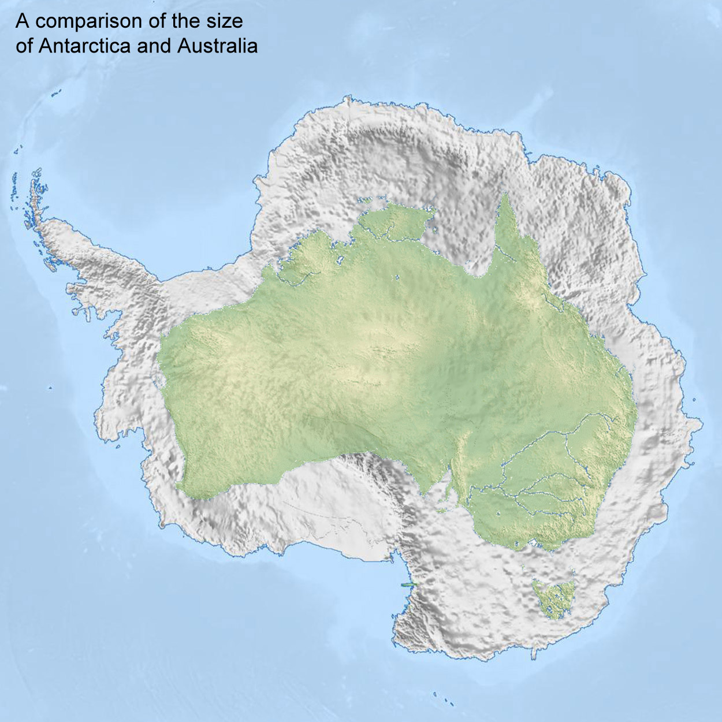
Antarctica is a continent, it is very roughly circular with a diameter of about 2,800 miles (4,500 km). There are no roads for conventional vehicles outside of short non-paved tracks around scientific stations, just a few "airports" that are rough landing strips usually on ice no commercial air or sea ports and no railways.
There is no infrastructure where you can buy fuel, get repairs or overnight accommodation other than as part of a (very expensive and very rare) short term adventure tourist package.
It’s also very BIG!

Slide 3
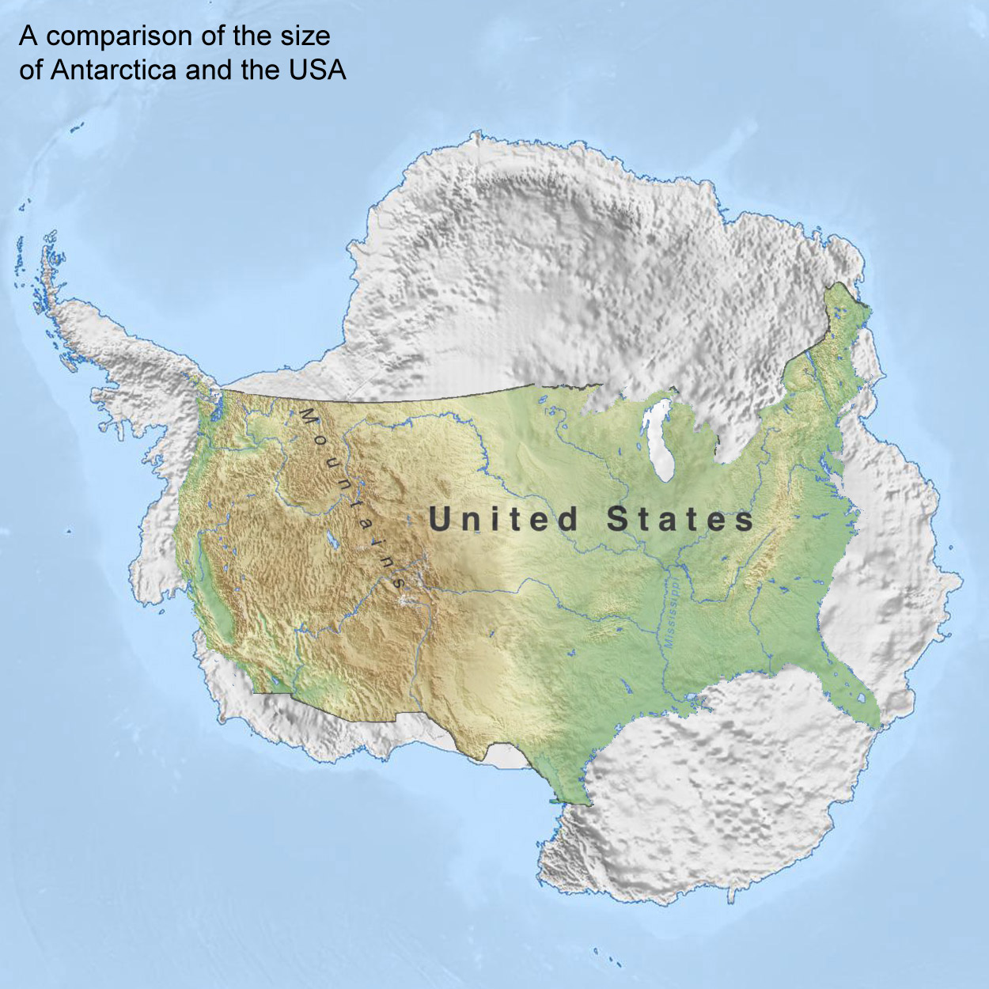
Antarctica is a continent, it is very roughly circular with a diameter of about 2,800 miles (4,500 km). There are no roads for conventional vehicles outside of short non-paved tracks around scientific stations, just a few "airports" that are rough landing strips usually on ice no commercial air or sea ports and no railways.
There is no infrastructure where you can buy fuel, get repairs or overnight accommodation other than as part of a (very expensive and very rare) short term adventure tourist package.
It’s also very BIG!

Slide 4
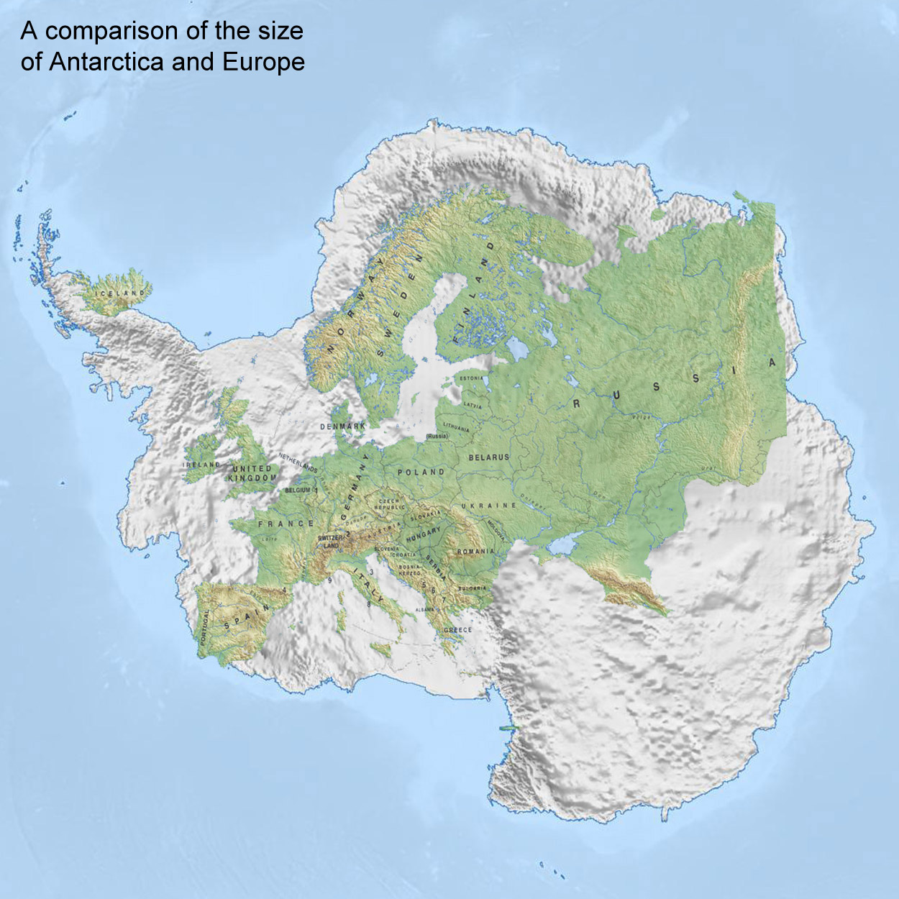
Antarctica is a continent, it is very roughly circular with a diameter of about 2,800 miles (4,500 km). There are no roads for conventional vehicles outside of short non-paved tracks around scientific stations, just a few "airports" that are rough landing strips usually on ice no commercial air or sea ports and no railways.
There is no infrastructure where you can buy fuel, get repairs or overnight accommodation other than as part of a (very expensive and very rare) short term adventure tourist package.
It’s also very BIG!

Slide 5
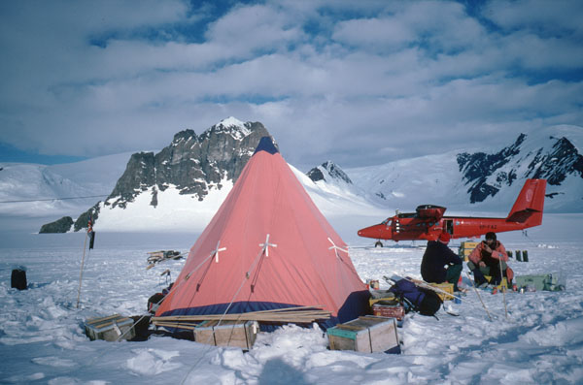
Field parties may camp for up to 100 days in the Antarctic summer months with periodical resupply which is taking place here by air.
Food and fuel can be dropped off many miles from the nearest base allowing remote and distant areas to be visited, the aircraft will also take out collected rock samples, this travelling field party are using snow mobiles and sleds to carry their equipment.

Slide 6
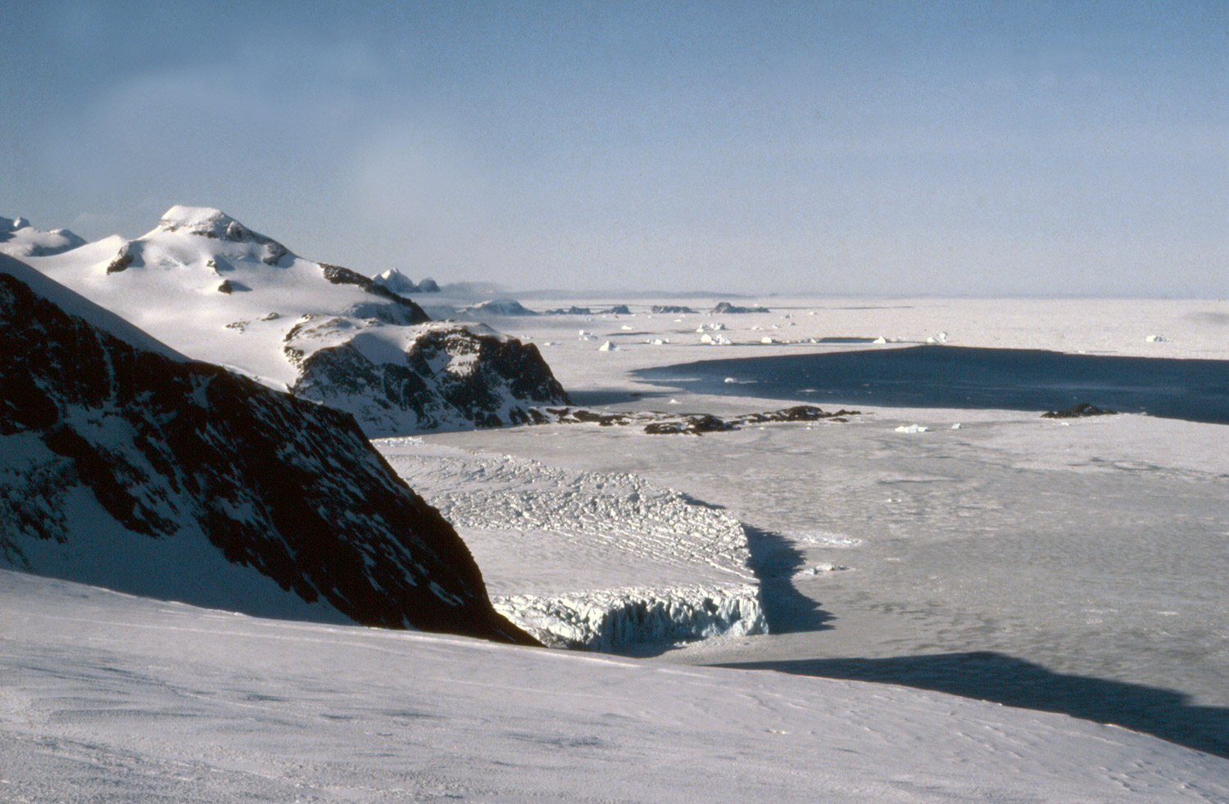
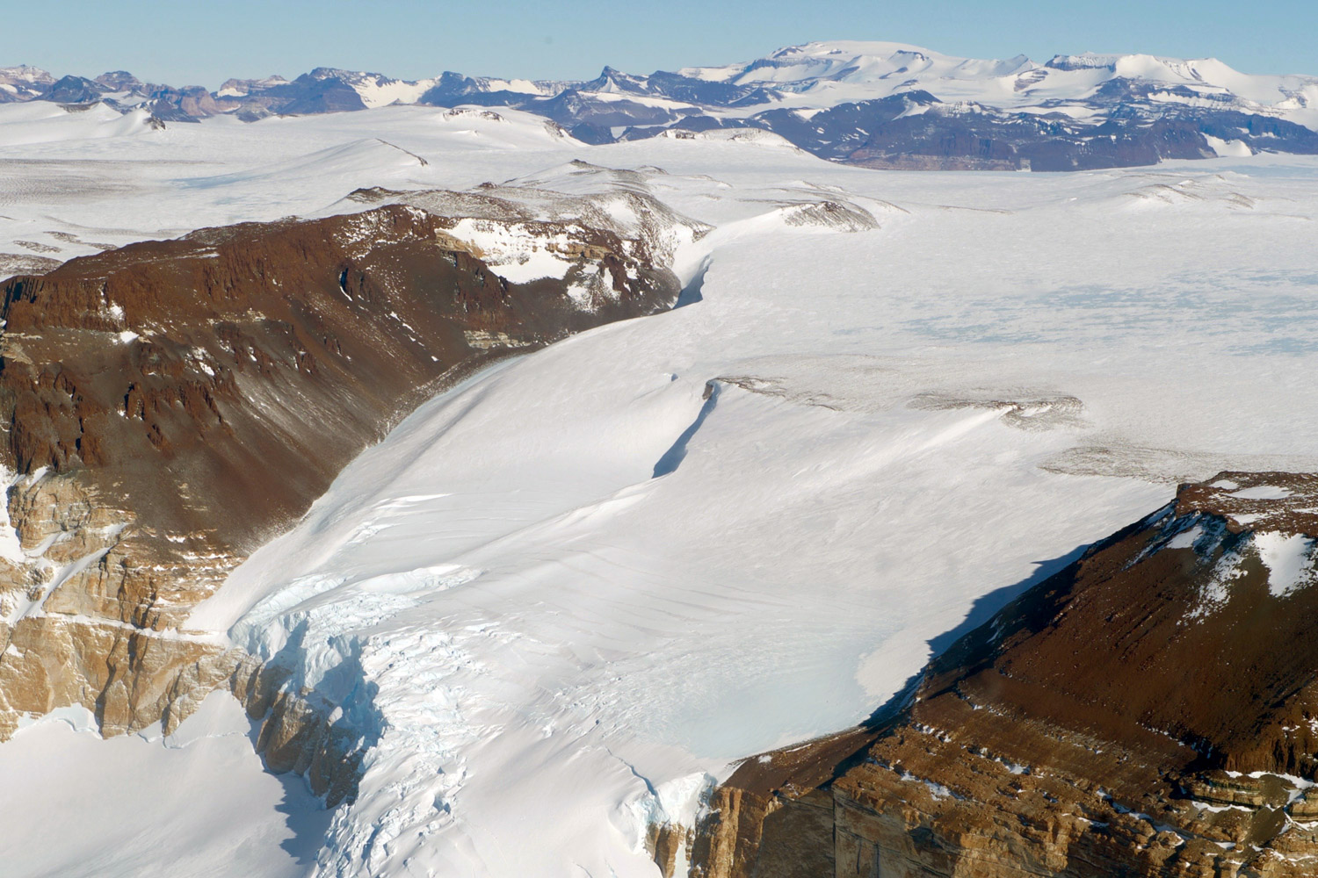
Getting Around Can be Hard
Getting around can be hard - 2

Slide 7
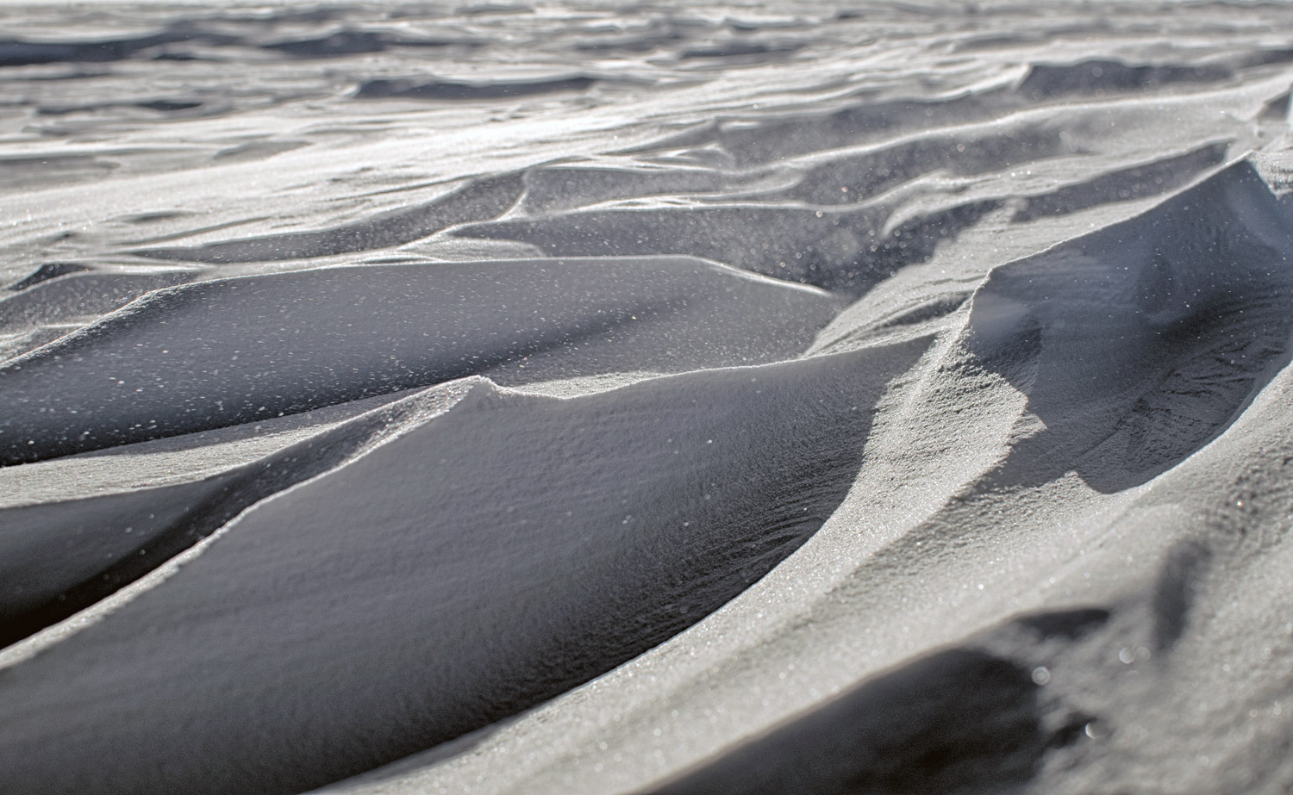
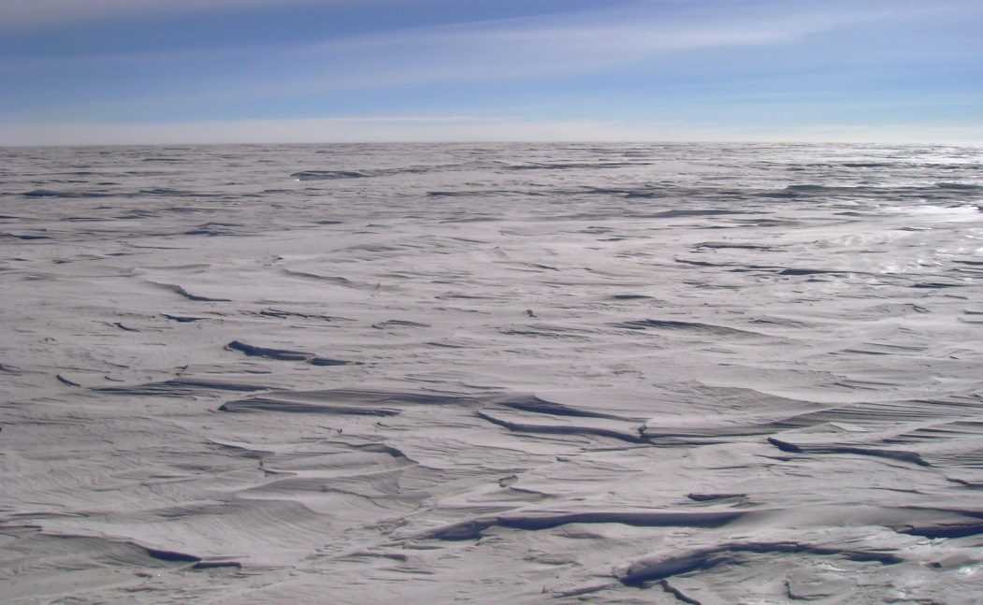
Different Speeds
on Different Days
The snow or ice surface can change in a short time, from one day to the next or during a day. It might snow and blow to form ridges called sastrugi, the temperature can rise to make the surface soft or even start to melt, ice flowers can form on a hard surface or a soft part-melted surface can freeze hard again. These things can drastically affect how quickly and easily you can move over the surface, for good and bad.
Sastrugi – here 10-15cm high

Slide 8
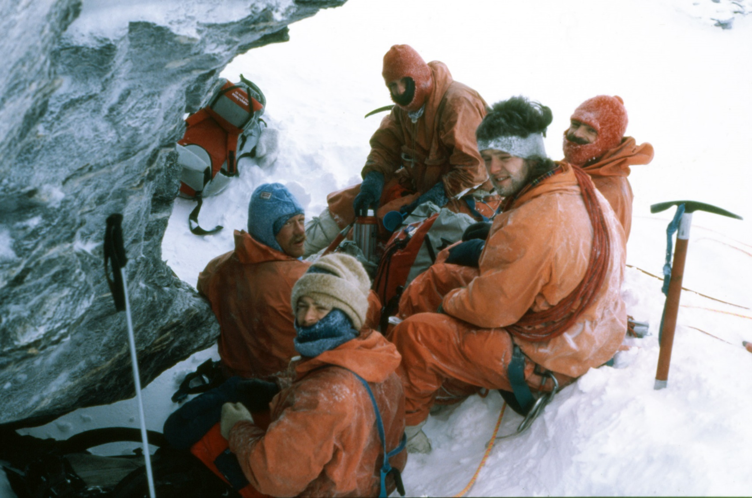
Weather
The temperature can fall or rise, there is a big difference between what you can comfortably and safely do at -10C, -20C and -30C.
Blizzards are an ever present possibility and can result in having to stop and wait until they pass, this might take a day or two, or a week, or two.
Even on calm and not especially cold days, low cloud can result in white-out conditions where it is like being inside a ping-pong ball making dangers such as crevasses much harder to see and slowing progress significantly.
Sheltering from the wind and hoping it won’t last for long

Slide 9
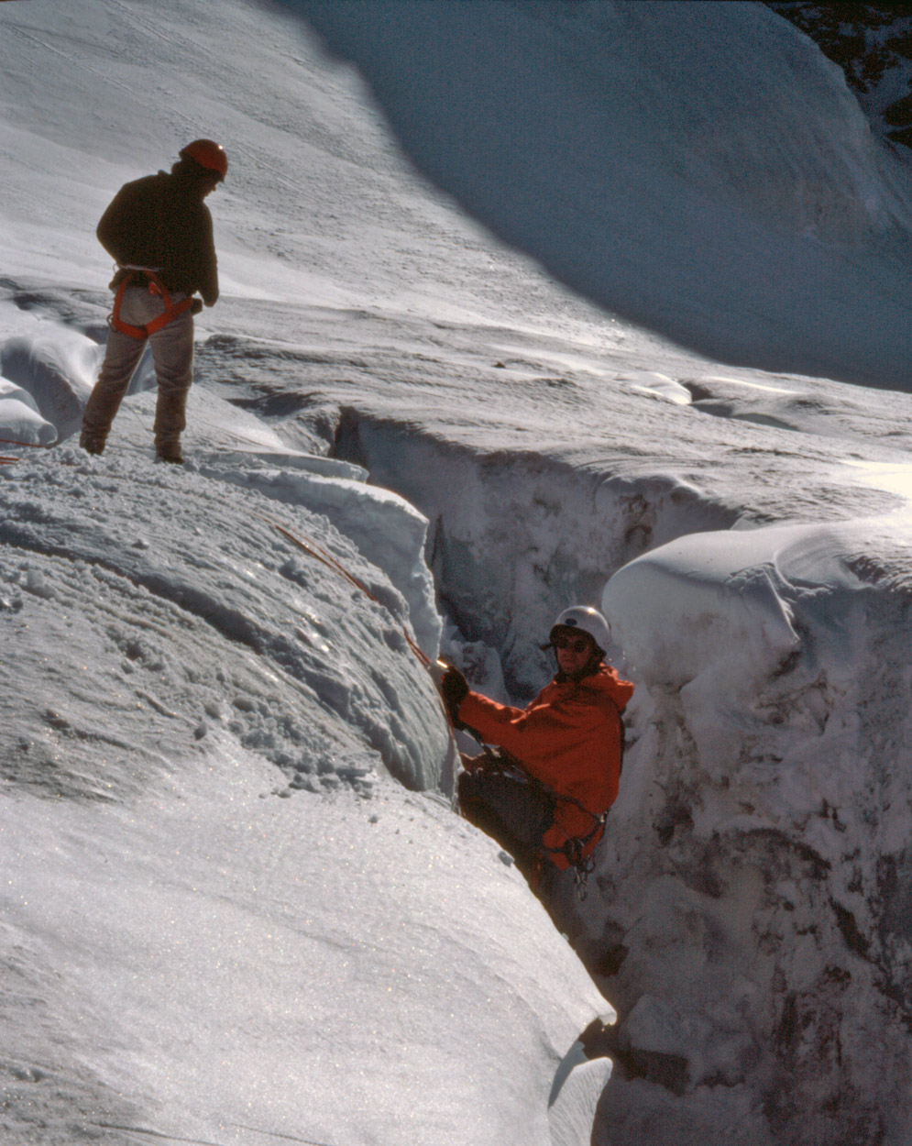
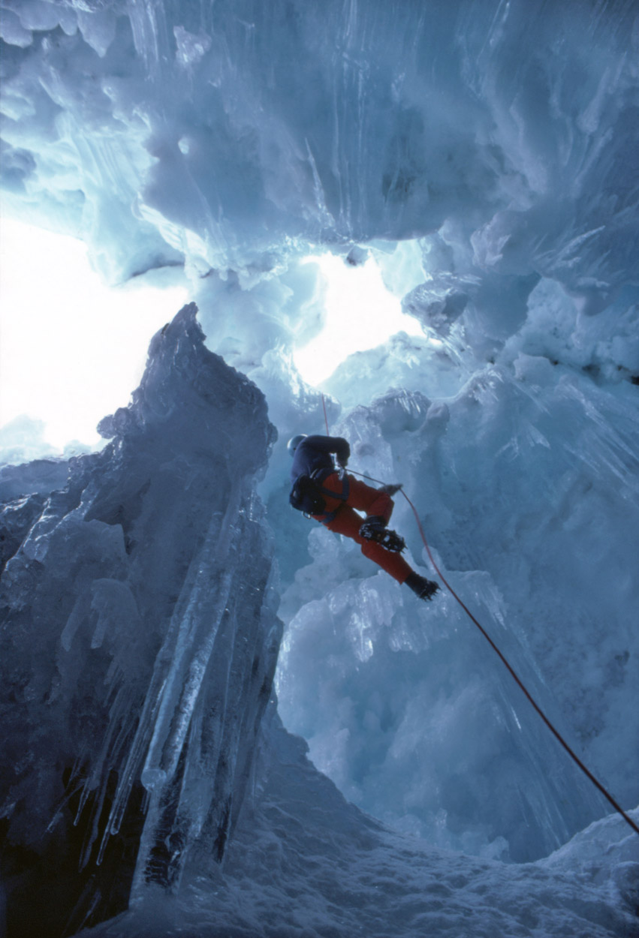
Hazards - Crevasses
One of the biggest and commonest hazards when travelling overland in Antarctica ae crevasses.
These are cracks in the ice that can be just a few metres deep or up to hundreds of metres deep. Blown snow may form a weak bridge over the top. Anyone passing through such terrain has to be vigilant and trained to spot and avoid crevasses, they should also know how to perform a crevasse rescue should someone fall in one.
Many lives have been lost from people and vehicles falling into crevasses.

Slide 10
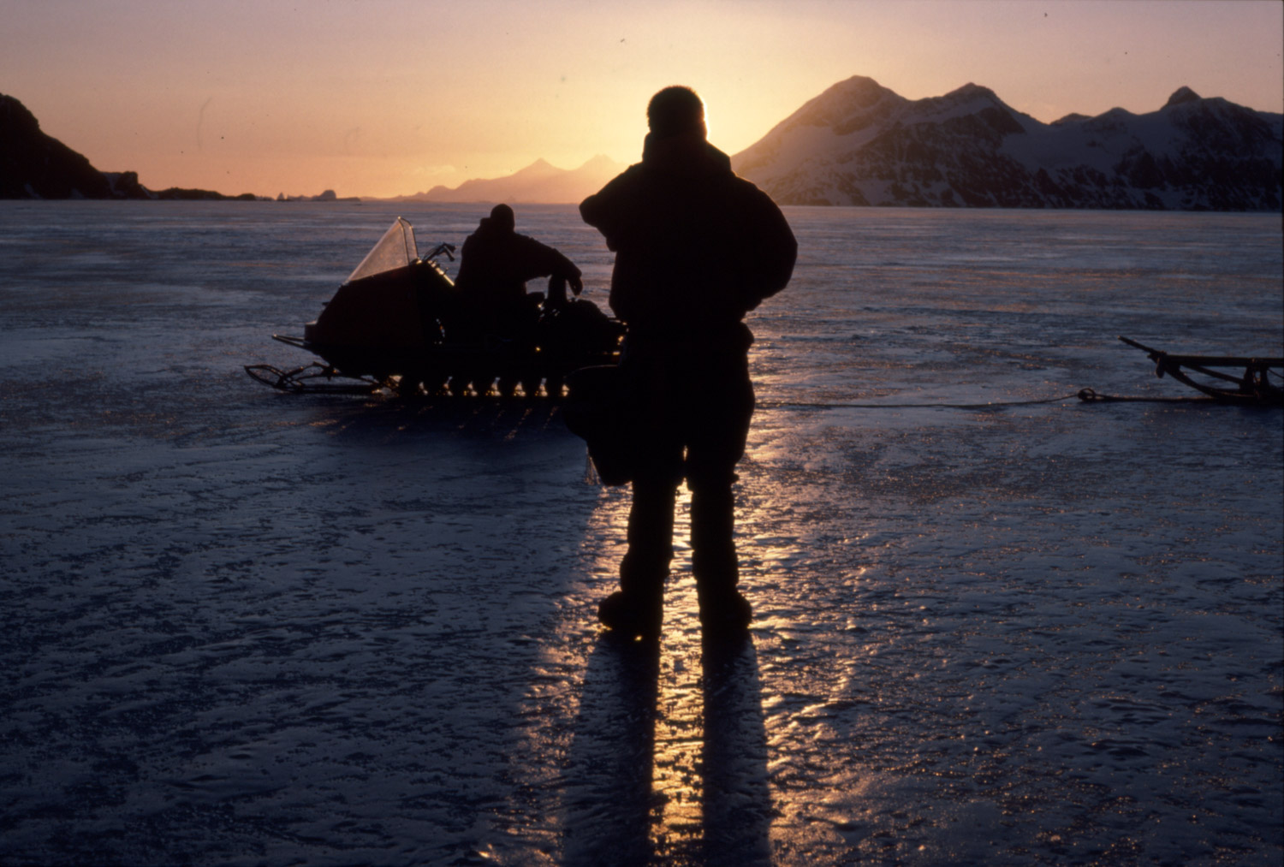
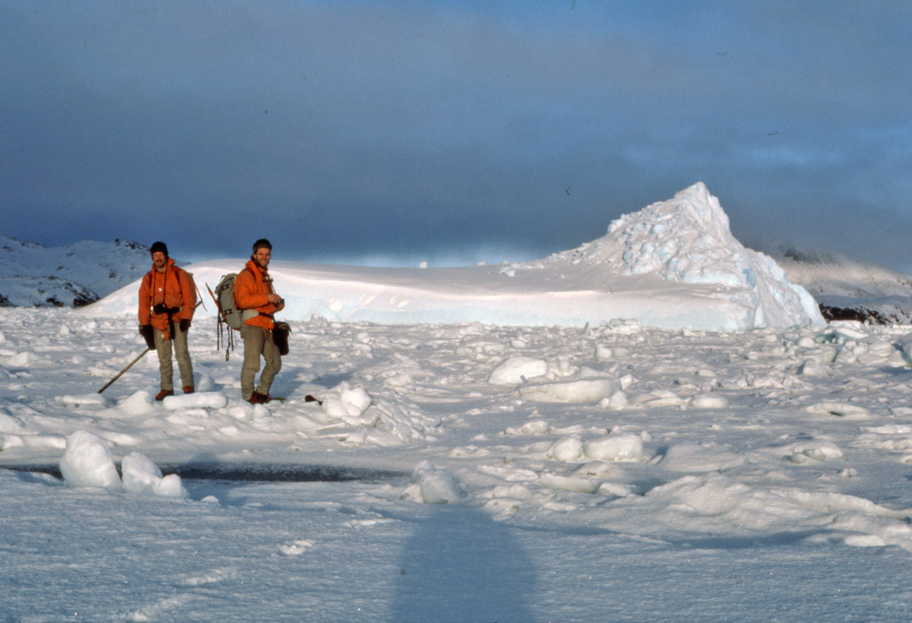
Hazards - Sea-Ice
Sea ice can be an excellent surface for travelling over if it is hard and strong.
It can also be treacherous if it isn't or if you're not sure. When many miles out to sea on apparently solid ice, it can be broken by a storm or waves resulting in countless separate ice floes which can be taken by wind and tides far from where it was. Don't spend the night camped on sea-ice, and don't travel across it in strong winds.

Slide 11
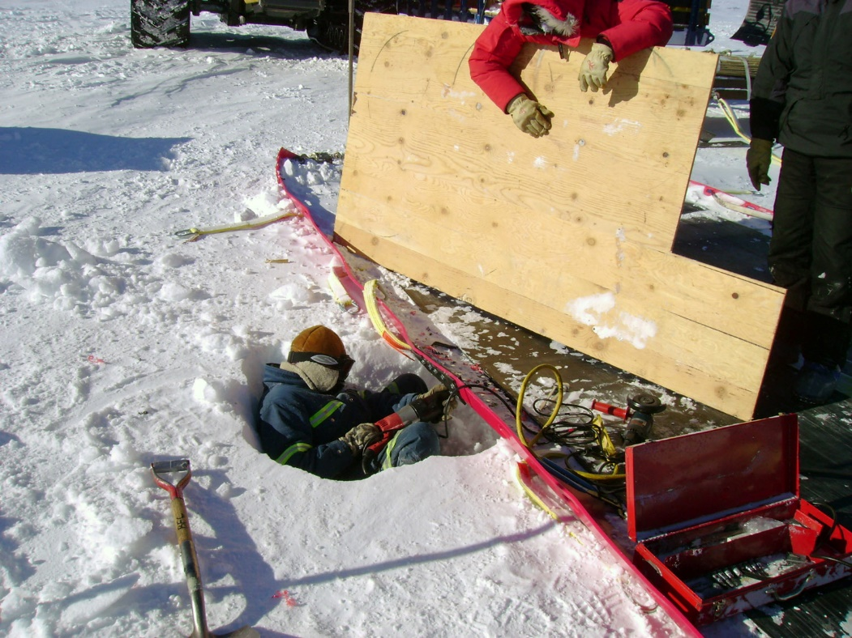
Hazards - Breakdowns
Vehicles in Antarctica tend not to be the most up to date, using yesterdays engineering. This means they are proven in use and are easier to fix when they break. If a vehicle breaks down deep in the field, it may be days until someone can fly out with a mechanic or spare parts to fix it.
Easier to fix vehicles make more sense and simpler technology is less affected by the harshness of Antarctica. This means that very expensive to deploy deep field units can work more effective days.
Repairing a sled in the deep field, a small pit has been dug to get to the right level

Slide 12
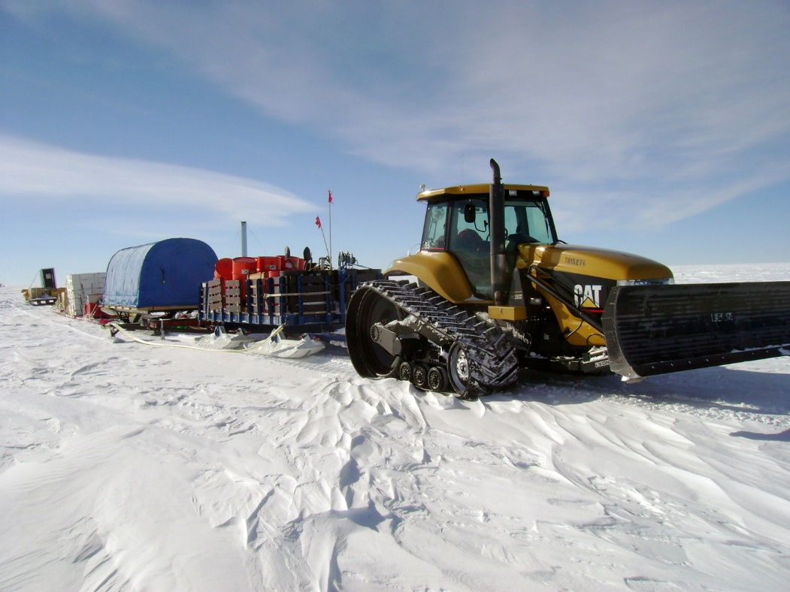
A Tractor Unit
Pulling sleds with fuel, equipment, and living accommodation as part of a multi-week, deep field expedition to measure weather conditions and deploy remote sensing apparatus.

Slide 13
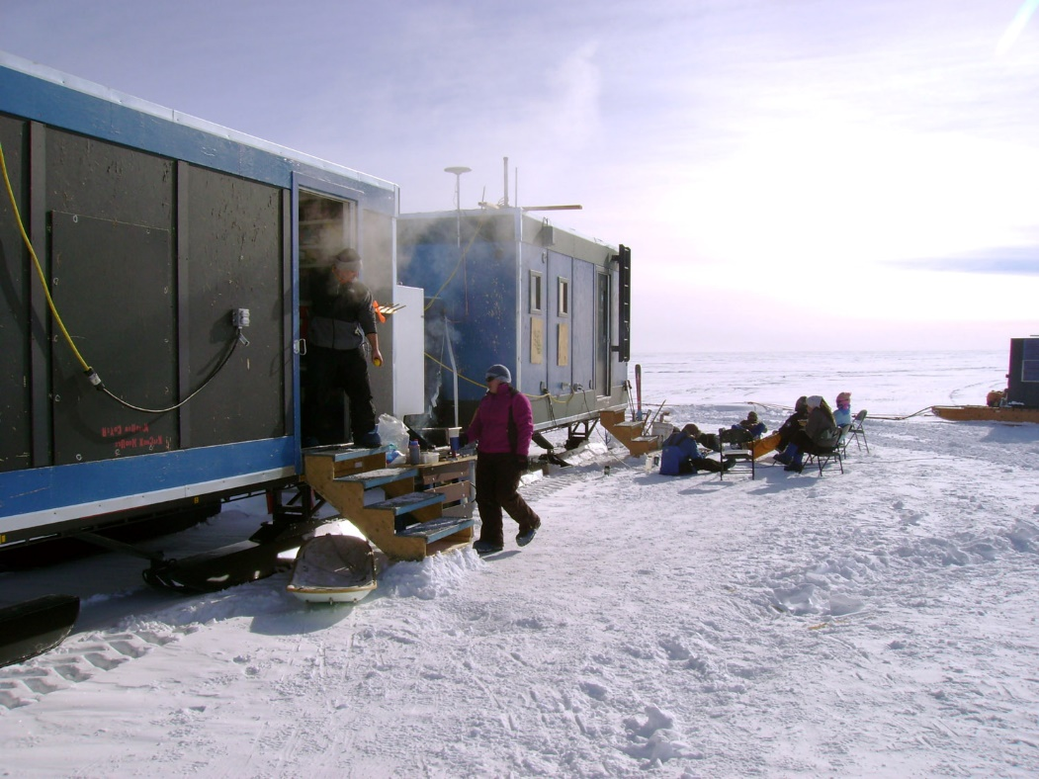
Accommodation units on skis
Part of a train of tractor pulled sleds.
This allows the group to spend long periods in the field being able to work and rest without taking a long time setting up and taking down camp each day, something that is much more time consuming in cold conditions.

Slide 14
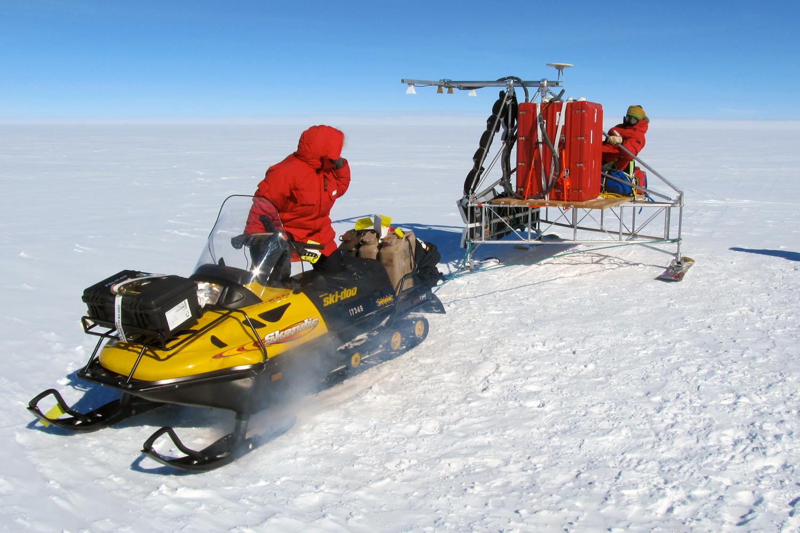
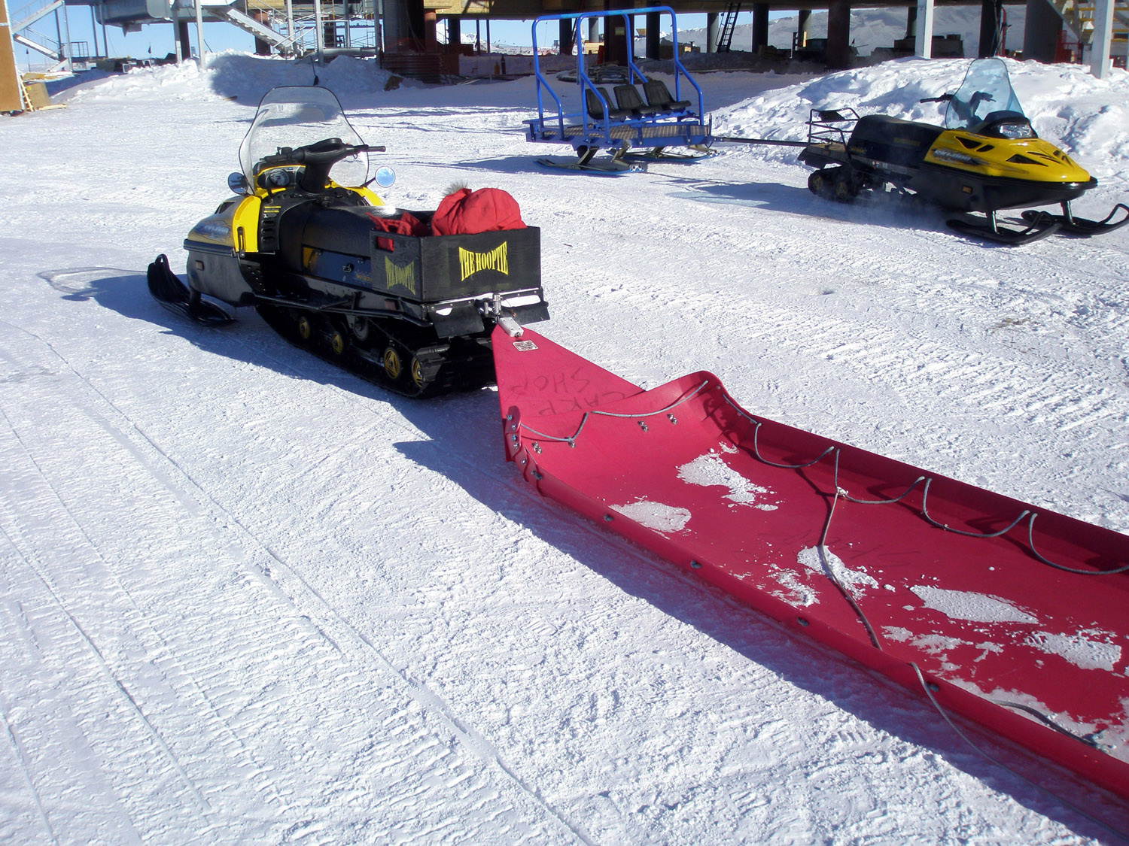
Snow mobiles
Here at the South Pole Station, a rugged plastic cargo sled foreground and a passenger sled background.
Snow mobiles may be used as run-abouts, they are used to take small teams for longer trips and can move scientific instruments on skis.
Photo: Lora Koenig & NSF

Slide 15
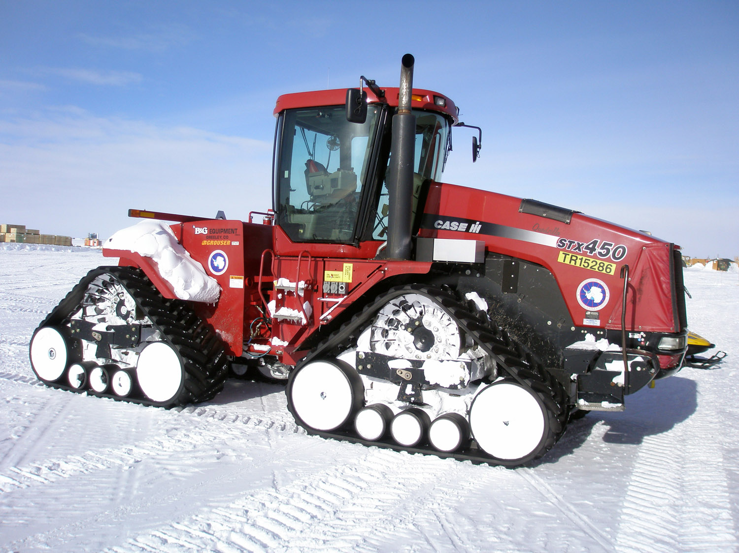
Heavy tractor unit
These are modified agricultural or construction vehicles adapted for extreme cold conditions and for driving over snow and ice.
This one will be used to pull a chain of sleds on multi-week trips away from base.

Slide 16
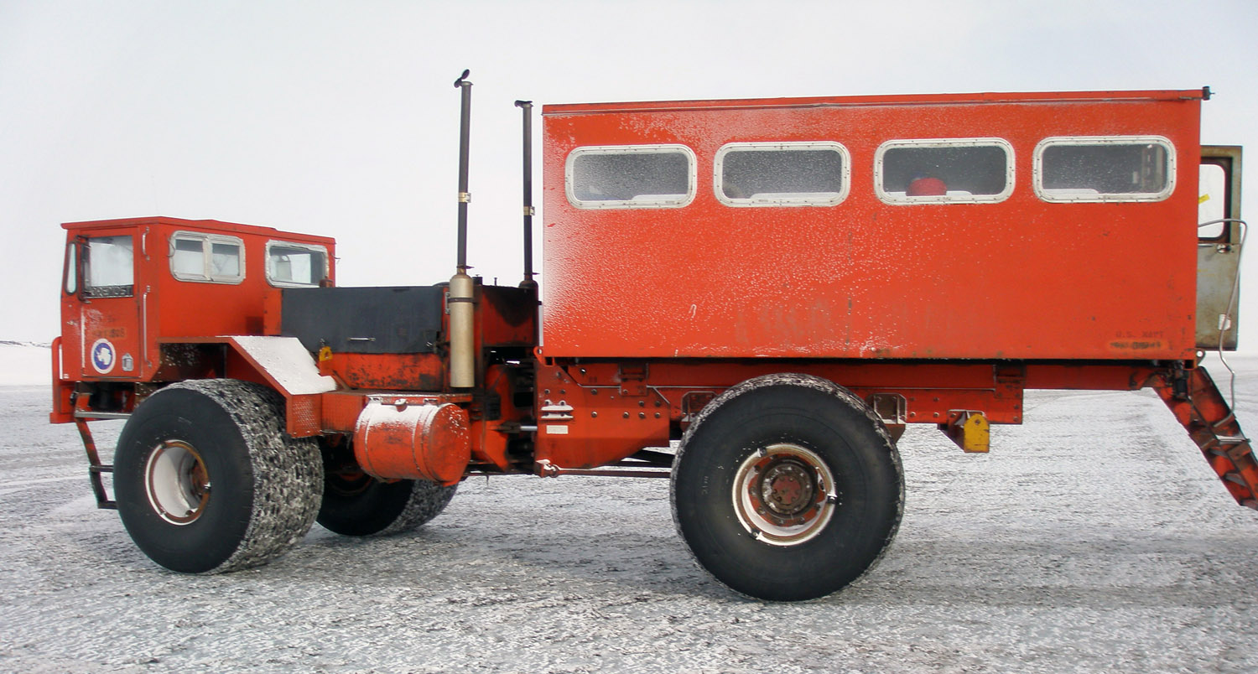
Delta
Used as an airport bus to ferry people and their belongings across the sea ice and onto the land at McMurdo station between the base and the airstrip.

Slide 17
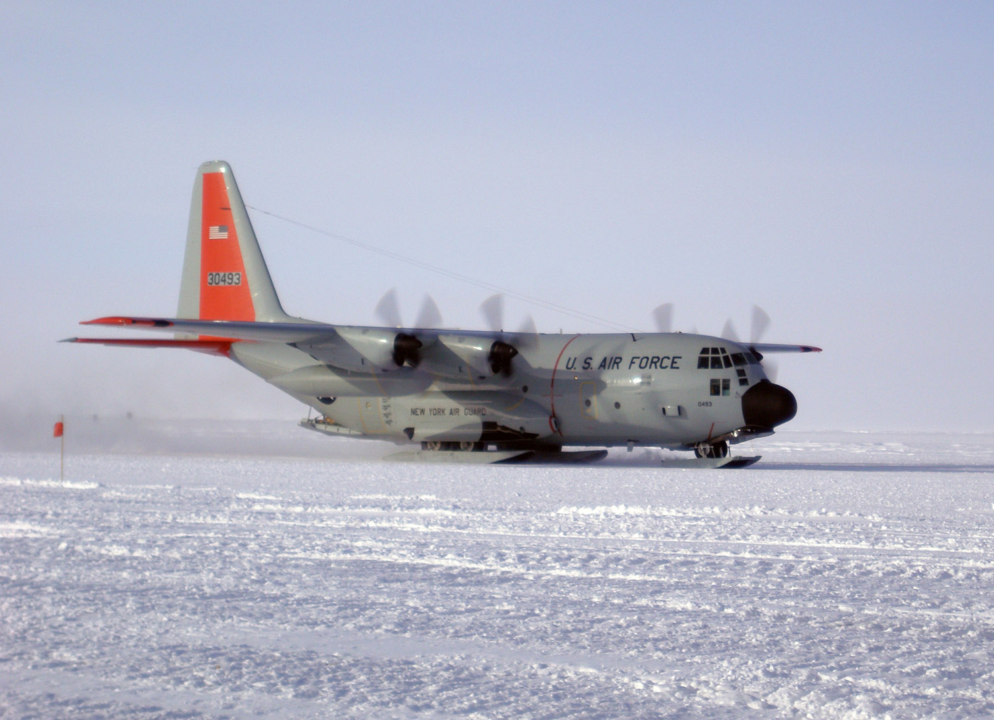
LC-130A
A ski equipped Hercules, used for flights from New Zealand to Antarctica, and as far as the South Pole for over 50 years.
They are used to transport people or as heavy cargo carriers. The South Pole Station was flown in entirely on these aircraft.

Slide 18
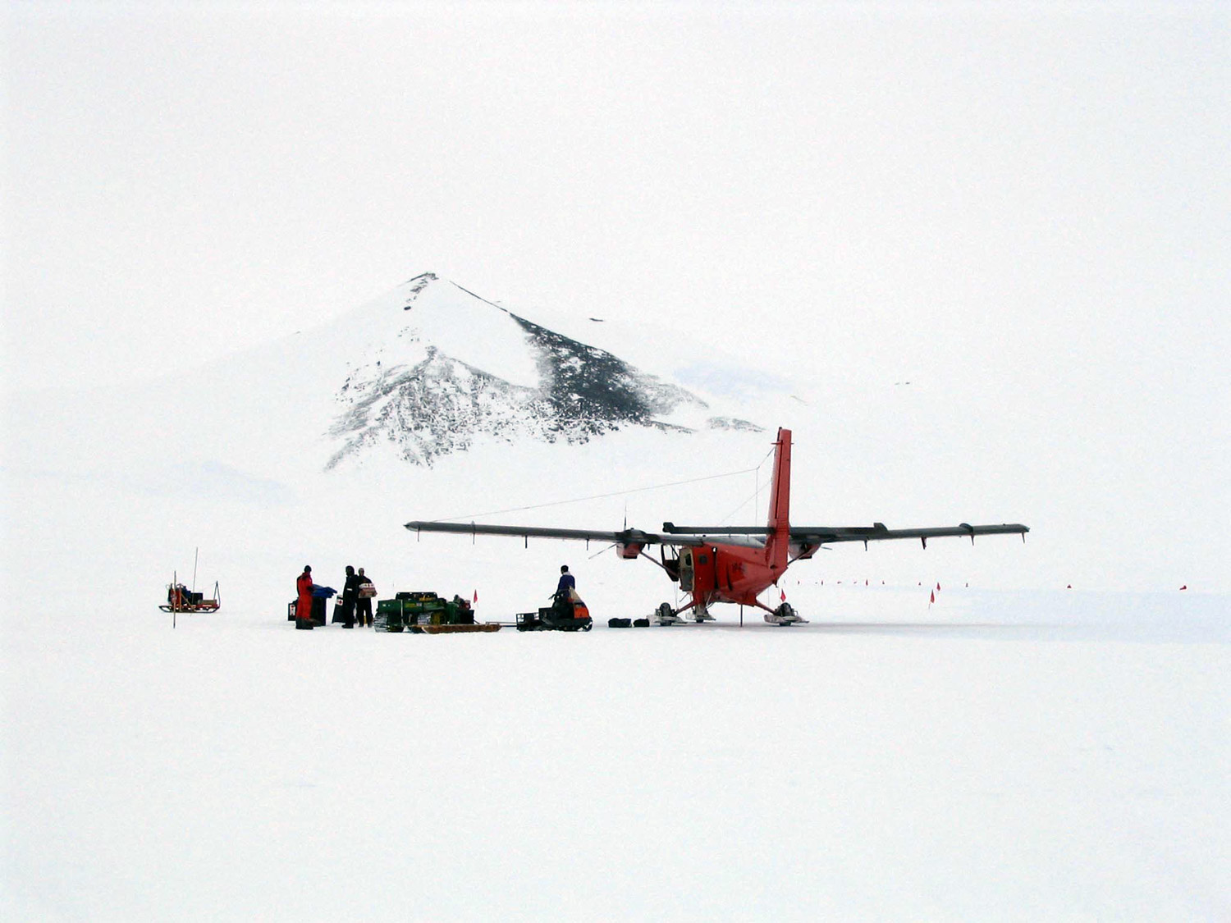
de Havilland Twin Otter
Another aircraft workhorse, used in Antarctica for over 40 years, mainly for short and medium length trips.
Especially as here, to meet with parties deep in the field to resupply with food and fuel and remove rock specimens collected, allowing them to function far from the base station for months at a time.
Photo: Tom L.C. CC 3.0 Attribution Share alike Unported licence

Slide 19
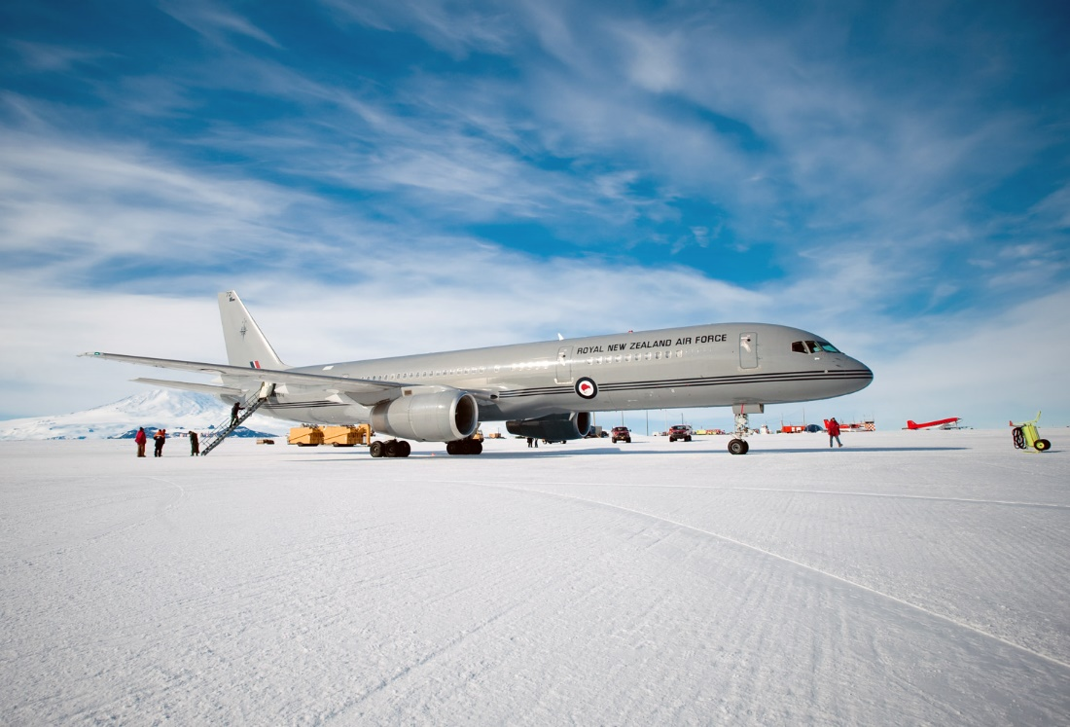
Boeing 757
In recent years, more conventional passenger jets have been used to reach Antarctica. These require better prepared ice runways with more frequent attention to the quality of the surface to enable them to land safely with wheels instead of skis.
Photo: Crown Copyright 2011 NZ Defence Force CC2 Attribution Generic licence

Slide 20
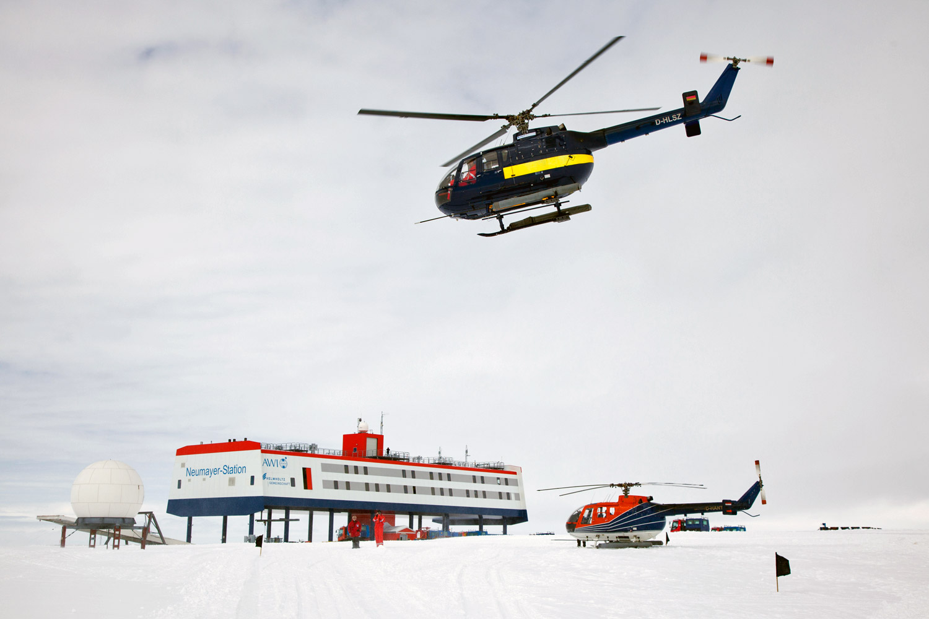
Helicopters
Useful for shorter trips over difficult terrain and extensively used by ships.
The two in this picture were both subsequently written off by making separate hard landings in white-out conditions, highlighting the limitations of helicopter use.
Photo: Thomas Steuer CC-BY-4 licence

