Slide 1
Expedition Leaders of the Heroic Age of Antarctic Exploration
Achievements and Legacies
Who was Douglas Mawson?
Copyright: This resource is provided free by CoolAntarctica.com, you’re welcome. It cannot be distributed by any other means, believe it or not people sometimes lift free resources and distribute them pretending they have been allowed to or even sell them as their own – I know! It’s shocking! If anyone asks you for payment for this or if you get it but not from CoolAntarctica.com, please email danthwhaler@gmail.com and the ghost of whaler Dan will exact retribution on the scurvy dogs.
This copyright notice must appear wherever this material is used. Any queries please email

Slide 2
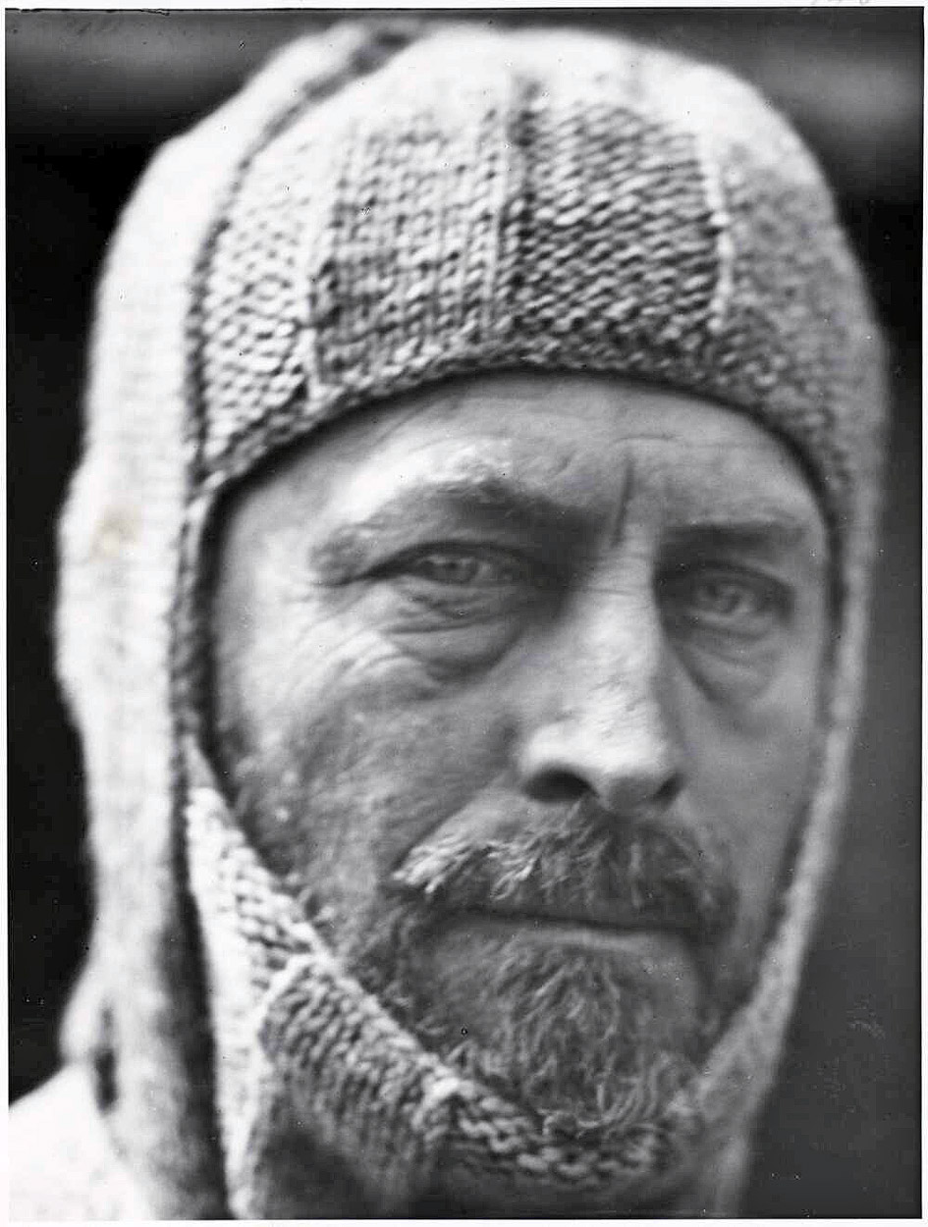
Douglas Mawson 1882 - 1958
Douglas Mawson was born in Yorkshire, England, moving to Australia at the age of 2. He is one of Australia’s best known and most respected heroes in any field.
He first went to Antarctica with Ernest Shackleton on the 1907-1909 Nimrod expedition when he was one of a party of 3 to reach the Magnetic South Pole for the first time, manhauling a sledge for 122 days over 1260 miles.

Slide 3
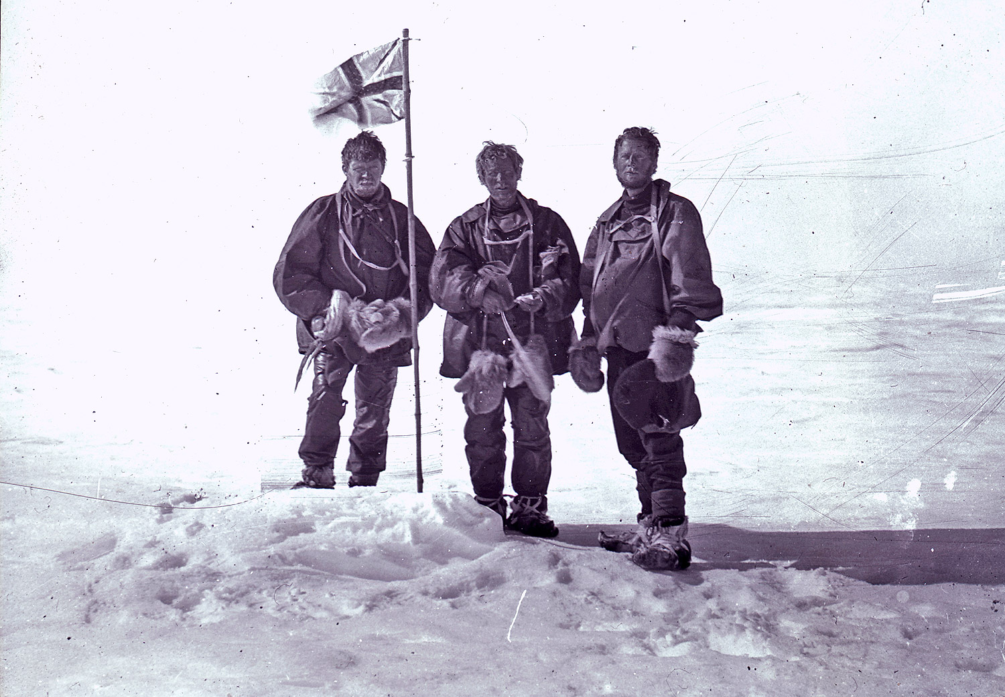
Alistair MacKay, Edgeworth David and Douglas Mawson,
January 16th 1909 (Saturday) at the South Magnetic Pole.

Slide 4
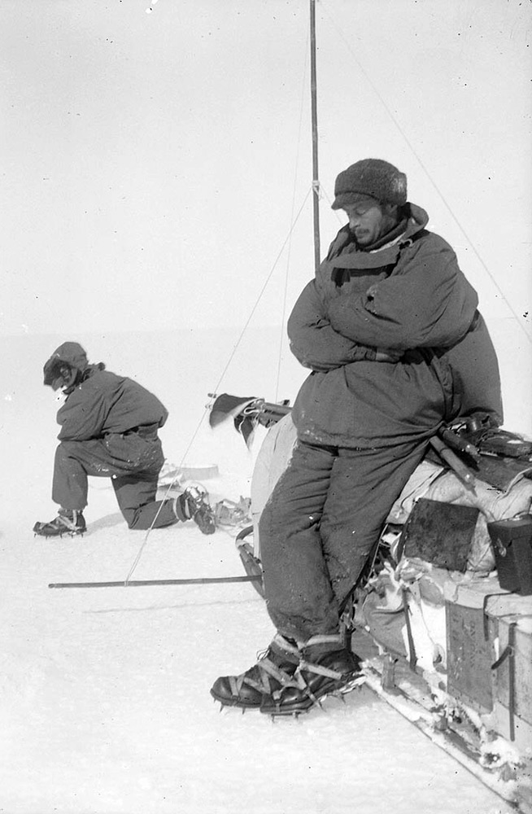
Mawson was invited by Captain Scott in 1910 to join the prestigious British Terra Nova expedition but declined and chose instead to lead his own Australian Antarctic Expedition to the region of Antarctica immediately south of Australia, almost totally unexplored at the time.
Mawson was driven by a quest for knowledge rather than by financial gain or the seeking of personal glory from geographical firsts such as reaching the South Pole. Instead, there was an extensive scientific programme and many specialist scientific staff on the expedition crew.
Mawson resting on a sledge

Slide 5
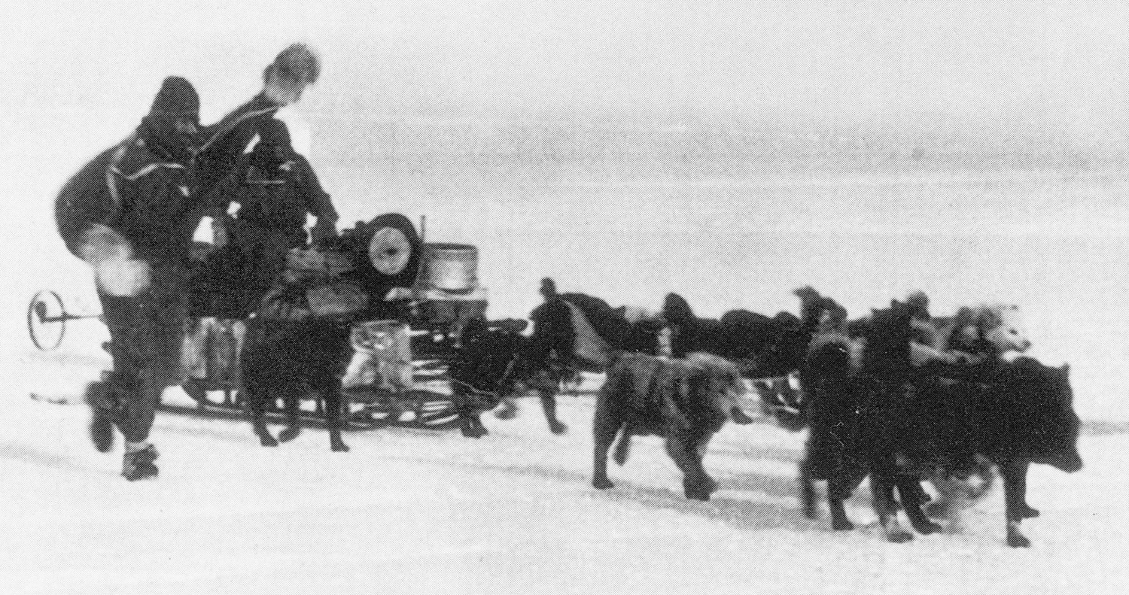
The expedition is most famous for a sledging trip undertaken by Mawson and two others, Xavier Mertz (Swiss) and Belgrave Ninnis (English).
In November 1912 they set off on a trip to survey a previously unexplored area, collect rock specimens and record scientific data along the way. A month into the journey Ninnis fell through a crevasse with six of the best dogs, a tent and many supplies, they never saw him again.
Mertz and Ninnis

Slide 6
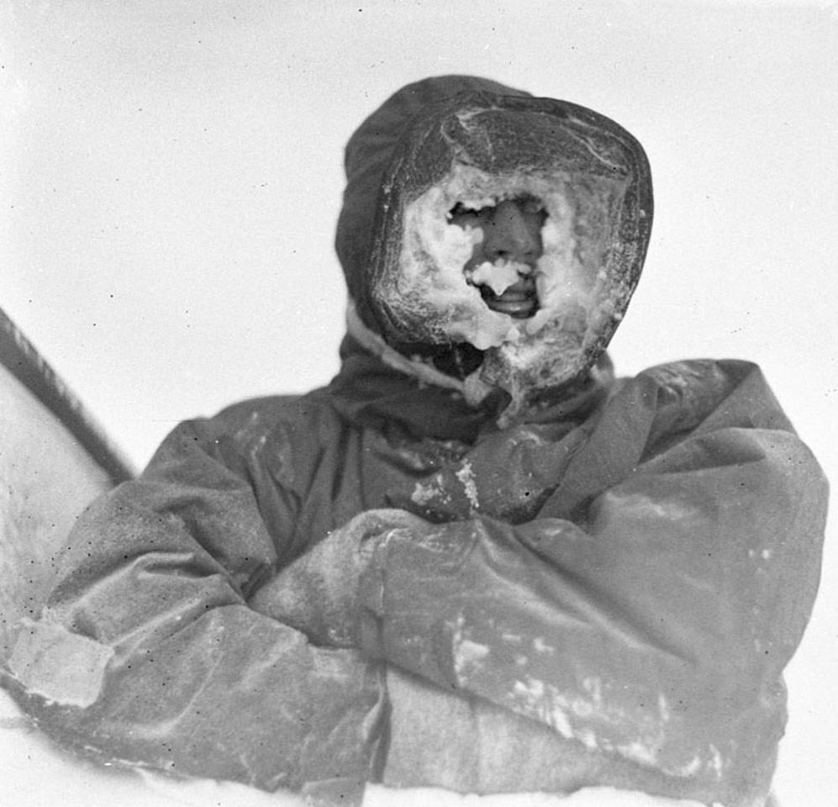
Mawson and Mertz turned back to the base, now in great difficulty due to the loss of food, shelter and vital other supplies. Just under another month later Mertz died from a combination of starvation, physical exhaustion and possibly vitamin-A poisoning from eating dogs’ livers.
Mawson was left alone having lost his two travelling companions, it took him 30 days to struggle back to the base, at one point he fell into a crevasse and was saved only by his manhaul harness attached the sledge which remained at the surface.
Dr. Mertz

Slide 7
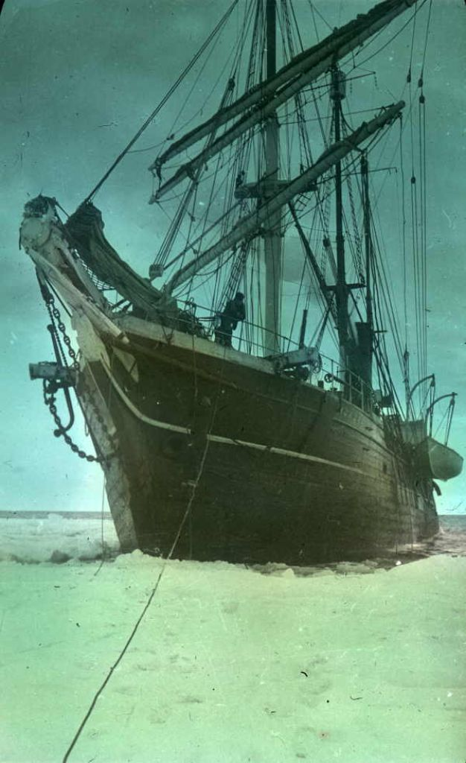
In spite of these tragedies, the Australasian Antarctic Expedition is today regarded as one of the greatest polar scientific expeditions ever because of the detailed observations in magnetism, geology, biology and meteorology that were made.
The expedition generated 22 volumes of scientific reports it took until 1947 before they were published in full (33 years later).
Mawson’s ship, the Aurora

Slide 8
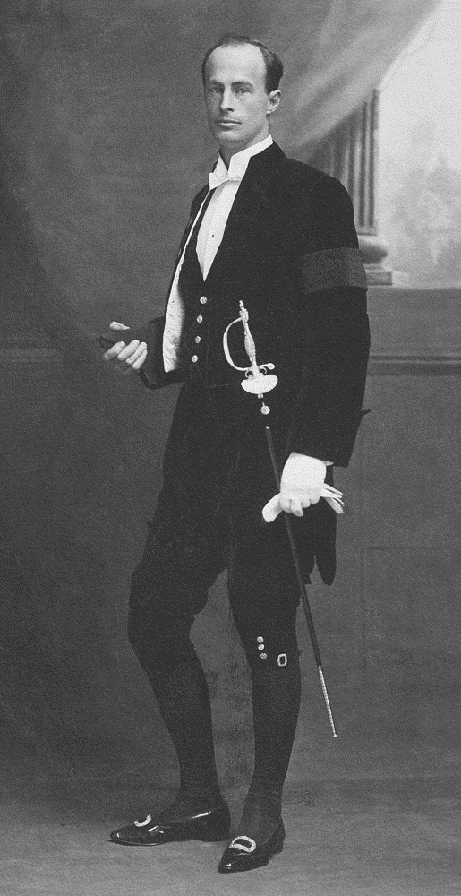
After the expedition, Mawson returned to his lecturing post at Adelaide University, Australia. He was knighted in 1914 and received a great many international honours during his life. He was made a fellow of the Royal Society in 1923, was a foundation fellow of the Australian Academy of Science, and president of the Australian and New Zealand Association for the Advancement of Science from 1935–1937. The Australian Academy of Science hosts a Mawson Lecture and awards a Mawson Medal award each year.
Douglas Mawson
in 1914

Slide 9
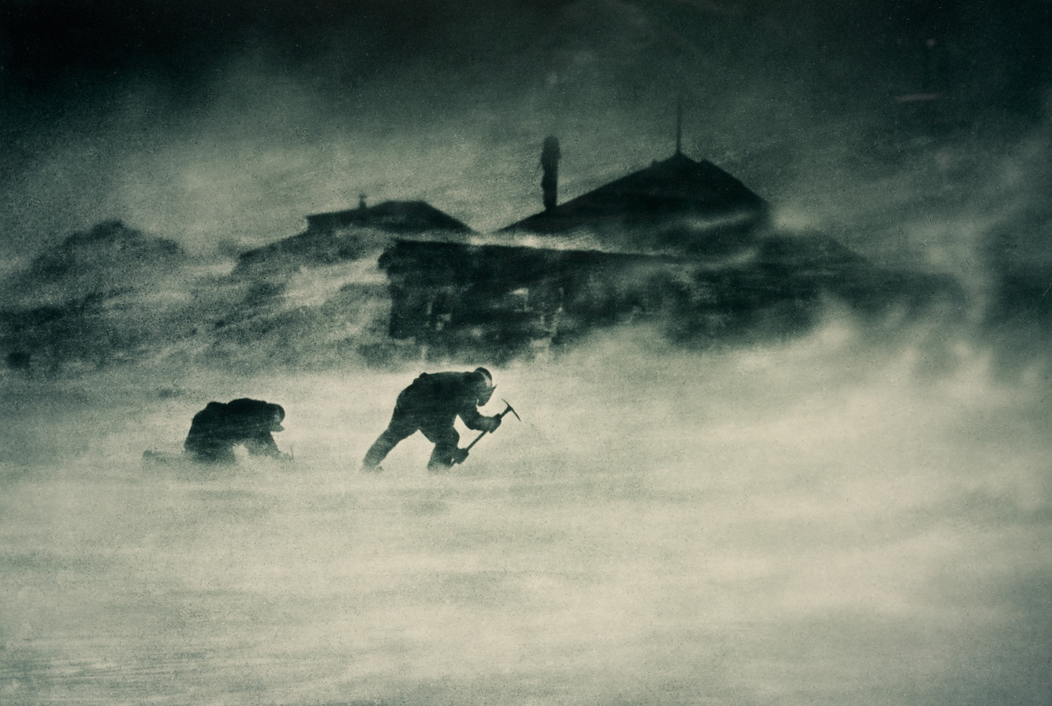
Mawson led two more voyages to Antarctica in 1929-30 and 1930-31 on board Captain Scott’s old ship, the Discovery. He died in 1958 at the age of 76.
There are many geographical features in Antarctica and Australia named after Mawson, his picture has appeared on $1 coins and the $100 note.

