Slide 1
Sir Ernest Shackleton and the Endurance Expedition
Copyright: Material on these pages is copyright Paul Ward / CoolAntarctica.com. It may be used as a presentation or printed for personal or public performance as long as it is not for direct or indirect commercial use (no pay to view, no use behind a paywall). It may be altered or modified, but not made publically available or transmitted to others in original or modified form without the written permission of Paul Ward / CoolAntarctica.com. Don’t even think about trying to sell this free resource. Most of the pictures are in the public domain.
This copyright notice must appear wherever this material is used. Any queries please email

Slide 2
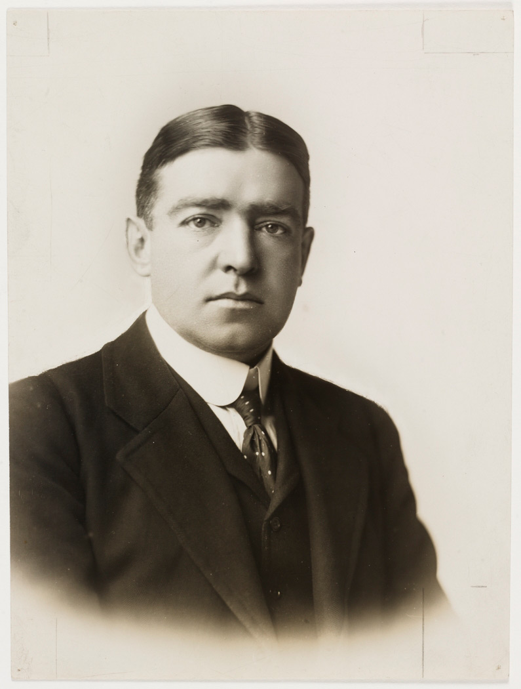
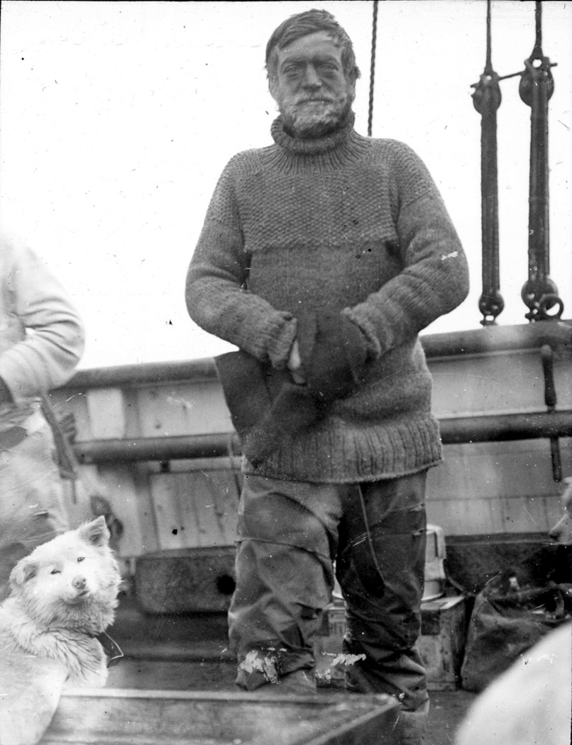
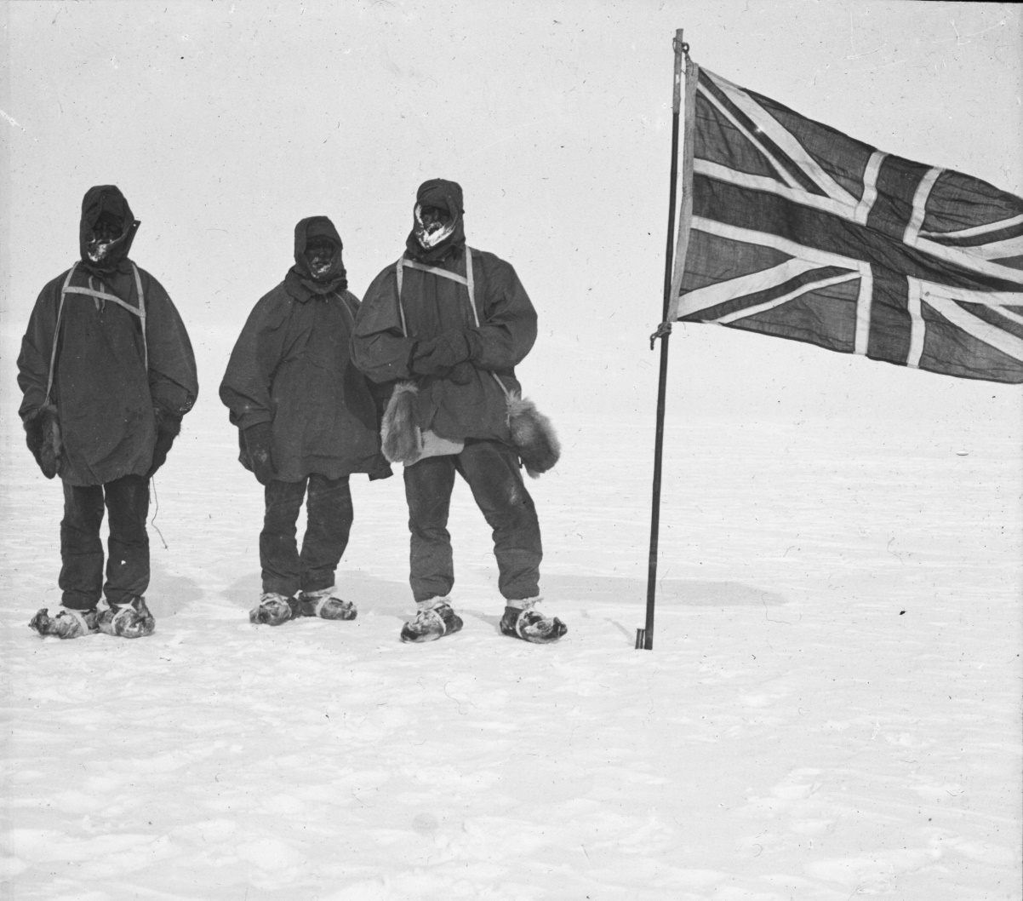
Ernest Shackleton was an Edwardian gentleman and Antarctic explorer from a hundred years ago

Slide 3
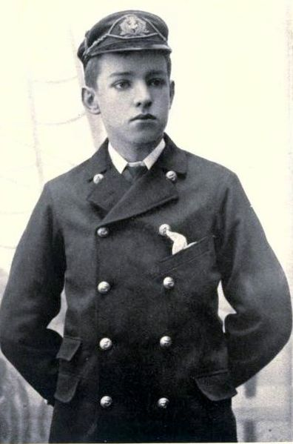
He was born in Ireland in 1874 to an English family, one of 10 children. His family moved to London in 1884. He wasn’t keen on school and went to sea at the age of 16.

Slide 4
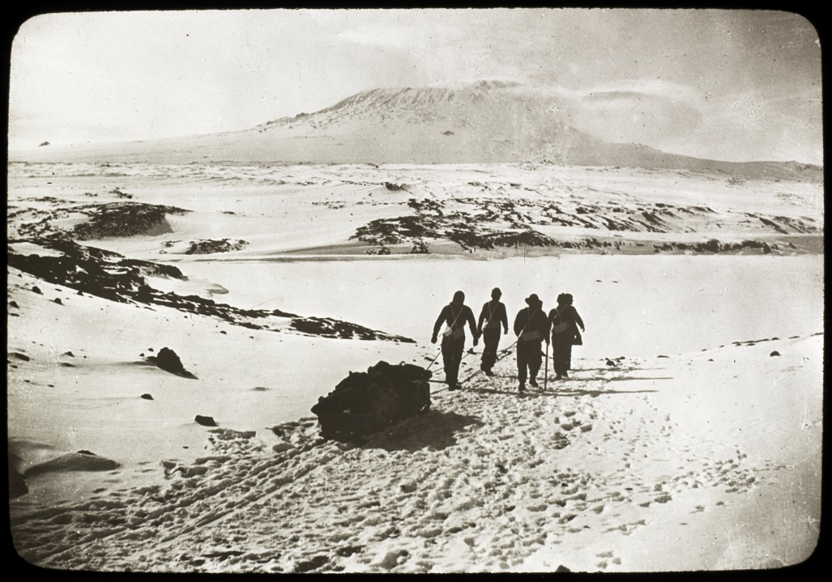
He became a certified master mariner able to command a ship. In 1901 he went to Antarctica for the first time with Captain Scott and came within 530 miles of the South Pole. In 1907 he led his own expedition and came within 97 miles of the South Pole.
Heading to Mount Erebus on the way to the South Pole

Slide 5
By 1914 he had been made Sir Ernest Shackleton. The South Pole had been reached by Roald Amundsen and Robert Scott in 1911/1912, so Shackleton organized a trans-Antarctic expedition to cross Antarctica from one side to the other via the South Pole.
An advert said to have been placed in a London newspaper by Shackleton for his Endurance expedition
Picture copyright Paul Ward

Slide 6
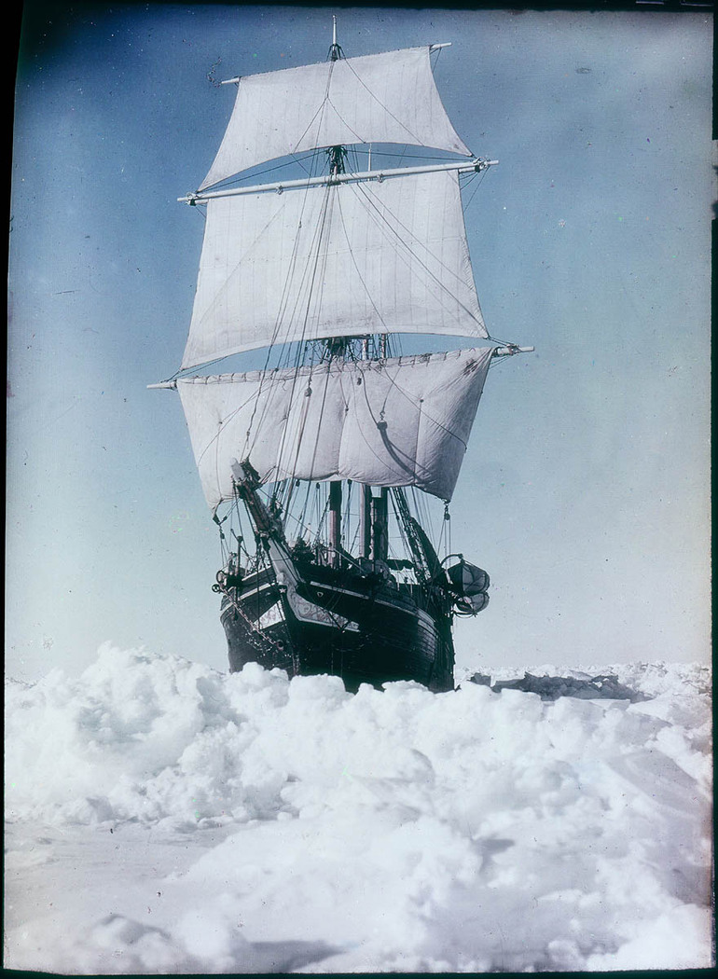
The ship to be used was called the Endurance, this is sometimes called the Endurance expedition, though was properly called: The Imperial Trans-Antarctic Expedition The Endurance set off from England just as the 1st World War was about to happen. Shackleton volunteered his ship and crew for the war effort but was told in a telegram to “Proceed”. It sailed in August 1914. 28 men including Shackleton were to reach the Antarctic.

Slide 7
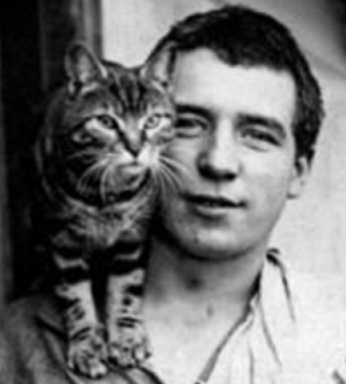
The journey started as expected, except a stowaway was found three days out of port after leaving South America for Antarctica. It was too late for Shackleton to turn back and so he offered the stowaway, 19 year old Perce Blackborow, a position of steward with the condition "If anyone has to be eaten, then you will be the first!". Blackborow accepted.
Stowaway Perce Blackborow with Mrs. Chippy, the ships cat

Slide 8
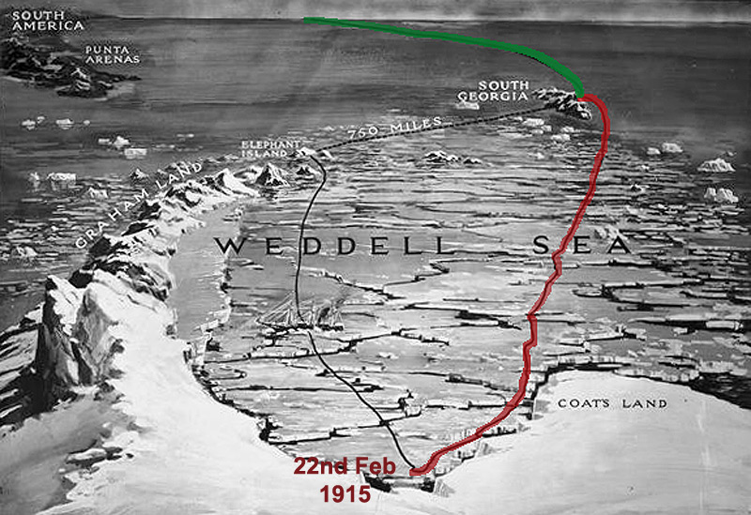
Some whalers he met at South Georgia on the way to Antarctica told Shackleton that it was a particularly bad year for sea-ice in the Weddell Sea. The ship made progress though it was difficult. On the 22nd of Feb 1915, the ship became frozen solid into sea-ice just one days sail from where the ship was headed.
The route of the Endurance via South Georgia to where it became beset in the pack-ice

Slide 9
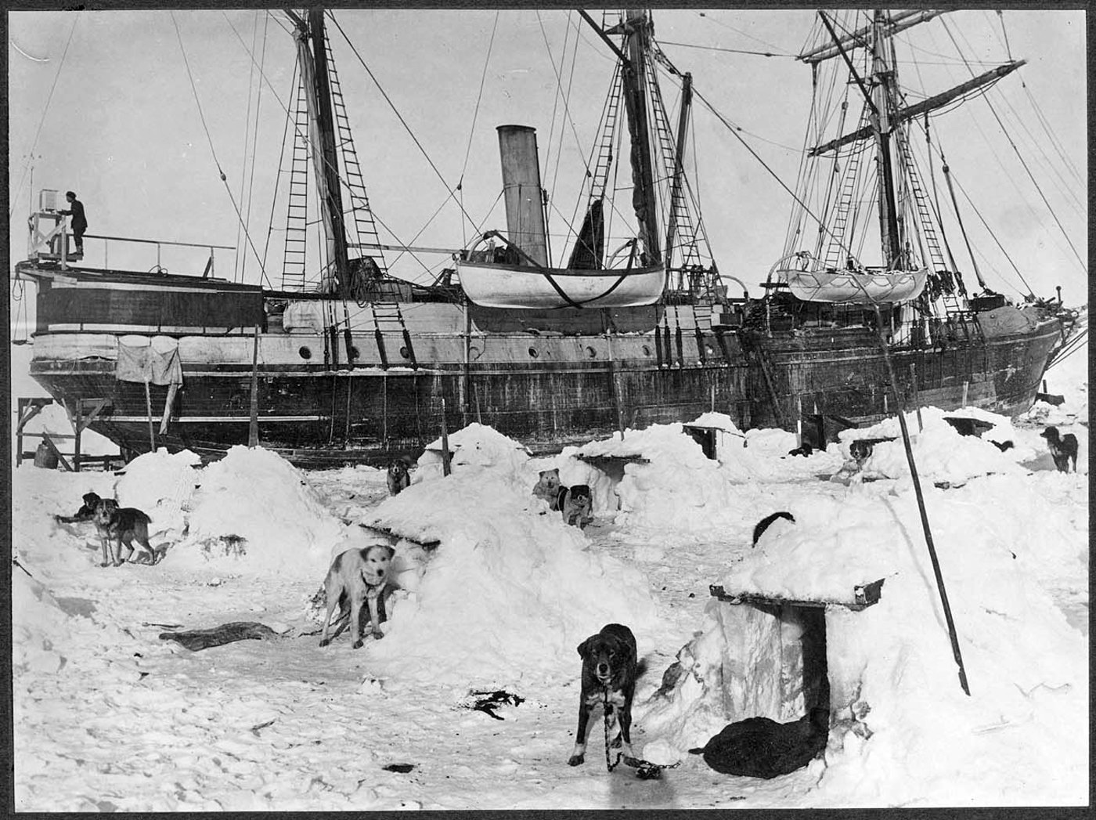
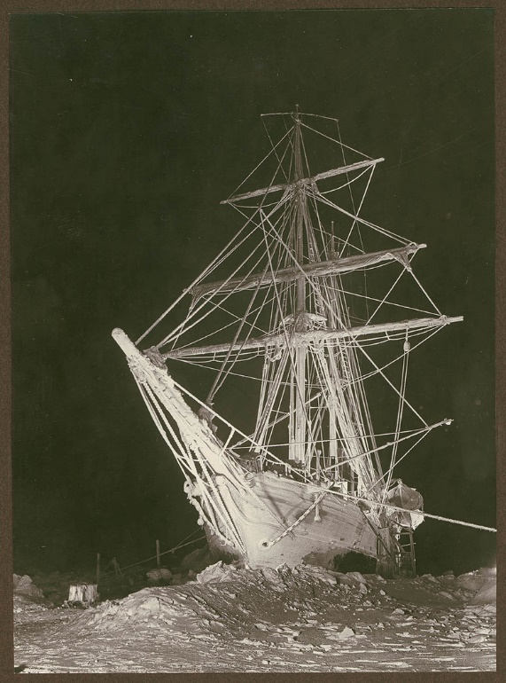
The ship drifted with the sea-ice north-wards, away from where they wanted to go. The crew lived on the ship through the winter, it was bitterly cold, there were 24 hours darkness around midwinter, the 21st of June. The sled dogs were put onto the sea-ice where they lived in “dogloos”, small igloos made of compacted snow.

Slide 10
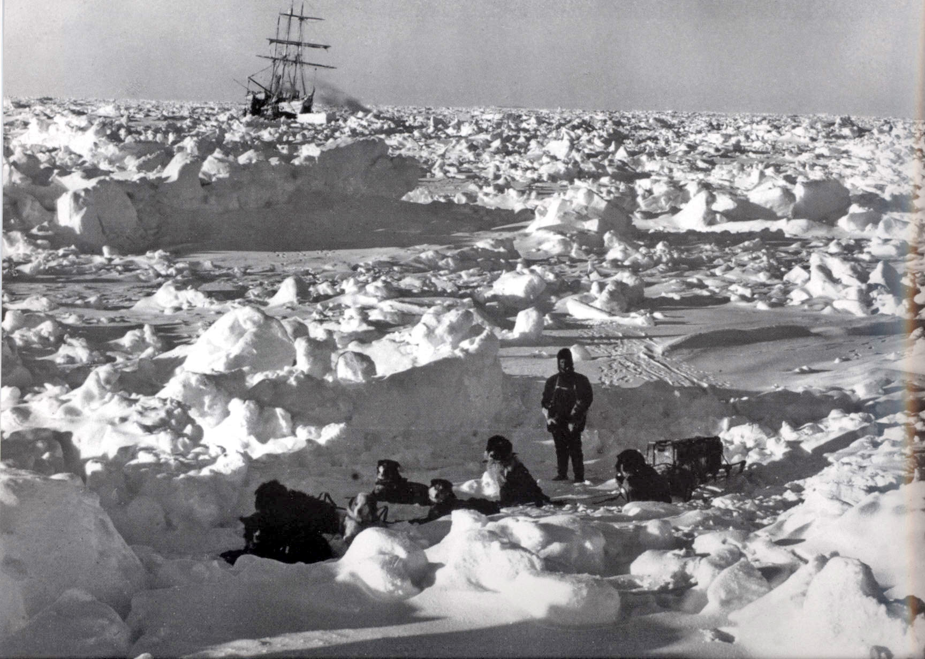
The dogs had been brought from England on the Endurance, some pups were born on the journey south, they would join the sled teams when they were big and strong enough. Trips by dog sled were popular in the quiet winter months when there was little else to do, as well as being a requirement to exercise the dogs and allow the men to practise their dog sled driving skills.

Slide 11
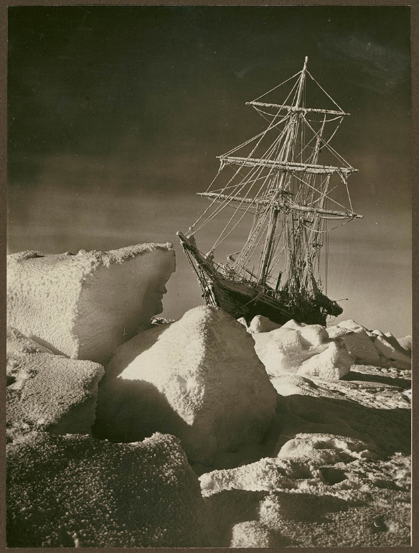
All through the winter, the crew were looking forwards to being released in the spring to carry on their expedition. In September 1915 however, the surrounding pack ice started to push on the ship, it creaked and groaned, floors buckled, doors no longer closed. Then the pressure was relaxed and the ship lived again, but was left tilted over at 15 degrees.

Slide 12
In late October, the ice pressed again, this time the ship sprang a leak. The pressure continued, Shackleton ordered all stores and equipment to be taken off the ship which was now beyond hope. This first place off the ship became known as “Dump Camp” because of the amount of gear that was thrown away there. “Ocean Camp” was established a mile and half from the Endurance on more solid older ice. On the 21st of November 1915, the broken and splintered ship sank below the ice into the Weddell Sea.

Slide 13
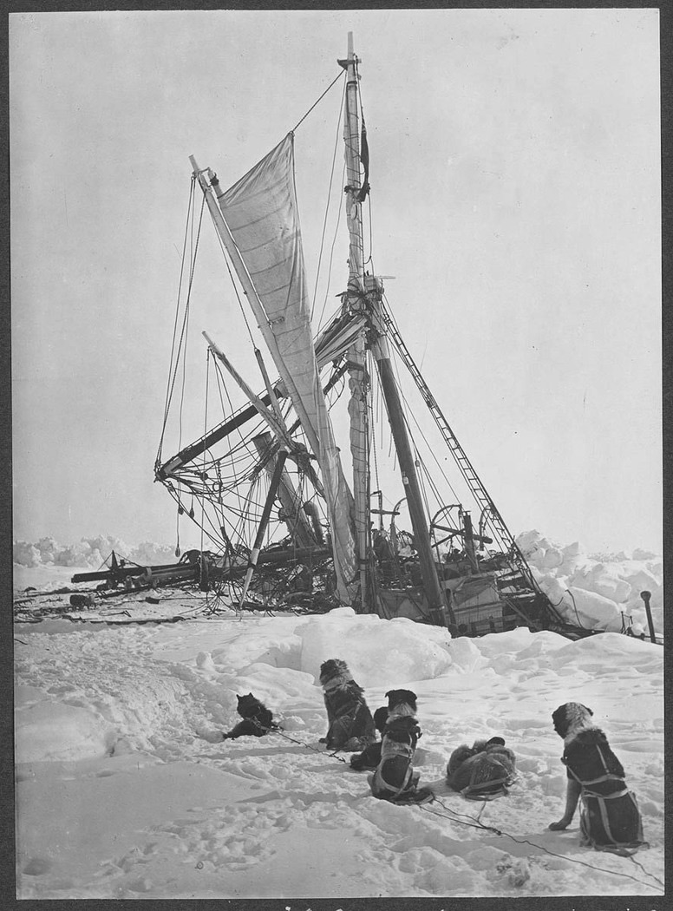
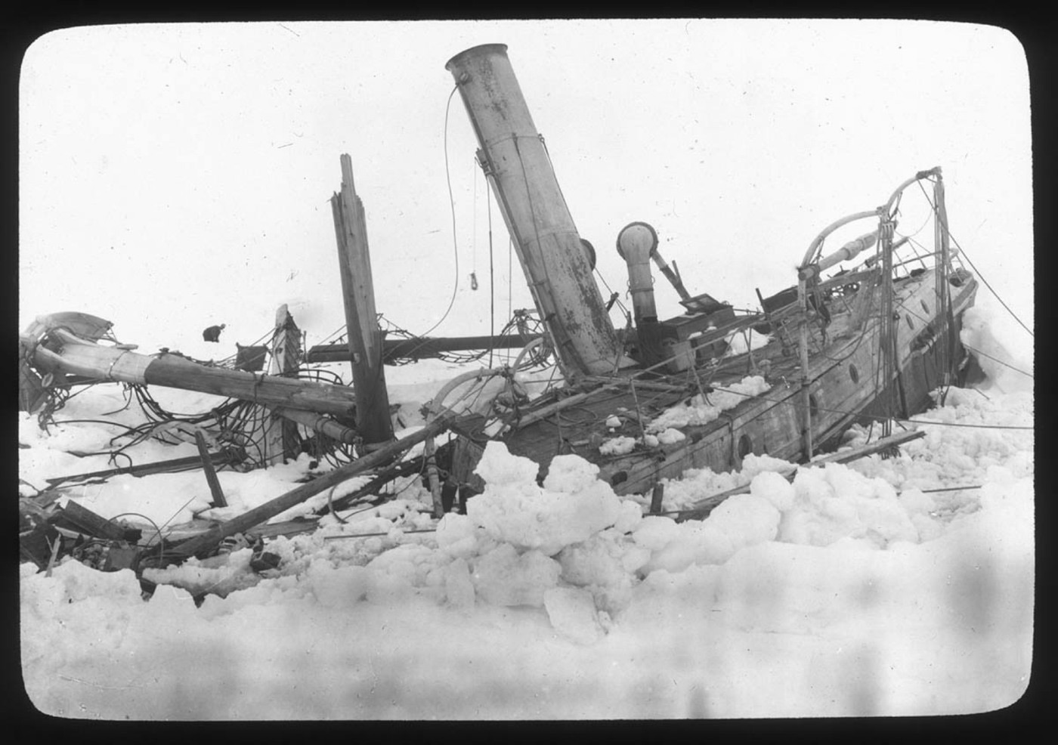
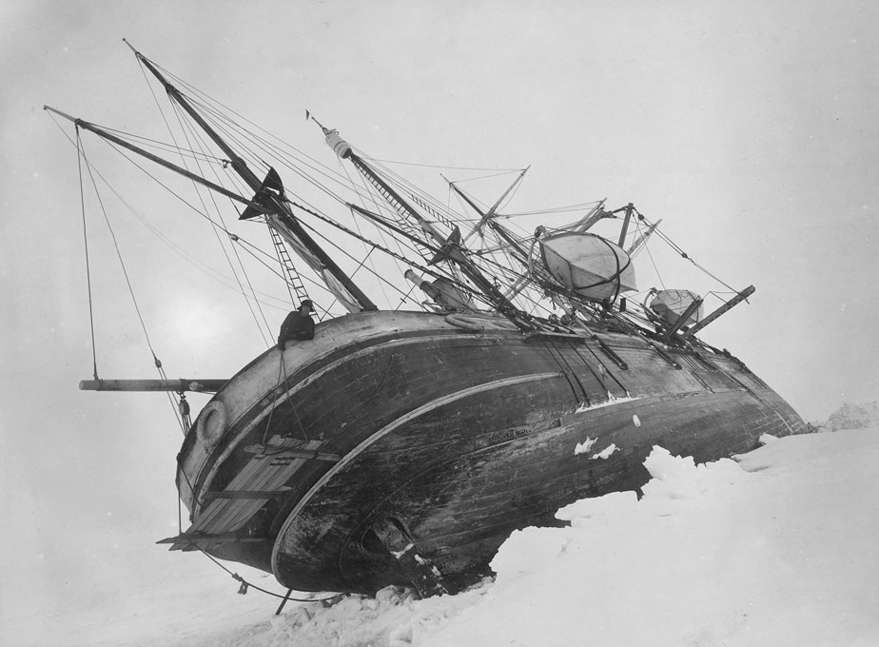

Slide 14
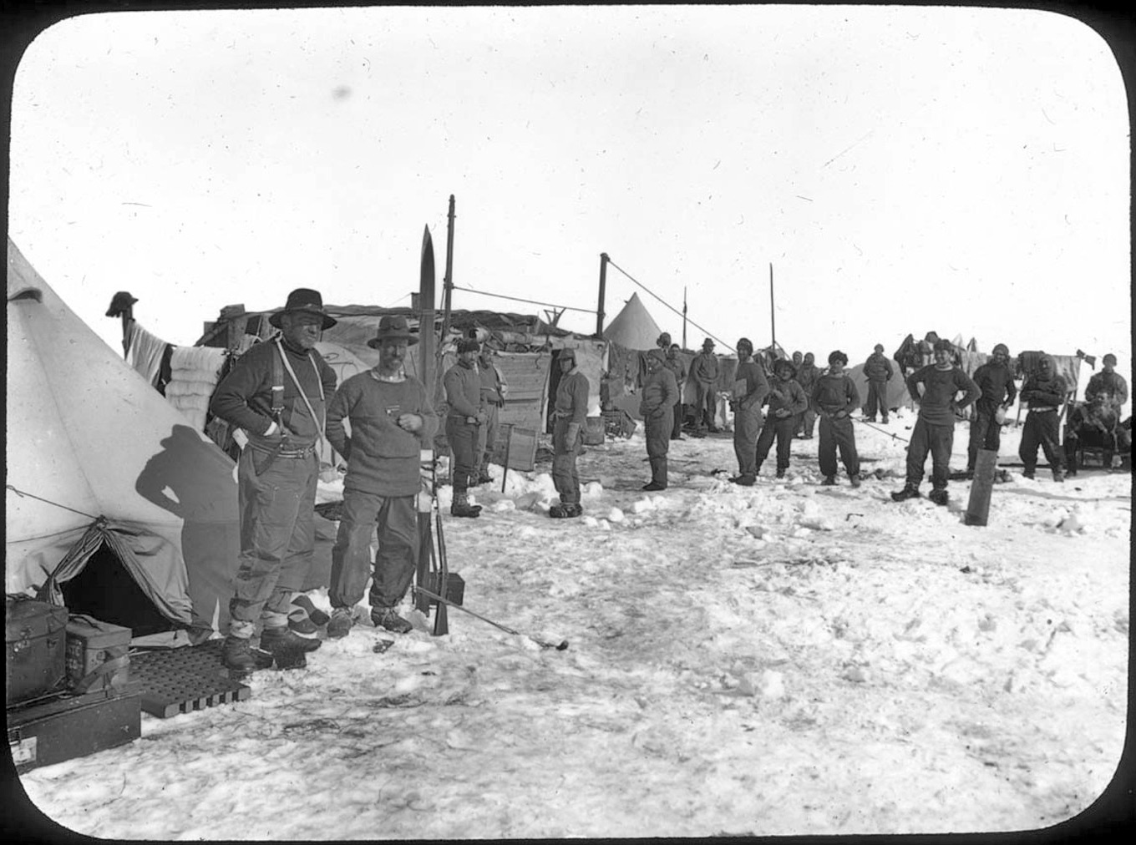
The crew now were living at “Ocean Camp”. There was no radio, no-one in the outside world knew what had happened, no rescue was going to come. They were on their own.
Ocean Camp on the sea-ice, Ernest Shackleton at left

Slide 15
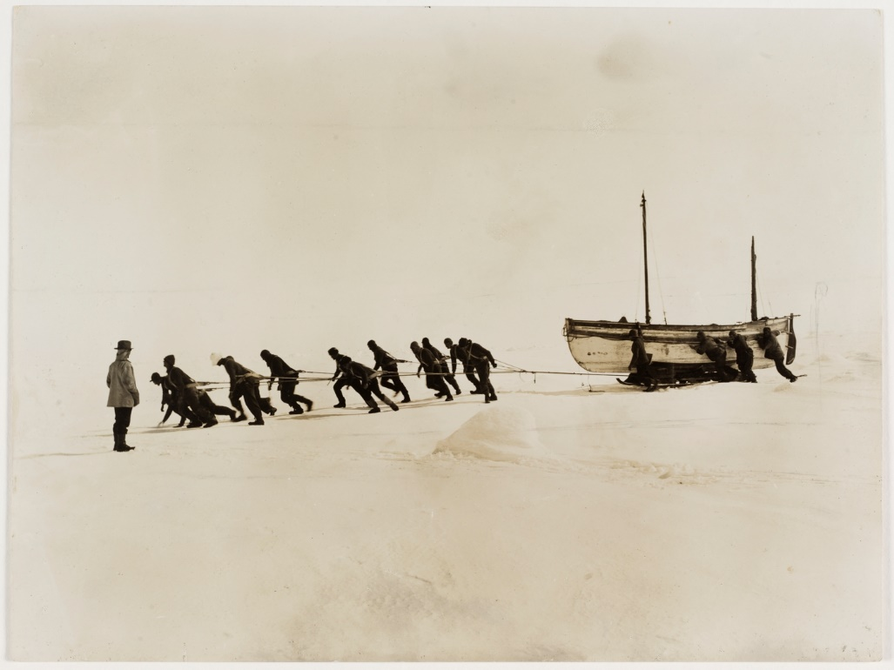
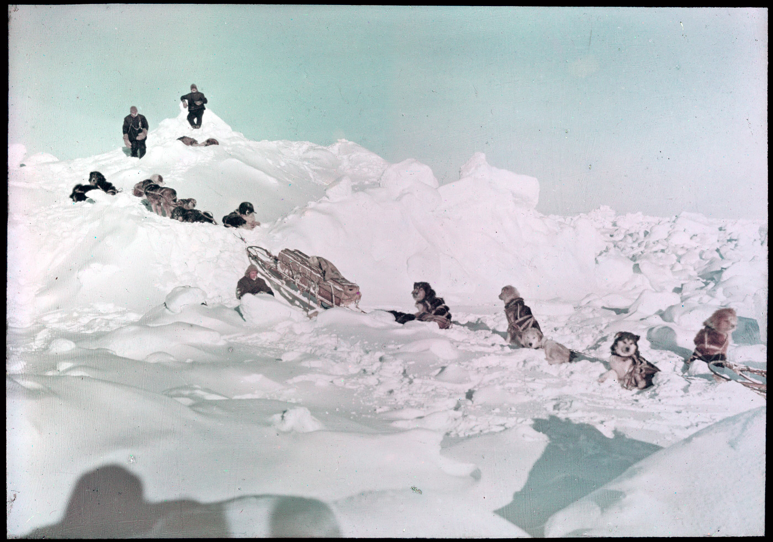
The ice was still drifting north, so they stayed at Ocean Camp for a month. On the 23rd of December Shackleton decided to start to move Westwards towards Paulet Island where he knew there was a substantial food depot, the camp was abandoned and the crew and dogs started to drag sleds and three lifeboats from the Endurance across the sea-ice. A reconnaissance by dog sled had shown the ice to be flat and suitable for travelling as far as the eye could see.

Slide 16
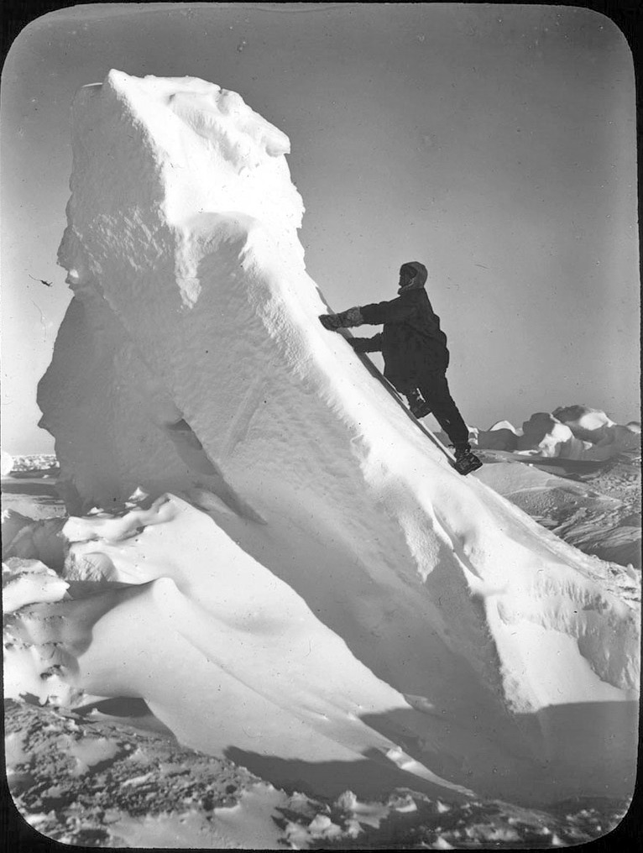
16 - After only a week un-negotiable broken and ridged ice to 5m high was encountered, a new camp is established "Patience Camp", they were to live there on the floe for nearly three and a half months. On the 9th of April 1916 the ice around had broken and the floe was surrounded by water. It was time to take to the boats and head towards the South Shetland Islands.

Slide 17
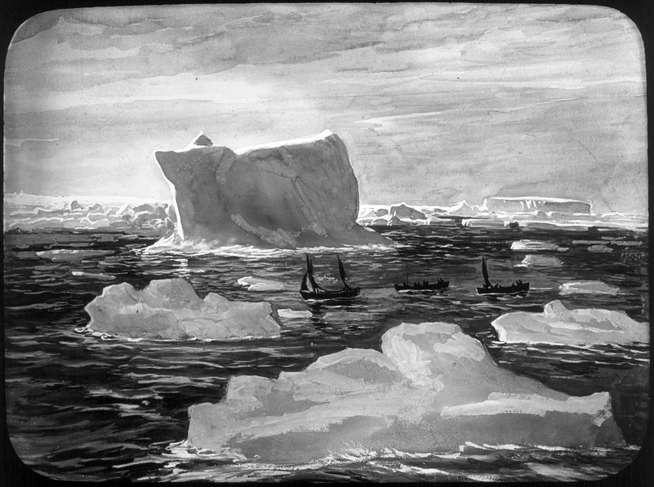
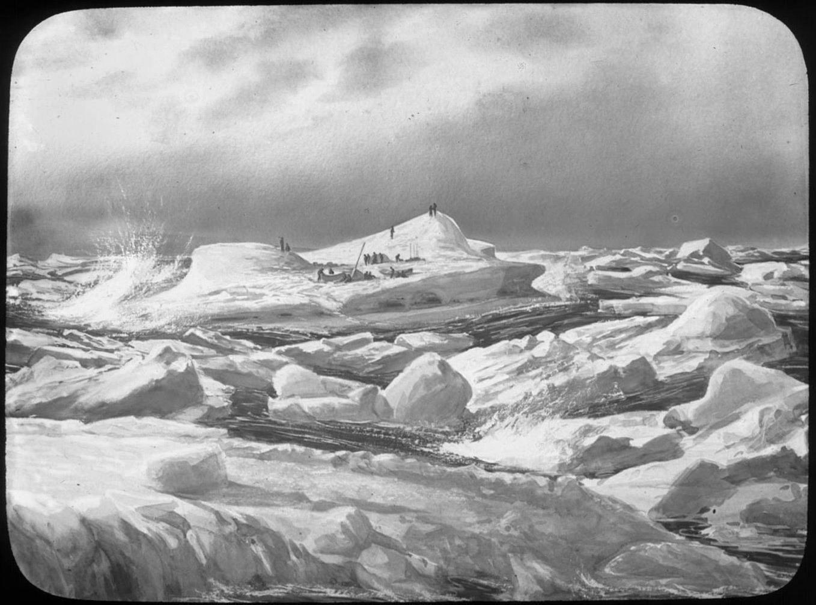
For five days, the men rowed and sailed the boats across the sea dotted with ice-bergs and pack-ice. For some of them this was the hardest part of the journey, wet and cold all the time, virtually no food or drinking water, little sleep and many cases of frost bite. At times they had to bail the boats out to prevent the stormy sea from sinking them and row for their lives.

Slide 18
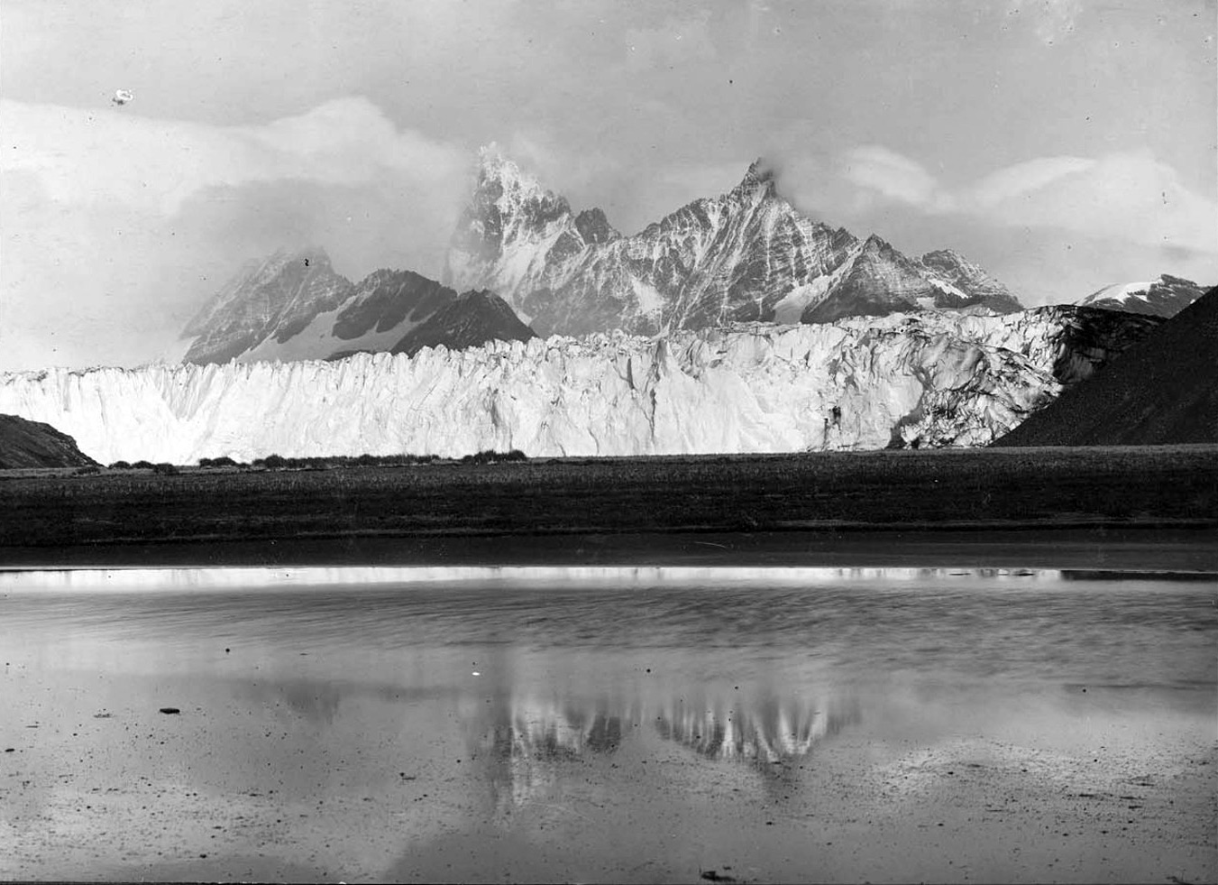
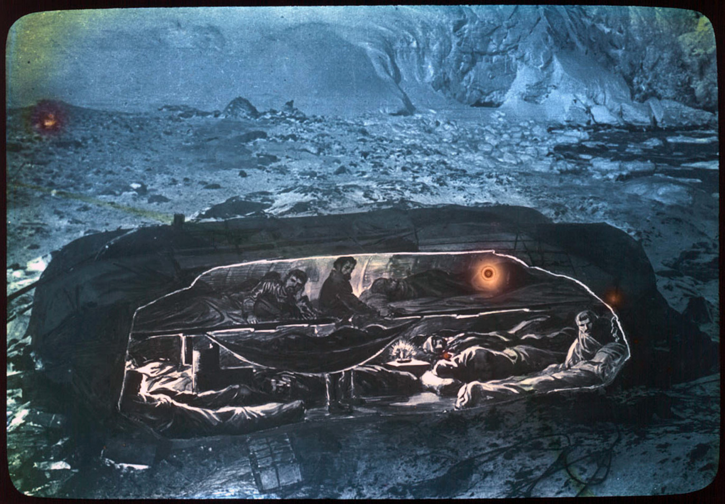
Eventually they arrived on Elephant Island, ecstatic to be on land again after 497 days. They spent a whole day drinking water from melted snow and eating fresh seal meat until they all finally had enough, the cooks worked hard! A shelter was made from two lifeboats and a low wall of stones and any other materials they had with them. They called it the “snuggery”.
Elephant Island

Slide 19
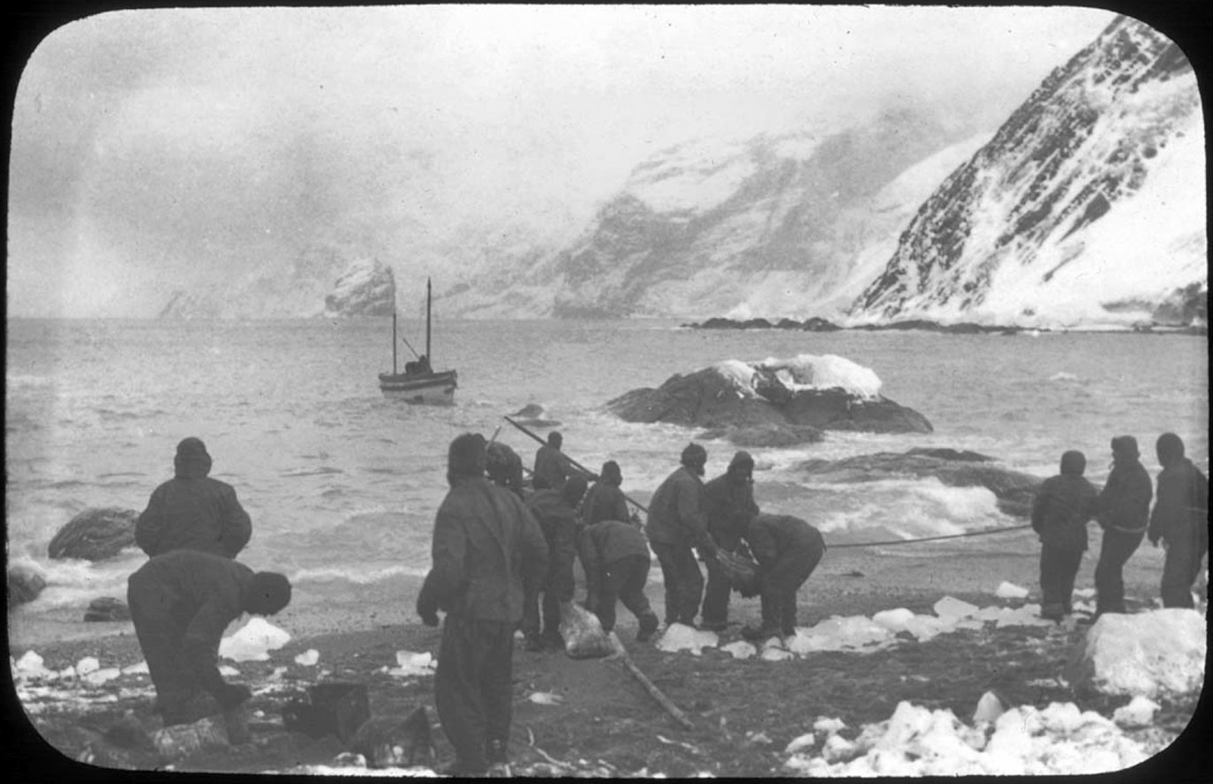
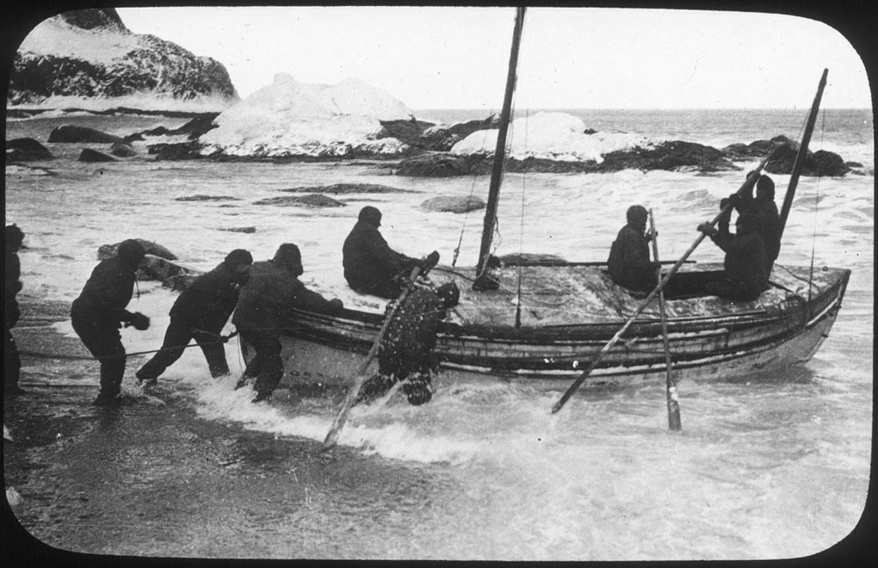
Elephant island was a respite, but the world wasn’t going to come there. The outside world didn’t even know there was any problem with the expedition. Shackleton decided to go back to South Georgia for rescue, it was 800 miles away, one of the stormiest times of the year and he only had an open boat that wasn’t in the best condition. The 22 foot lifeboat James Caird set off on the 24th of April, with a crew of 6, the next day the pack-ice closed in again.
Launching the James Caird

Slide 20
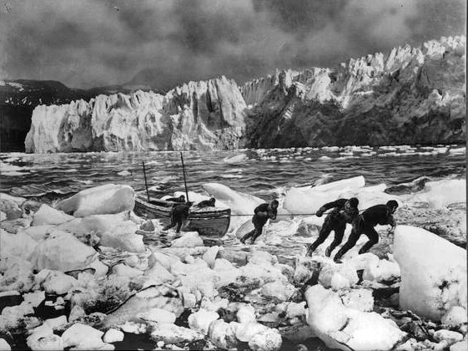
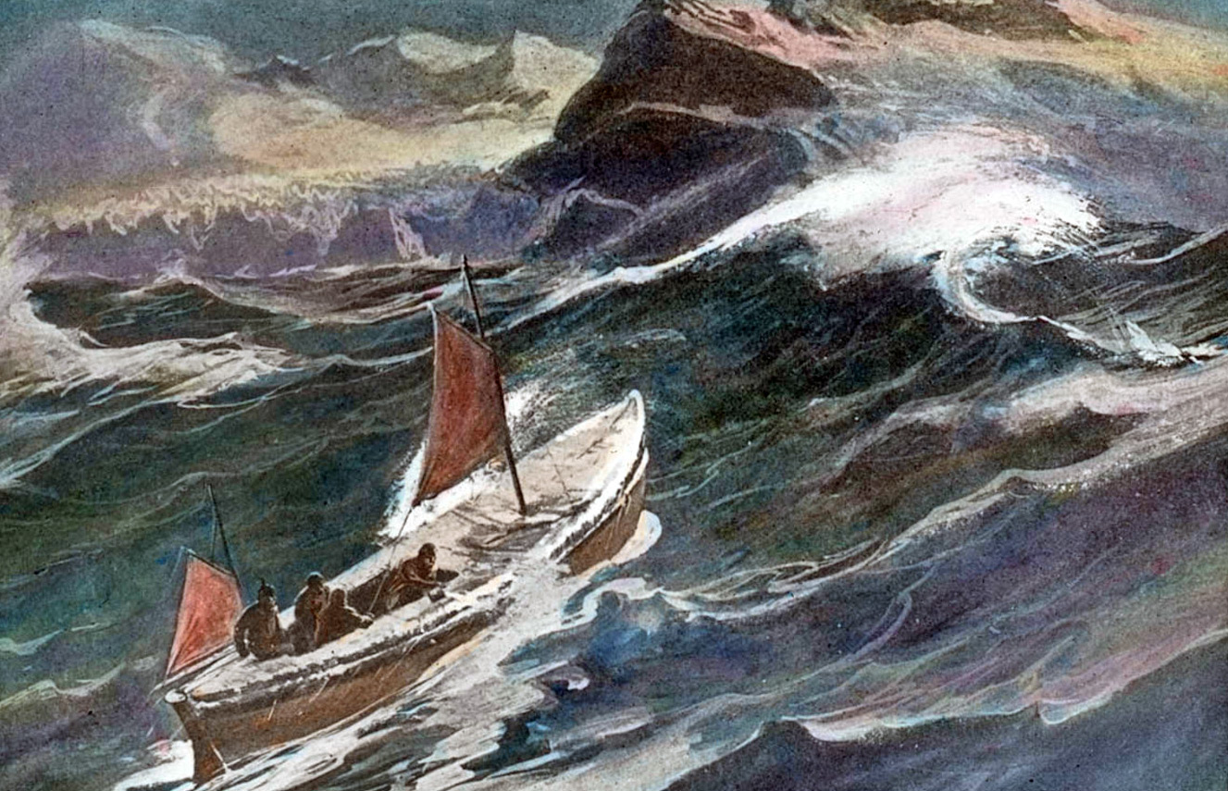
The voyage of the James Caird is one of the most epic small boat journeys of all time. Navigation was by “dead reckoning” as the sun was covered by cloud for days on end. Ice up to 15 inches (38cm) thick formed on the boat and threatened to capsize her, it had to be chipped off by hands stiff with cold with the threat of frost bite. Sea-water came in and made everything wet, gigantic waves and storms made the men think they would never survive. After 14 days though, they landed on South Georgia, they had thought it might take them twice as long.
Arrival on South Georgia,
pulling the James Caird up the beach

Slide 21
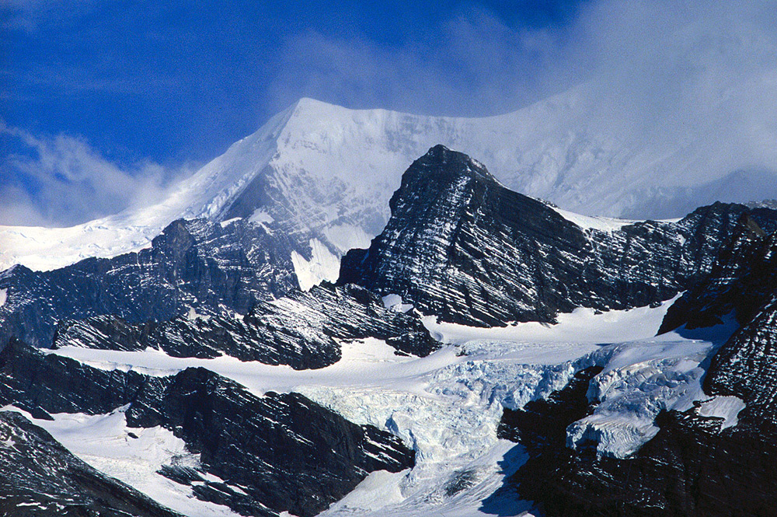
South Georgia meant rescue was nearby, but first Shackleton had to alert the whaling station. They had landed on the wrong side of the island. To reach the whaling station 22 miles away, the backbone of mountains and glaciers that ran the length of the island had to be crossed, no one had ever done this. Shackleton set off with Tom Crean and Frank Worsley to cross the mountainous island. Two of the other men were unable to walk, the third was left to look after them.
South Georgia, looking towards the central ridge of mountains that Shackleton had to cross

Slide 22
Once again with all the odds against them, Shackleton and his two companions succeeded. They reached the whaling station filthy and with torn clothes, unrecognisable at first. "When we got to the whaling station, it was the thought of all those comrades that made us so mad with joy... We didn't so much feel safe as that they would be saved.“ Shackleton in his diary

Slide 23
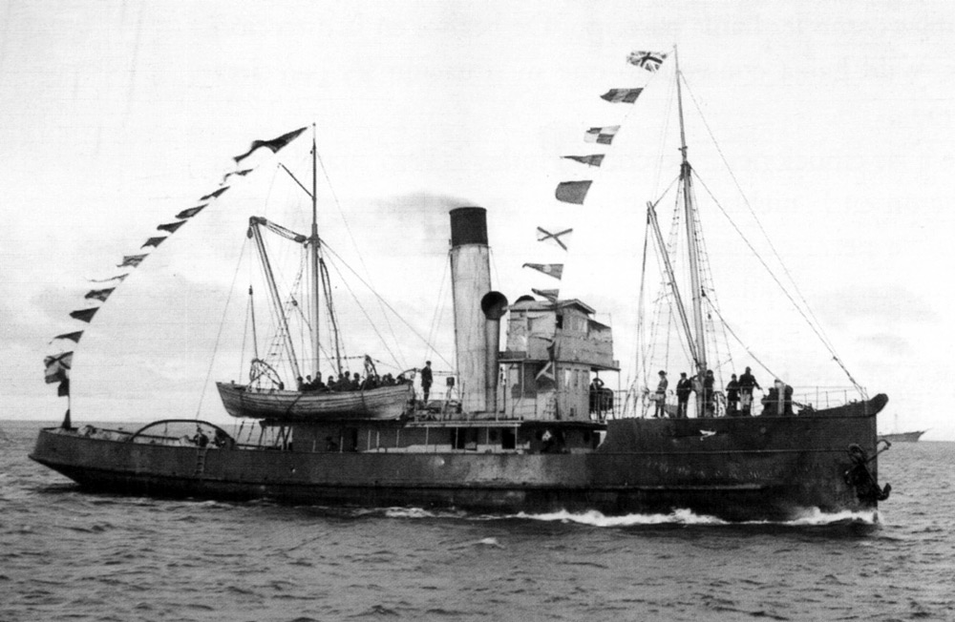
Shackleton immediately arranged for a British whale catcher to go from South Georgia to Elephant Island and rescue the 22 men still there. It was turned back by pack ice 60 miles away. Shackleton went to find another rescue ship. He tried a second time and a third time, always being turned back by heavy pack ice that the boats could not penetrate. Eventually a steam tug named Yelcho loaned by the Chilean government made it through on the fourth attempt.

Slide 24
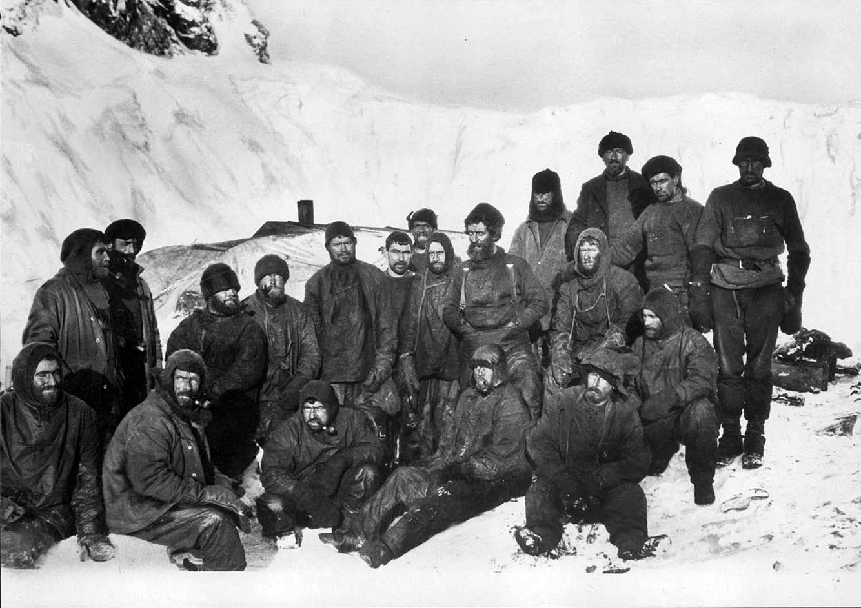
Life on Elephant Island had been tough for the remaining men, they thought rescue might come in a month, it had been four months, food was short, some were ill and getting worse, living conditions were very bad and it was winter again.

Slide 25
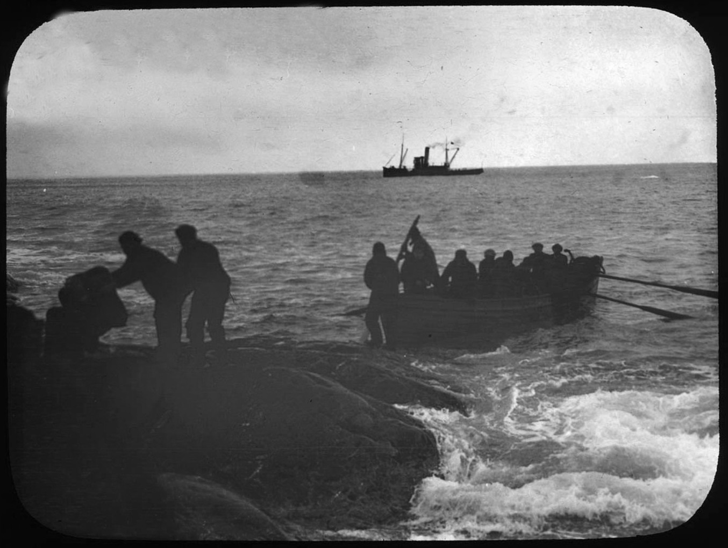
A boat from the Yelcho soon approached close enough for Shackleton, who was standing on the bow, to shout to Frank Wild: "Are you all well?" Wild replied: "All safe, all well!“ and the Boss replied: "Thank God!"

Slide 26
Not a single life was lost
For scientific leadership, give me Scott; for swift and efficient travel, Amundsen; but when you are in a hopeless situation, when there seems to be no way out, get on your knees and pray for Shackleton. Incomparable in adversity, he was the miracle worker who would save your life against all the odds and long after your number was up. The greatest leader that ever came on God's earth, bar none. Sir Raymond Priestley.
Right here is where I wish to tell about the only unfair deal that happened on the expedition. There were not enough fur bags for all hands, so some of the wool bags were used to make up the deficiency. We drew lots to see which kind of a bag each would get. There was some crooked work in the drawing as Sir Ernest, Mr. Wild ( second in command ), Captain Worsley, and some of the other officers all drew wool bags. The fine warm fur bags all went to the men under them. I think that action was enough to show what wonderful men were in charge. They always took the brunt of things and when there was any danger they were first to go ahead. The safety of his men was Sir Ernest's first thought, his own last. William Bakewell
Asked by an interviewer asked 60 years after rescue: "How were you able to survive, as so many other people perished with expeditions?" "Shackleton" Lionel Greenstreet

Slide 27
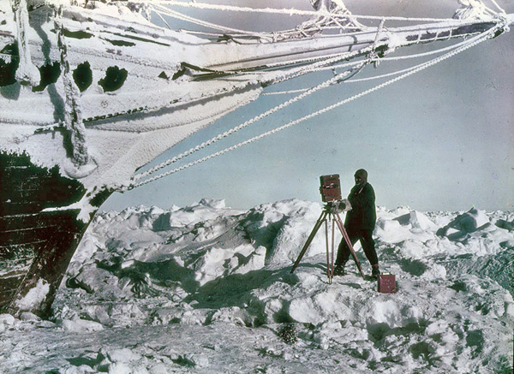
The pictures in this presentation were taken by Frank Hurley, the expedition photographer. They were taken mainly on glass negatives with a large, heavy, wooden box camera. They were rescued from the Endurance as she was sinking, dragged across the sea-ice for 4 months, taken in the lifeboats to Elephant Island and eventually brought home by the Yelcho.

