Slide 1
Antarctica
The Last Continent
(short text version)
Copyright: Material on these pages is copyright Paul Ward / CoolAntarctica.com or reproduced with permission from other copyright owners. It may be downloaded and printed for personal reference or public performance in an educational establishment as long as it is not for direct or indirect commercial use. It may be altered or modified, but not made publically available or transmitted to others in original or modified form without the written permission of Paul Ward / CoolAntarctica.com. Pictures by Alan Light, Drummond Small, Mike Usher, Paul Ward, Text by Paul Ward / CoolAntarctica.com
This copyright notice must appear wherever this material is used. Any queries please email

Slide 2
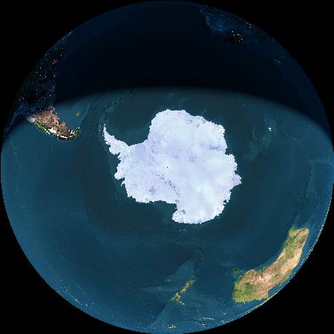
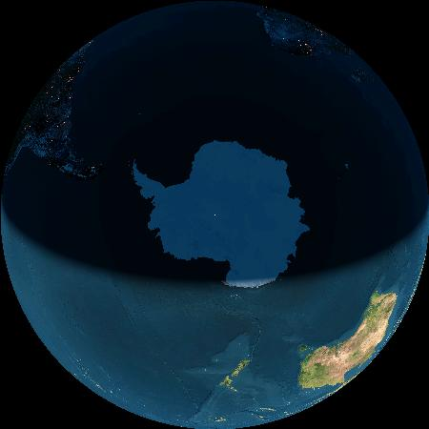
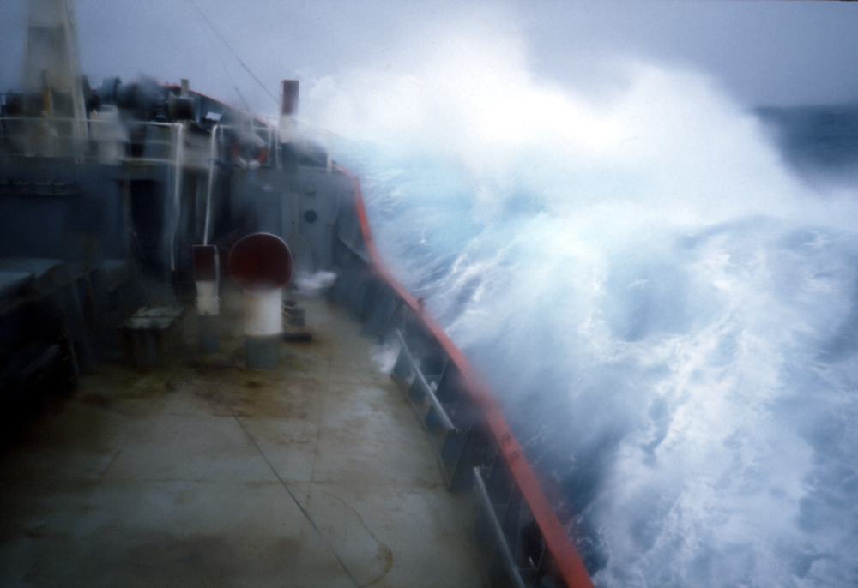
Antarctica covers the South Pole
Africa
South America
South Pole X
X
Australia and NZ
Midnight at the pole 21st December
Midday at the pole 21st June
The Living Earth, Inc. copyright 2006

Slide 3

Most people still get to Antarctica by ship. You have to cross “Drake’s Passage”, which is a narrow sea. It is the roughest sea on Earth!

Slide 4
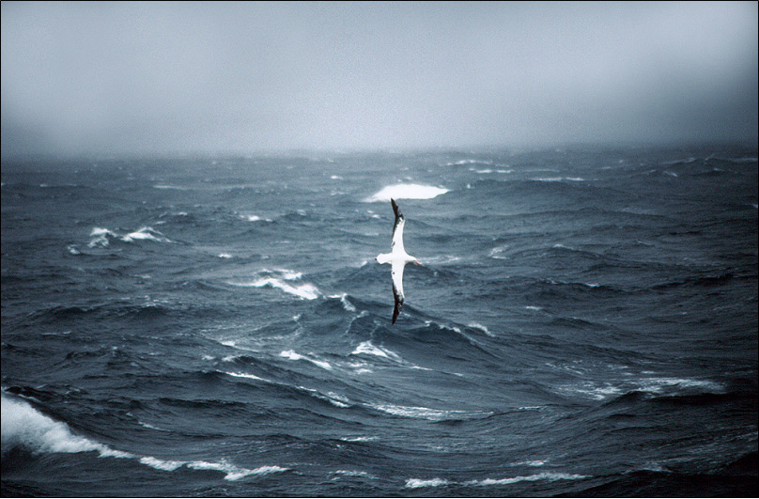
As your ship comes closer to Antarctica, you will see lots of albatrosses. This is a young Wandering Albatross. The Wandering Albatross has the greatest wingspan of any bird at up to 3.5m.

Slide 5
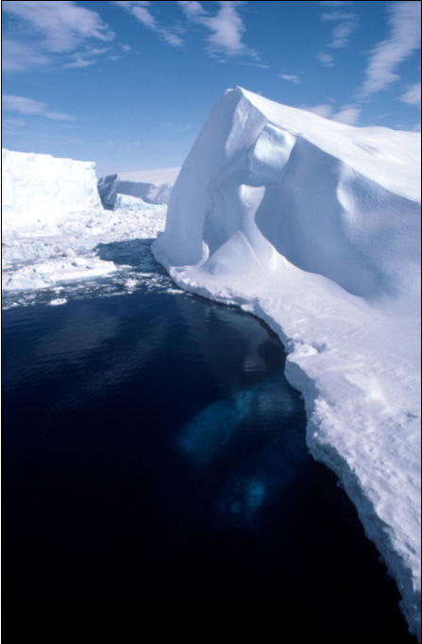
The first iceberg you see is like a doorway to the Antarctic.
When you do see an iceberg you will know that you have arrived in Antarctica and are sailing in the sea around Antarctic waters.
Antarctica will be like a different world. Unlike anything you have ever seen before.
Welcome to Antarctica.

Slide 6
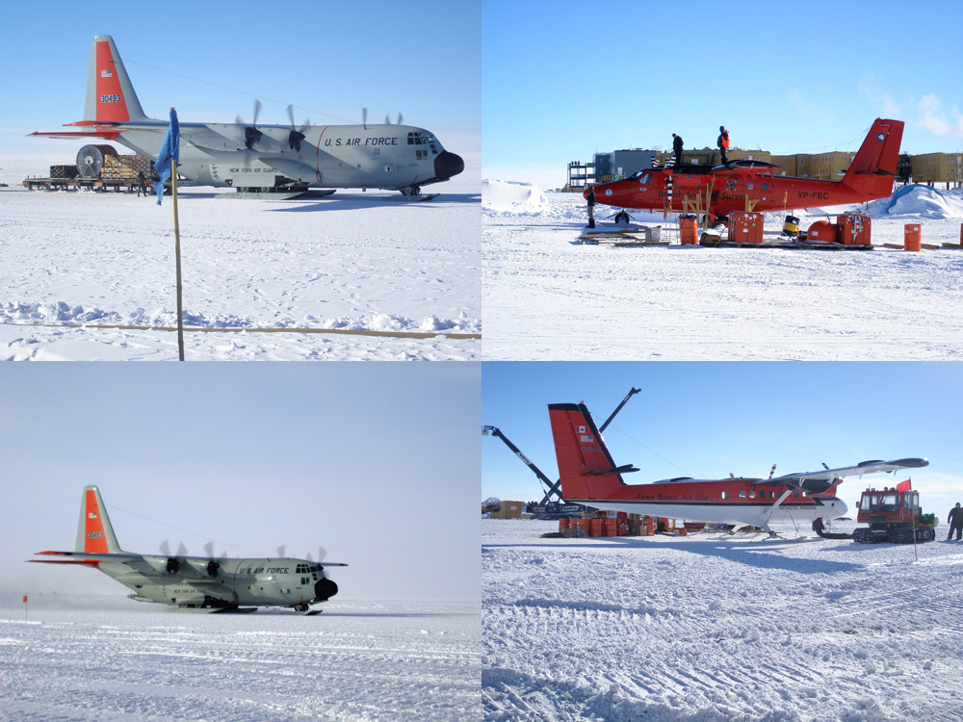
More and more people get to Antarctica by air. Ice runways are becoming more common and this is an increasingly used form of transport for those on scientific bases. The passengers can be dropped off in South America or Australia to get to their own country instead of taking weeks on board ships as used to happen.

Slide 7
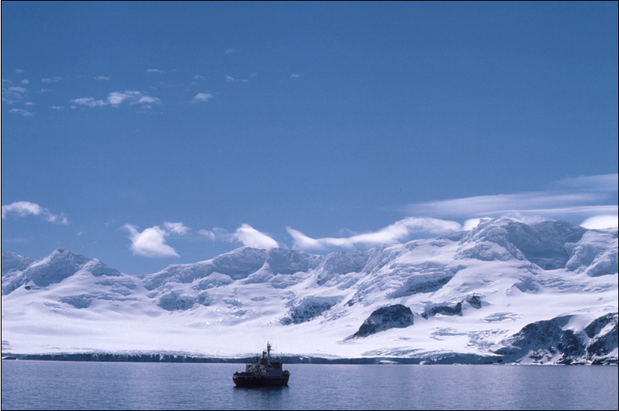
Ships are one of the best ways to travel around Antarctica. The continent and surrounding islands are either very mountainous and rugged broken up rock, or a big mass of ice.

Slide 8
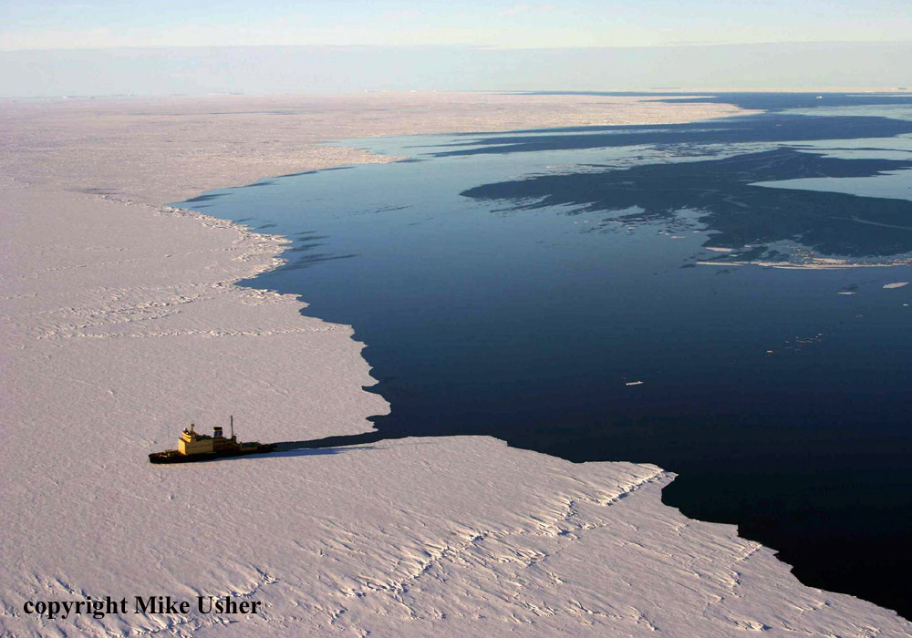
In the Antarctic spring, a Russian icebreaker enters sea ice that formed in the winter. Not all ships in Antarctica are icebreakers, but most have extra strength for the ice. Ice attached to the coast is common in the spring. If ships can break through it cargo can be delivered without waiting for the weather so much.

Slide 9
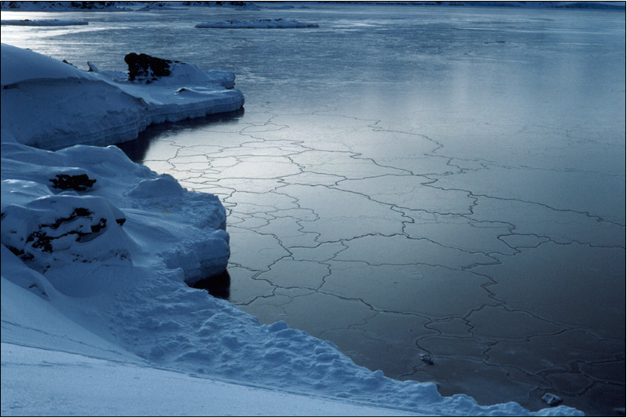
This is sea-ice forming. It is about 2.5cm thick. It is soft enough to push your finger through! As the tide rises and falls it forms these shapes which look like jigsaw puzzle pieces. They push over on top of each other. The sea freezes quickly in calm, cold conditions. It doesn't freeze earlier because the surface of the sea moves too much.

Slide 10
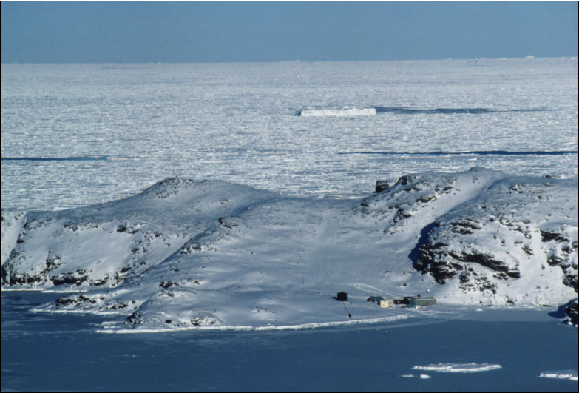
As winter approaches, the only people left behind in Antarctica are scientists and support staff on research stations. At this time about 1000 people live in an area 1.5 times larger than the USA. Sea-ice doubles the area of Antarctica. Flights are very rarely attempted because it is too dark and the weather is terrible.

Slide 11
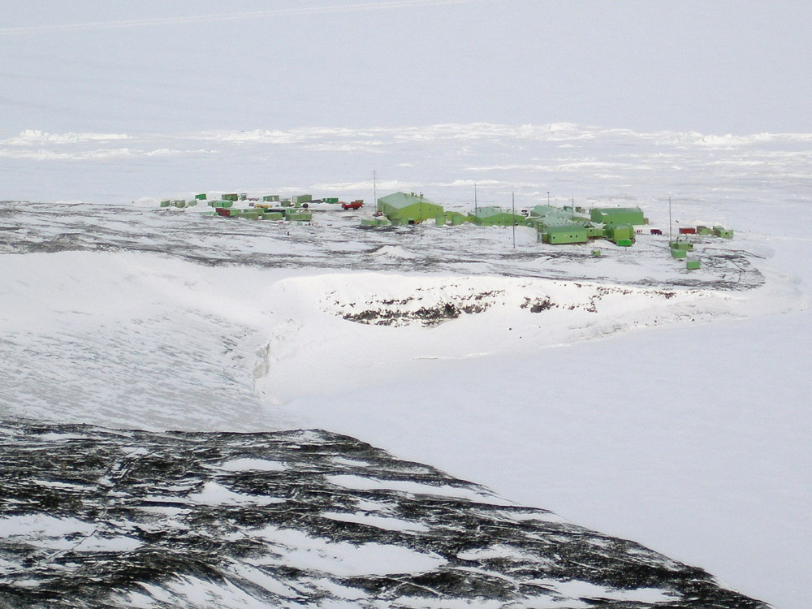
New Zealand Scott base. This is an average size for an Antarctic base, there are about 10 people over the winter and up to 85 in the summer. The industrial style buildings are typical of Antarctic bases sadly.

Slide 12
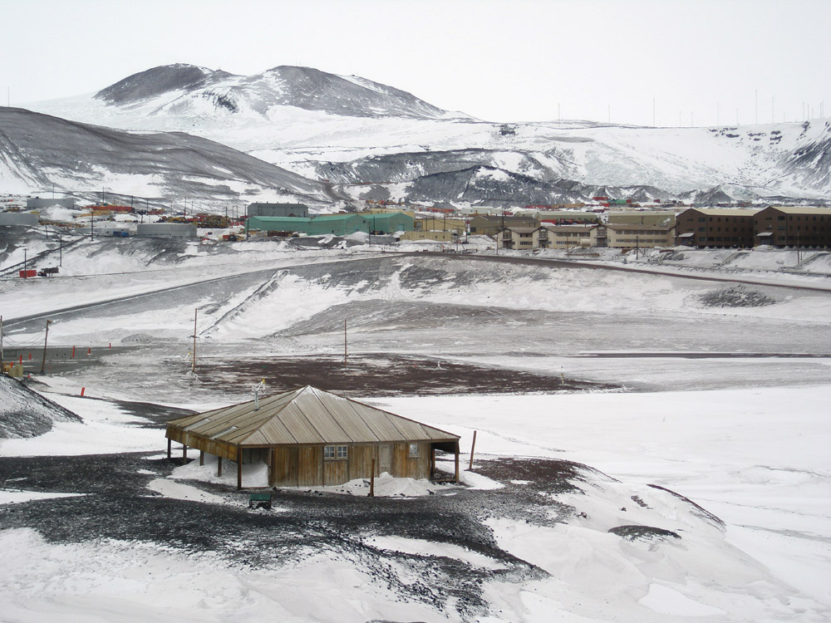
Antarctic bases old and new. Near to us is Hut-Point, McMurdo Sound. This hut is from Captain Scott’s 1904 Discovery expedition that had about 25 men. Behind it is the modern McMurdo base. This has about 250 people in the winter and 1000 in the summer – it is easily the largest Antarctic Base.

Slide 13
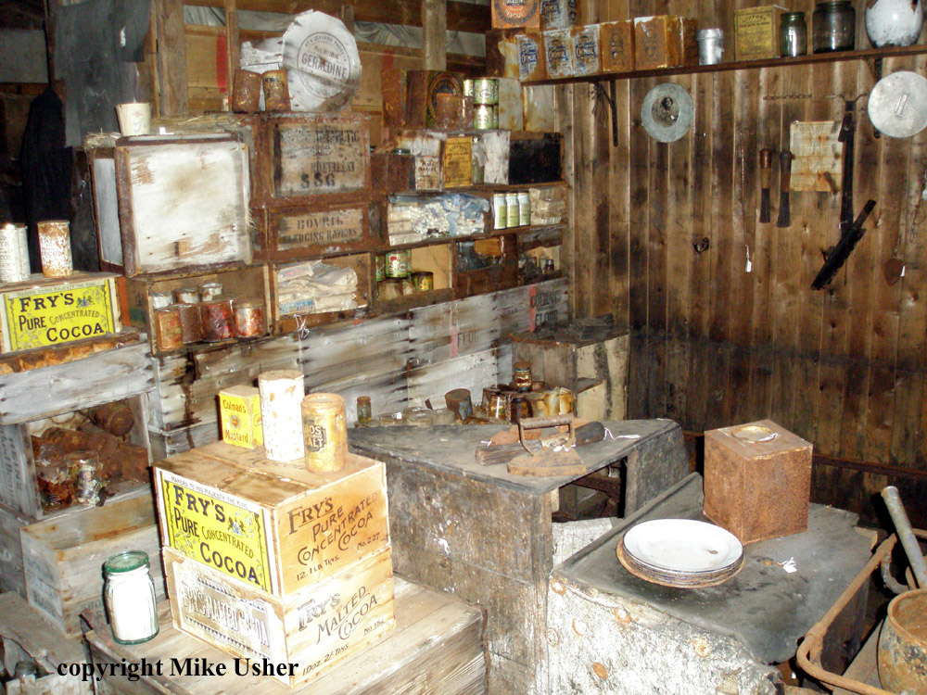
Inside Scott’s hut it is like a time capsule. There have been few visitors most of whom have respected the hut the way it was left. This and cold temperatures mean that many items are exactly as they were when left over 100 years ago.

Slide 14
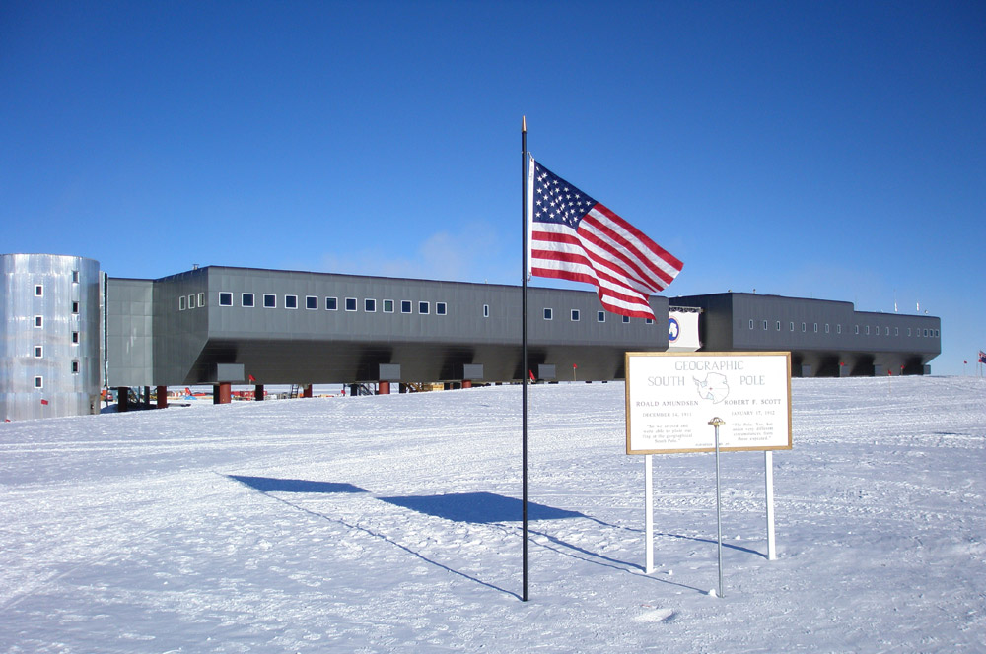
Amundsen-Scott Base at the South Pole. This base houses 75 over the winter and 250 in the summer. It is the third base built at the South Pole, the other two were buried by snow and ice. Like other modern base designs on ice, this is held up on legs. It can be raised in the future so that it is not buried by snow and ice.

Slide 15
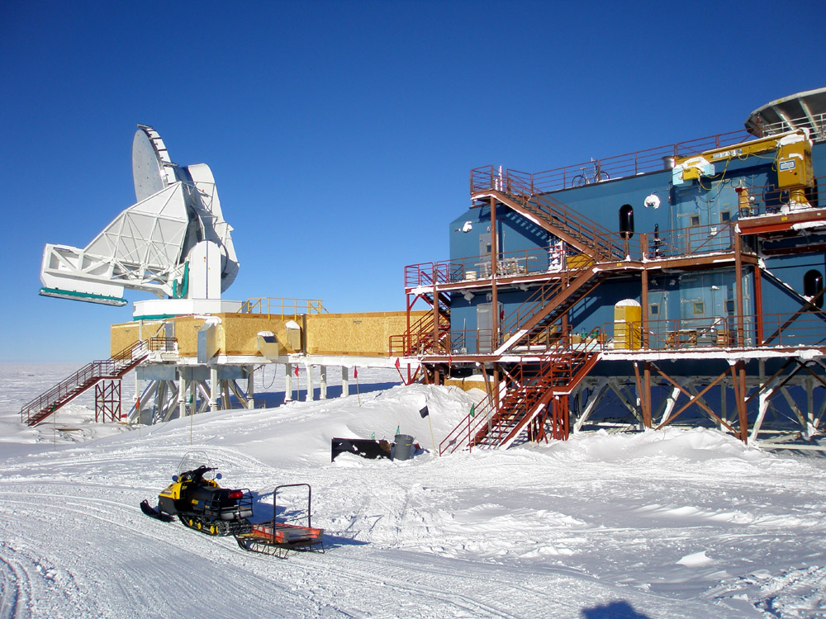
Science in Antarctica. Bases in Antarctica exist so that science can take place, there are lots of different projects from the small to the large. This is a 10m telescope and laboratory at the South Pole.

Slide 16
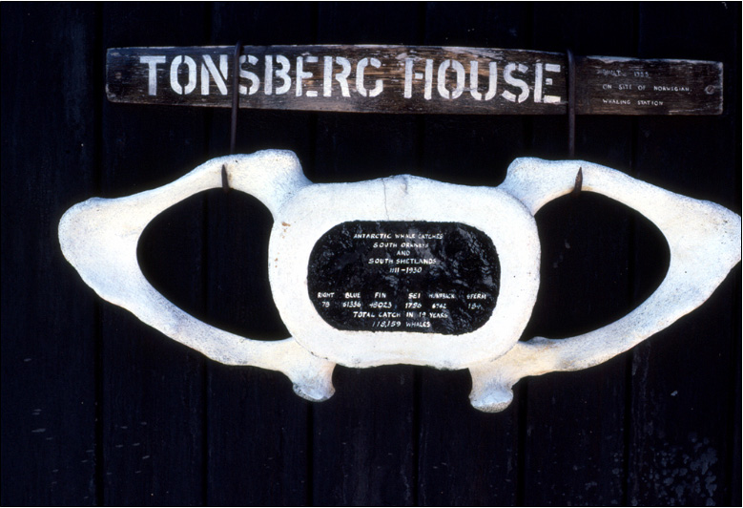
Whalers and sealers were the first to explore Antarctica. They killed lots of whales and seals and many species became endangered. International laws were passed to stop them and the seal populations have recovered. However, the great whales are still in danger. This plaque is painted on a whale vertebra on an Antarctic base. It represents 118,159 whales killed between 1911 and 1930 – in just one part of Antarctica.

Slide 17
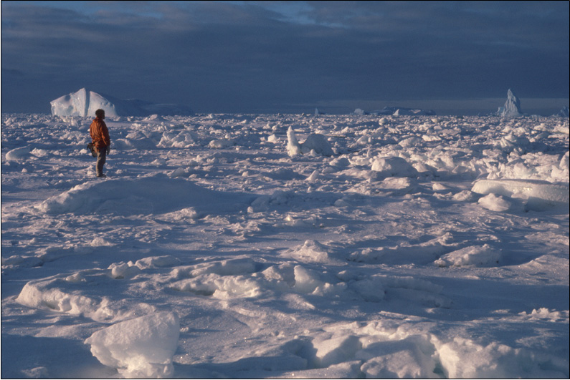
Pack-ice is “glued” together by the sea freezing between the pieces to give a solid surface. It is very rough and broken up. This makes the surface very difficult to travel over. Vehicles or people on skis have to stop-start constantly and always change direction to find the best path.

Slide 18
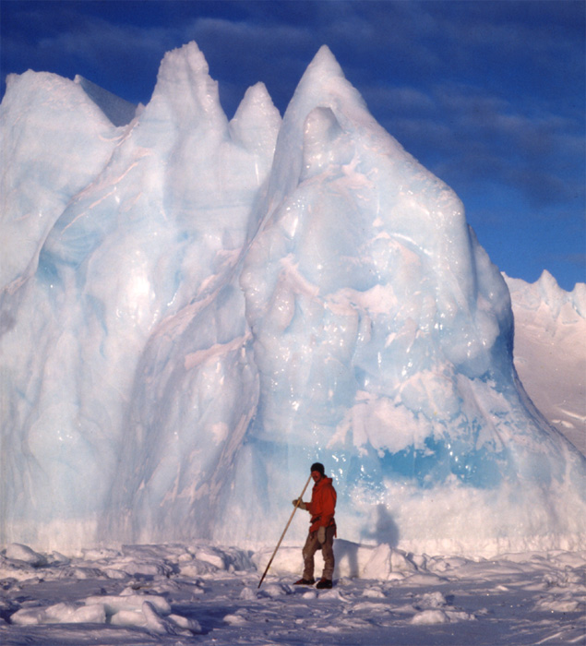
Standing next to even a small berg can be very exciting and scary!
If the sun is out, the different colours warm up at different rates. Clear regions can act like a lens warming up the interior.
You can hear lots of creaks and bangs.
The sea-ice around it is also creaking as the tide rises or falls. It becomes an uncomfortable place to be.
There’s also the fact that you’re on ice not very thick, and there’s 8-10 times more ice below your feet than you can see above.

Slide 19
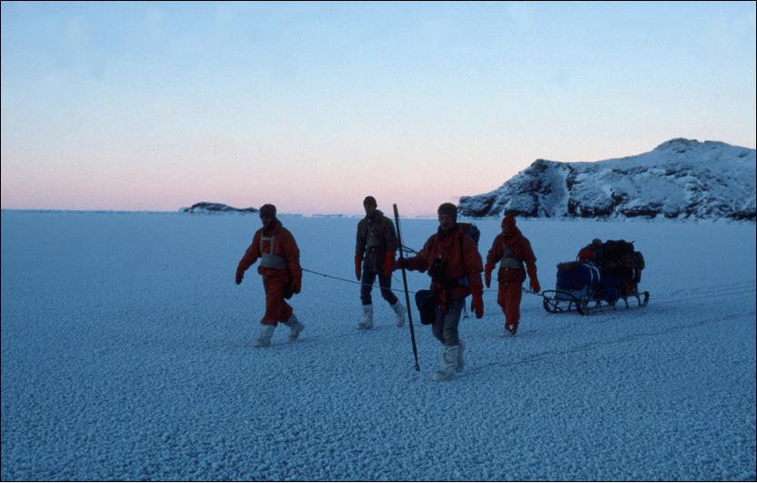
Fast-ice sometimes doesn't move from its original place. After many days of low temperatures it becomes hard and strong. This makes it an excellent travelling surface. The long pole carried by one of these men is used to test the ice – more than 3 “thwacks” to get through and it’s safe to walk on, less than 3 and you must re-trace your steps carefully.

Slide 20
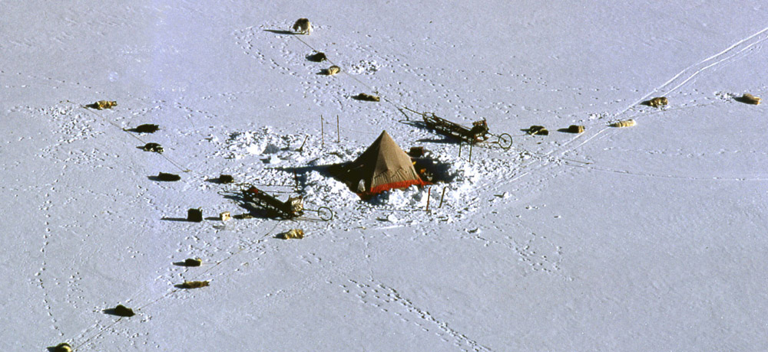
Field work in Antarctica. Some scientific work in Antarctica takes place away from bases in remote areas. This picture shows a traditional camp from the 1970’s when the field party had two dog teams and sleds that can be seen here arranged on either side of the tent.
Scenes like this can still be seen today in the Antarctic summer except that instead of dog teams pulling the sleds, skidoos are used. Field parties like this are visited by small aircraft for re-supplying with food and fuel so they can spend longer away from base and go to more remote areas.

Slide 21
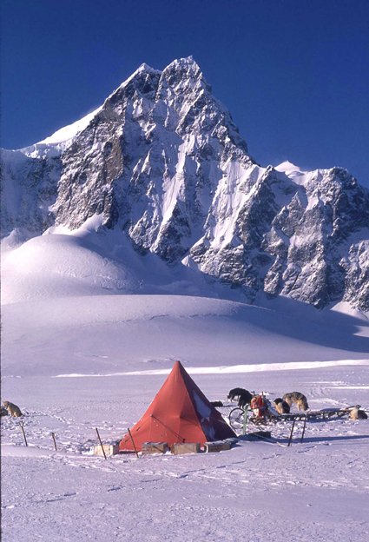
A field party in Antarctica is the purest way of experiencing the continent.
Nothing can match doing this with sleds pulled by dogs. This is now a part of history never to be repeated. Dogs have not been allowed in Antarctica since the Antarctic Treaty stopped them in 1994.
It was 20 years or more before that though that dogs were used for travel because they were the best method. Vehicles with internal combustion engines have been used for many years now.

Slide 22
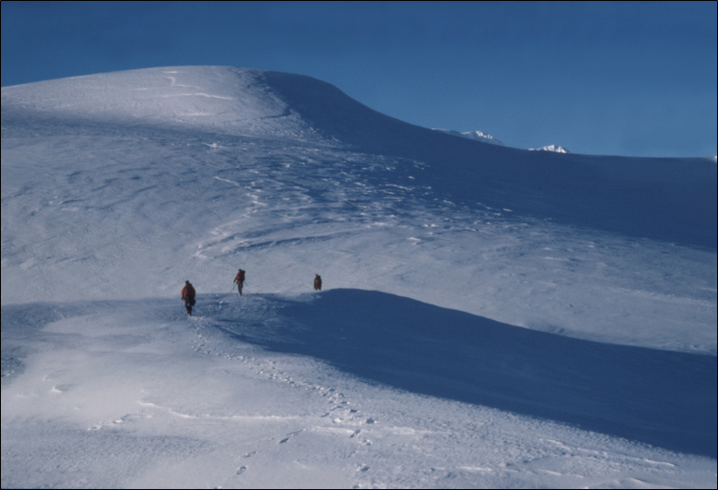
Crossing glaciers and ice fields is dangerous because there are so many crevasses. These are cracks in the ice that form when the ice sheet direction changes or when it goes over an obstacle. Roping-up is required, so if one person goes down a crevasse, the others are able to rescue them.

Slide 23
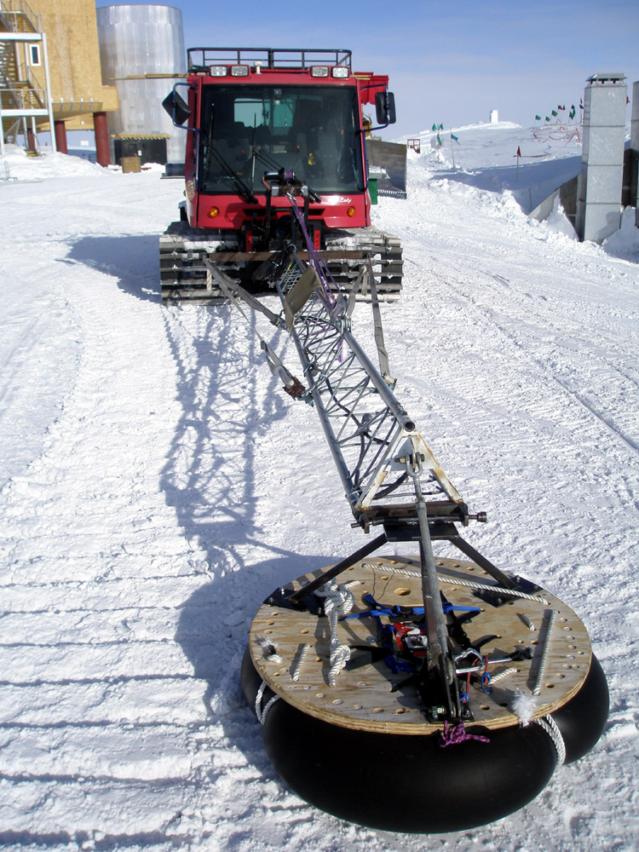
A tracked vehicle (called a Pisten Bully) with a crevasse probe.
The crevasse probe is electronic. It is held on the end of the long arm, the wooden disc and inner tube let it ride in front of the vehicle on the snow or ice.
This vehicle will be the first one in a convoy going ahead of all the others, finding crevasses and stopping before any other vehicles are in danger.

Slide 24
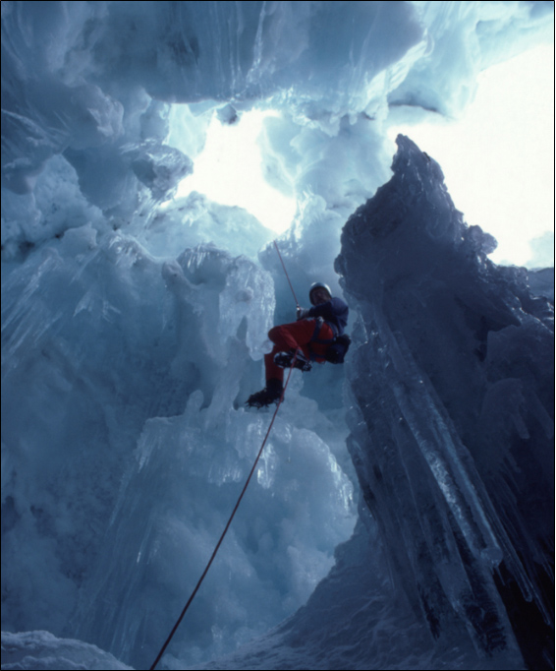
Investigating a crevasse – deliberately!
Crevasses are often covered over by a bridge of blown snow. Such bridges may be strong enough to support a vehicle or so weak that they cannot support a single man.
You must be very careful when approaching them. Training to rescue yourself or others who may fall into a crevasse is a part of the preparation needed to travel around Antarctica overland and away from bases.

Slide 25
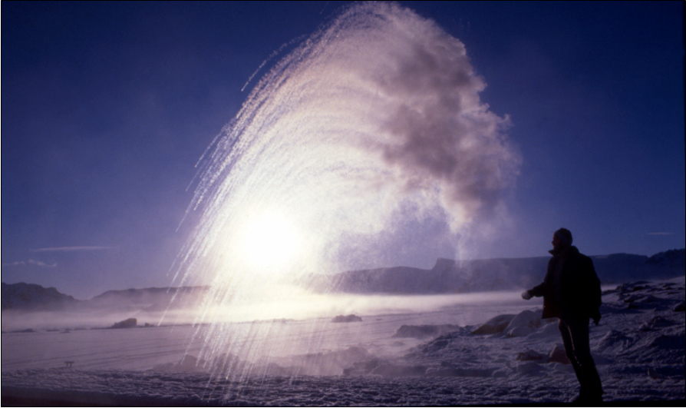
Here’s a fun thing to do on a cold day (-32°C here). Take out a flask of boiling water and a plastic cup. Pour the water into the cup and throw it into the air. As the boiling water hits the cold air, it instantly vapourises and drifts away. The streaks towards the bottom left are small pieces of ice. The rest just becomes gas.

Slide 26
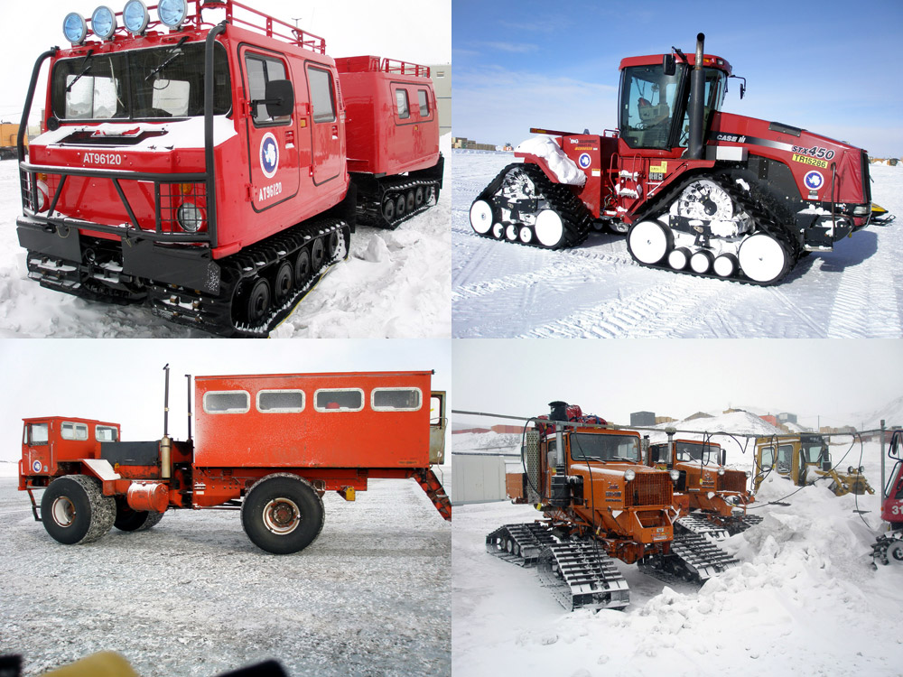
Antarctic land transport. Many vehicles have tracks instead of wheels including all those that go away from the bases. Vehicles with wheels are used in and around bases where conditions are easier.

Slide 27
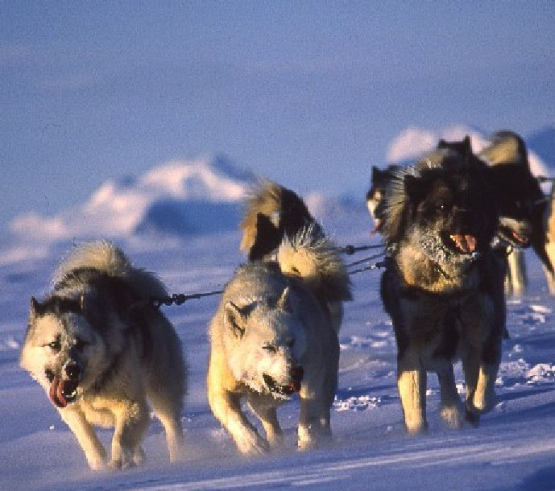
The original form of transport in Antarctica was dog-sled pulled by huskies. These animals helped to open up Antarctica and for a long time were the only reliable form of transport until engined vehicles became reliable and trustworthy.

Slide 28
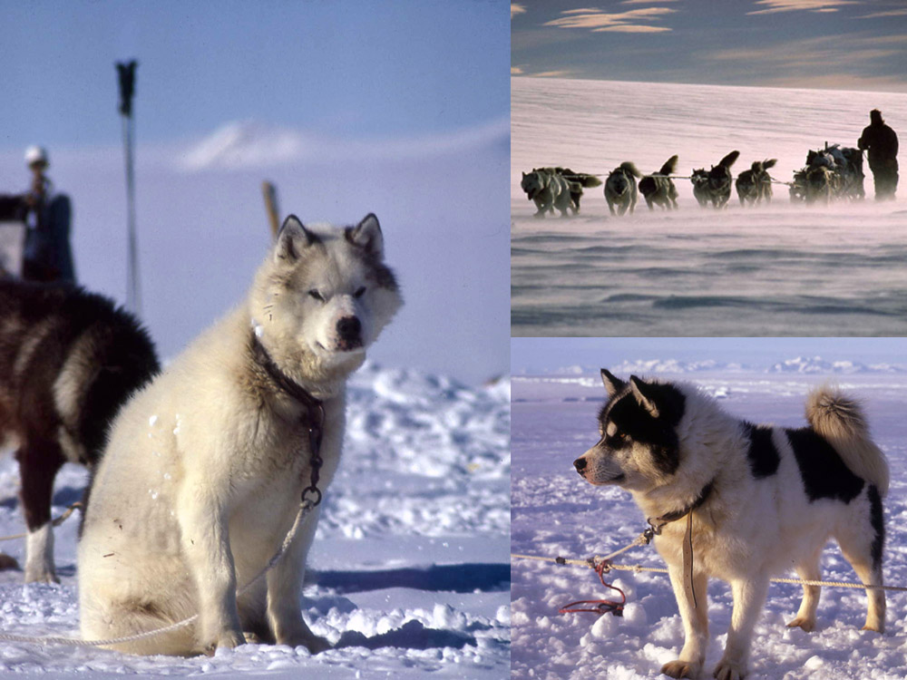
Strongly built, powerful and loyal. The men who worked with huskies never forget the connection of man, dog and landscape, being part of the pack and working to a common goal in a challenging but ultimately hugely rewarding environment.

Slide 29
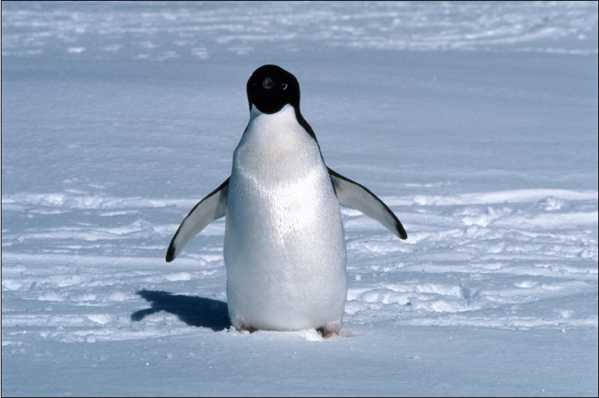
Antarctica is home to many millions of penguins. This one is an Adélie. It is the commonest species found in Antarctica. It lives in the deep south. This one is seen crossing the sea-ice to its nest site in early spring. As the season goes on the ice breaks up and it doesn’t have to go so far.

Slide 30
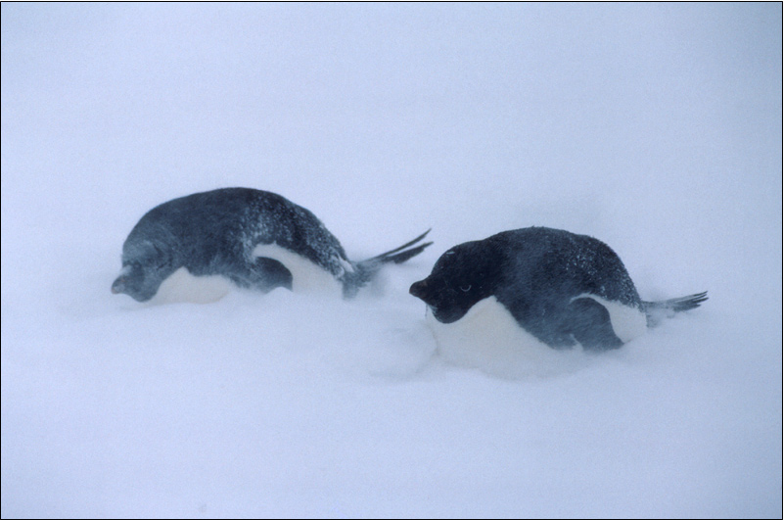
Early spring can still bring storms. These penguins are on their way to their nesting grounds and have to face out the weather. They head into the wind so their feathers are not ruffled. This gives them the best insulation. They pull themselves as short and squat as they can to reduce the size of their bodies. This way they don’t lose heat.

Slide 31
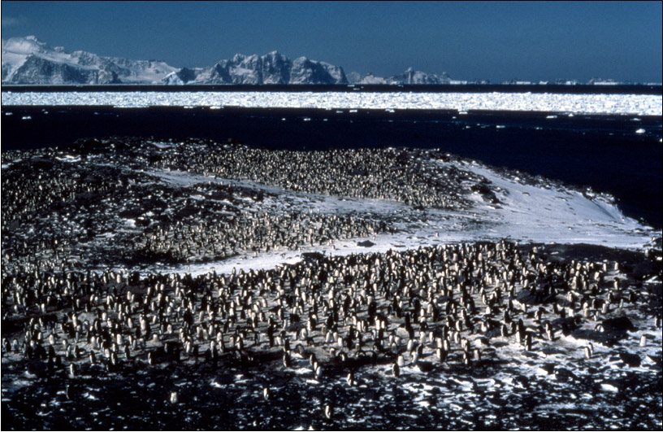
The penguins have come here to nest. This is only about half as many penguins as will eventually arrive. Those who come early get the best places. They are a little raised and are the least likely to get wet when it warms up and the snow melts. Note the pack-ice in the distance. This will break up as the season goes on.

Slide 32
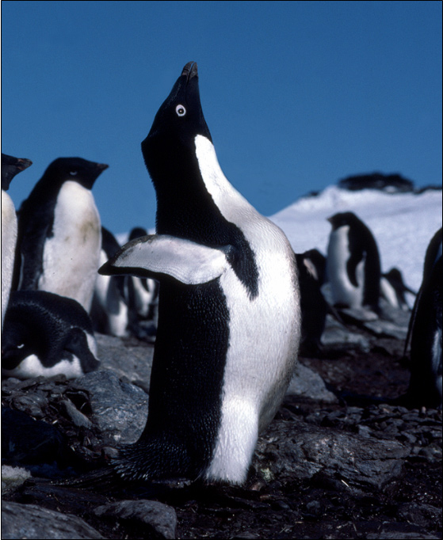
This male adélie penguin in the is advertising for a mate early in the breeding season.
It is very important for him to be noticed by other female penguins so that he can find one to lay eggs with.

Slide 33
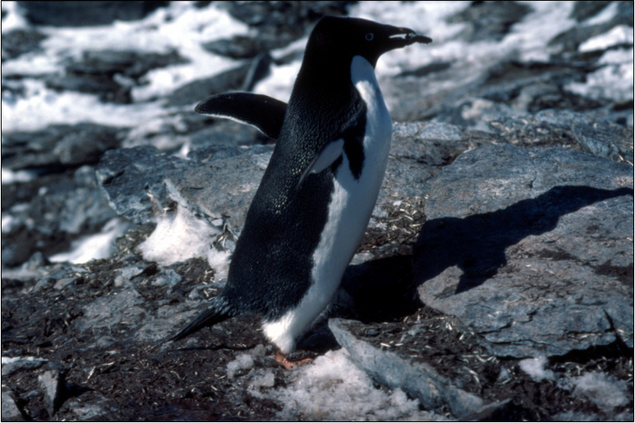
Once a mate has been found, nest-building begins. Penguin nests are not impressive like other birds. They consist of just a circle of stones on the ground. There aren’t many stones around, so they spend most of their time stealing stones from each other, over and over again.

Slide 34
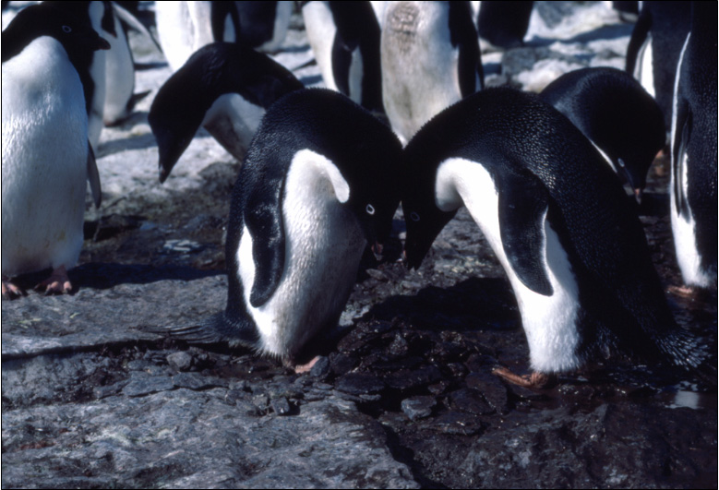
The proud parents to be by their magnificent nest – that’s it I’m afraid. This pair are in the process of a courting ritual. Starting low down they weave beaks together, getting higher and higher, eventually throwing their flippers back with a loud “awk, awk, awk” sound. It teaches them what their mate’s voice sounds like.

Slide 35
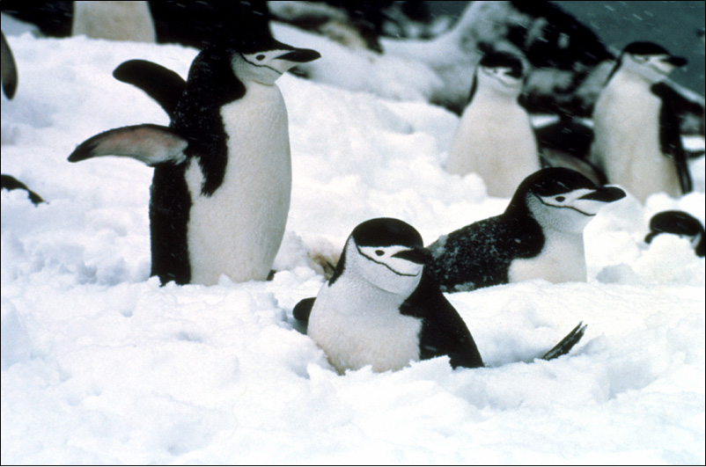
Snowfall at nesting time can be a problem. It’s just around freezing point and this can cause problems for penguins with eggs or chicks. If the snow melts and floods the nest, the chicks or eggs will become chilled. Note the reddish colour under the flipper of the penguin to the left. A way of losing excess heat is by diverting blood through the flippers.

Slide 36
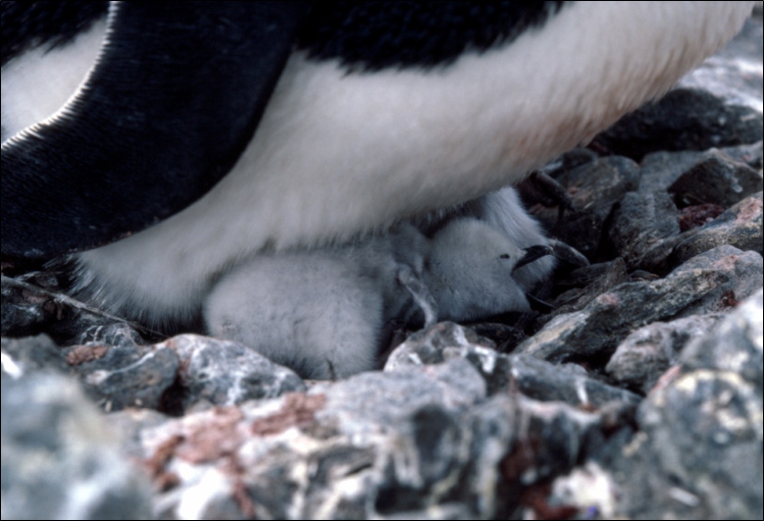
Eventually the eggs are hatched and the chicks born. Covered in fine down, they are always protected by one of the parents until they are large enough to be able to regulate their own temperature. Penguin chicks grow at a rapid rate. Parents take it in turn to baby-sit or catch food.

Slide 37
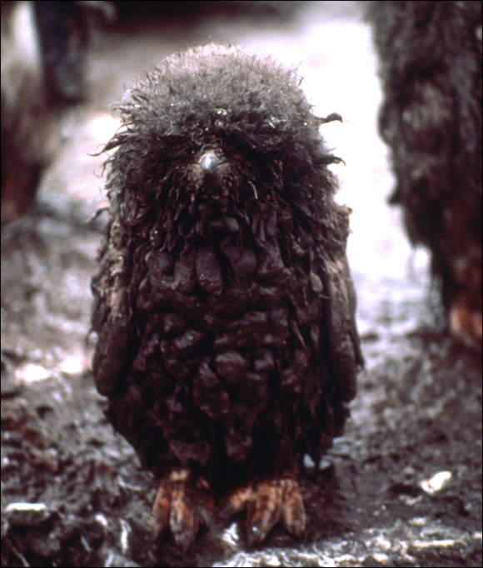
Some chicks get dirtier than others of course!
On a more serious note, getting so dirty can be dangerous because the down is unable insulate the chick. This means that the chicks can get too cold.
Unlike the adults, the chicks can’t go into the sea to wash themselves off.
Adélie Chicks don’t go into the sea until they have moulted their juvenile down (baby feathers) and gained the adult feathers.

Slide 38
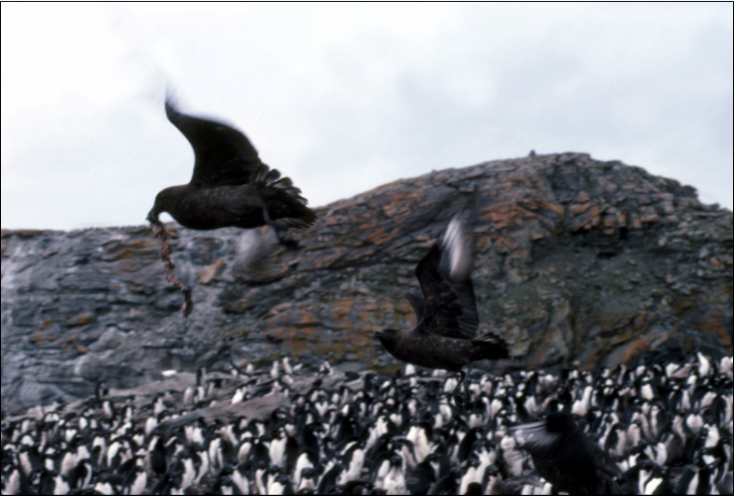
Predatory skuas come looking for unguarded eggs and unguarded or weakened chicks. They are always ready to pounce! Even though they cause trouble for the penguin colony, they only kill a small number of chicks.

Slide 39
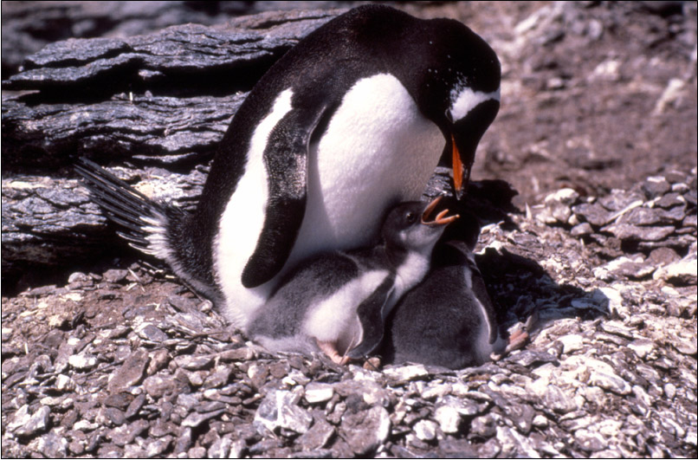
Gentoo penguin and chicks. They are one of the calmest and least aggressive of Antarctic penguins. There are two sub-species. This is the southern sub-species which is found down to the Antarctic Peninsula. The slightly larger northern sub-species is found mainly on the sub-Antarctic island of South Georgia.

Slide 40
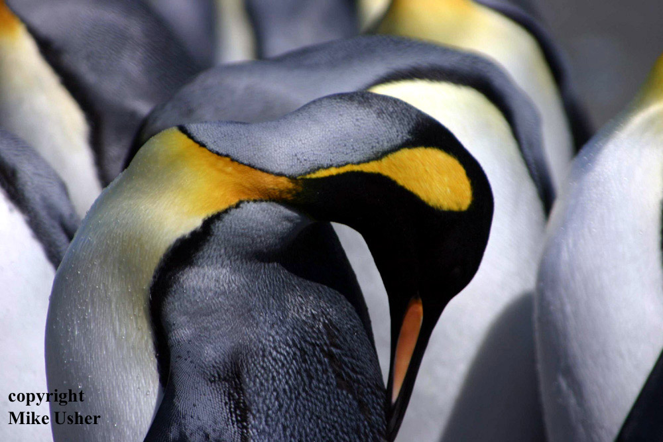
A King Penguin cleaning itself. These are the second largest kind of penguin. They are nearly 1m tall and weigh about 15kg. They are not birds of the ice, they breed away from the pole on the islands around Antarctica where it is not quite so cold.

Slide 41
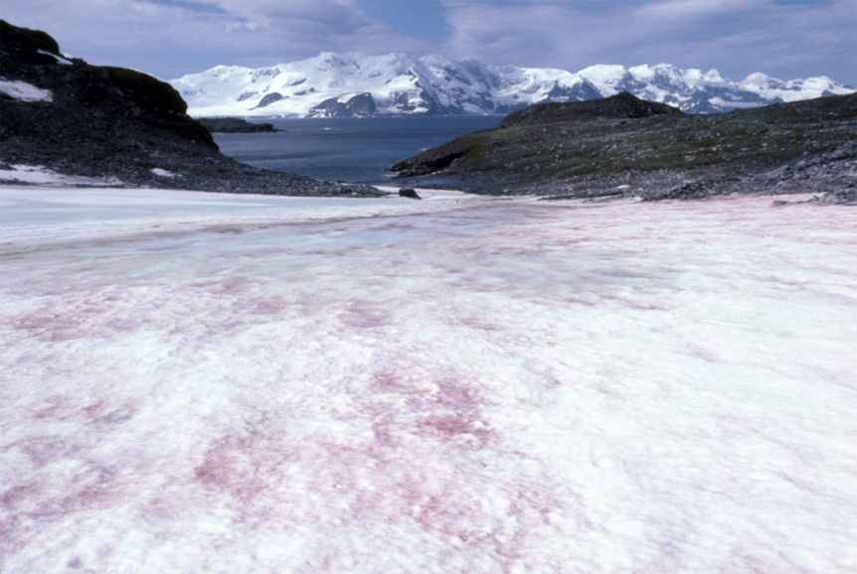
Raspberry ripple snow. Snow algae live in the top 10 inches (25cm) or so of recent (the last year’s) snowfalls. It is found in polar and mountainous regions in the spring. As snow and ice begin to melt it releases stored nutrients. Treading on the snow can release a faint smell of watermelon from the algae.

Slide 42
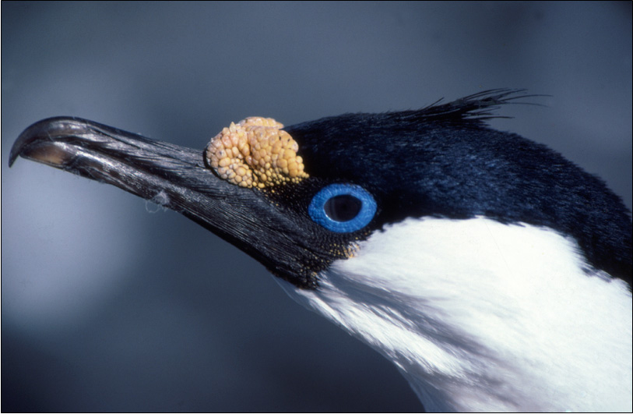
Blue eyed shag. It’s a cormorant that nests in Antarctica down to the Peninsula. Blue eyed shags will not go far from open water, a fact that early Antarctic explorers soon learnt. When they are sighted by an entrapped ship it is a sign that an ice-free region is not far away.

Slide 43
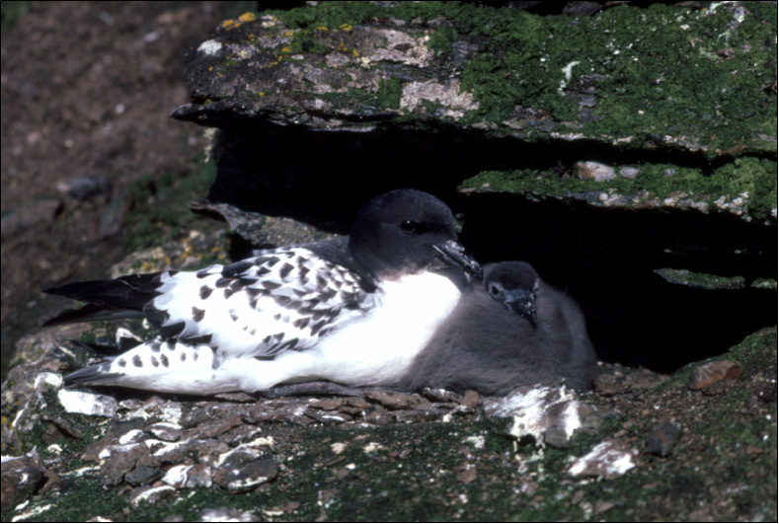
Cape Pigeons or Pintados are common small birds around Antarctic coasts. They are similar in size to common pigeons, although are not closely related because they are sea birds. They nest on ledges close to the sea.

Slide 44
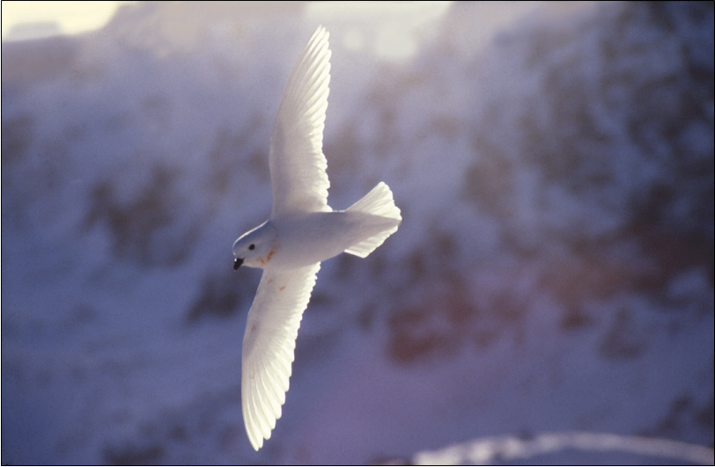
Snow petrel courtship takes place largely in the air. The female leads the male in an aerial ballet around the cliffs where they nest. The male’s task is to keep up. Unwelcome attention is responded to by some accurately vomited krill, the source of this male’s pink necklace.

Slide 45
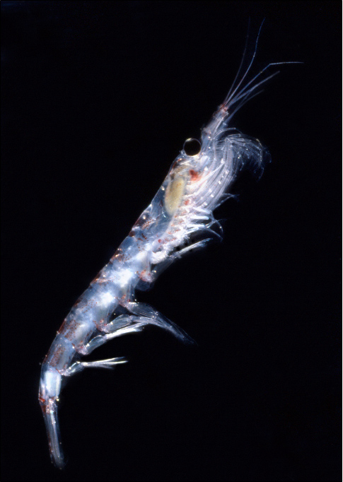
Krill are the engine that drives the Antarctic ecosystem. They are shrimp-like crustaceans about 4-5 cm (2 inches) long.
They feed on microscopic phytoplankton which are floating plants that respond quickly to the rise in daylight in the spring. As krill colonies are so large, they are available to nearly all Antarctic animals that are bigger than they are.
In other oceans, the animals that feed on phytoplankton tend to be smaller, so the ability to “tap” the food chain so close to the bottom is not available as it is in Antarctica.
Krill outweigh the human population of the earth by a factor of 2 or 3. Single swarms have been estimated as containing over 2 million tons of krill spread over 450 square kilometres.

Slide 46
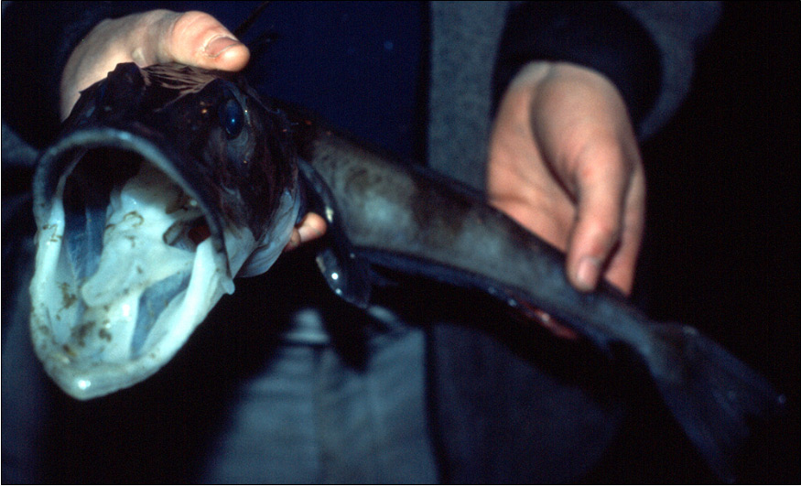
Antarctic fish are probably the best cold-adapted fish that the world has ever seen. They have lived at between -2°C and +2°C for 20-30 million years and they do not travel to other seas. This ice fish has no red pigment in its blood to carry oxygen. Low temperatures and high blood volume mean that it does not need it.

Slide 47
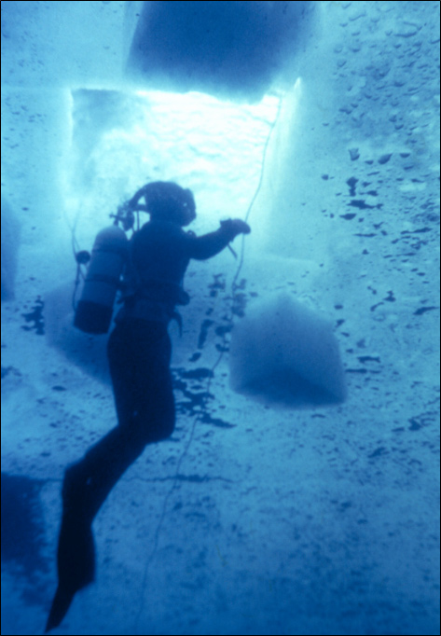
Dive holes can be made with a chain-saw which has an especially long blade. This is what has happened here.
A square hole is cut and then the floating ice cut into 4 pieces. These 4 pieces are then pushed down from the surface under the ice where they float up because they are naturally buoyant. These 4 pieces can be seen around the diver.
Under-ice divers are always attached to the surface by a rope held by a line-man who lets the line out or pulls it in by a series of commands. In emergency, he can pull the divers manually back to the surface through the hole.

Slide 48
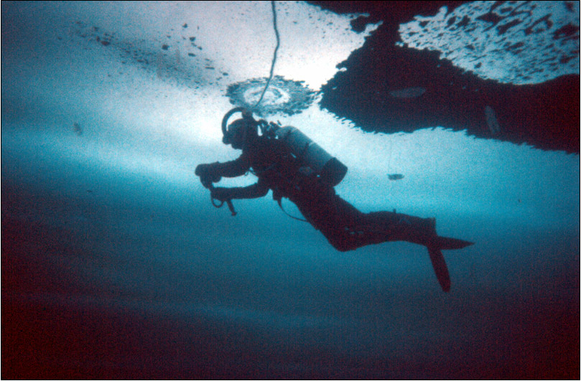
Some ghostly roughly oval shaped objects can be made out in the water, this is a shoal of jellyfish-like creatures called ctenophores. Diving under ice can be an ethereal experience. A fun thing you can do after a dive is to take your weight belt off and push yourself back under the ice, stand up and walk about upside down.

Slide 49
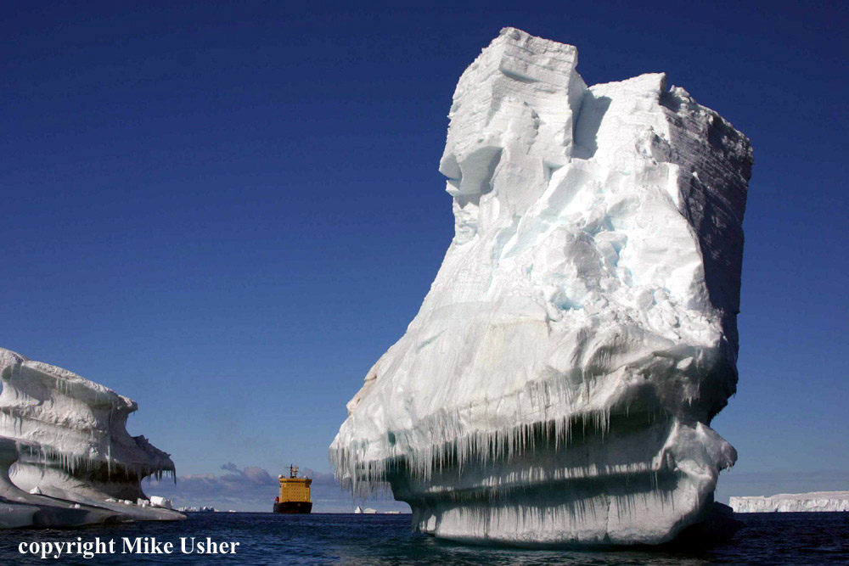
A very eroded iceberg. There has been a lot of melting above the sea level. The berg is not really as big as it seems here, the ship is quite a long way behind!

Slide 50
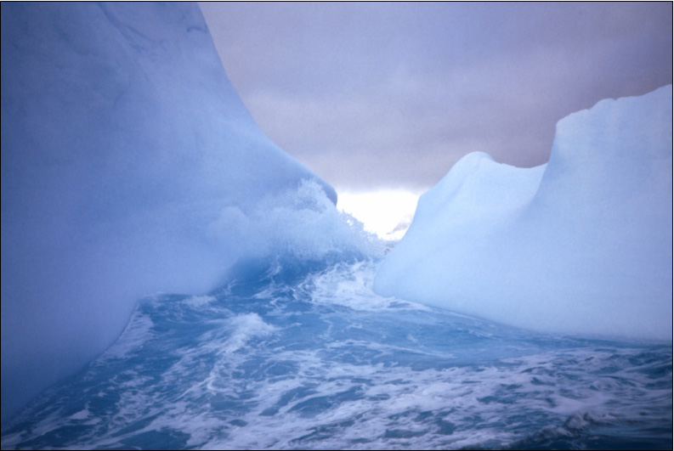
This was a particularly fascinating place. We sat in a small high-powered inflatable boat watching the waves rise and fall. As the waves rose, the gap in the berg became flooded, and as they fell it was just ice. We debated whether or not to try and rush through as the waves were rising. In the end we decided that it might be too dangerous!

Slide 51

Mountains that emerge from an expanse of ice are called “Nunataks”. They are like islands that emerge from the ocean, except that in this case the ocean is one of snow and ice. Surprisingly such sterile environments can attract birds that nest on them despite being many miles from the sea and food.

Slide 52

Antarctica is very good at dramatic scenery.
Built on an a remote Nunatak, this is the former Soviet Leningradskaya Station. The nunatak is 1,000 feet high (over 300m) in a part of Antarctica called Oates Land.
This base was open between 1971 and 1992. It was closed because it was too expensive and difficult to get supplies to.
It may be re-opened soon

Slide 53

One of the finest animals in the world (IMHO) – an Antarctic fur seal. These creatures can seem quite frightening at first contact because they feign attacks and growl at you. When you’re more familiar and comfortable with them, they can be the best truly wild animal to make contact with.

Slide 54

Fur seals were brought very close to the edge of extinction by sealers in the 1800’s. They have made an excellent recovery since then. Now their numbers are threatening some fragile habitats in sub-Antarctica islands.

Slide 55

Newly born Weddell seal pups are officially some of the world’s cutest creatures. They flop about on the ice in the early days after their birth. They are not able to co-ordinate their over-sized flippers until they grow into them. The mother had arrived at the birth site some 10 days earlier. She came with enough resources of blubber and protein to double the 25kg (55lb) birth weight of a pup in 10 days.

Slide 56

Weddell seal milk is one of the richest produced by any mammal and contains about 60% fat. It helps the pups grow quickly shortly after birth. The pups are weaned at around 7 weeks when they weigh about 110kg (242lb). Adults they will weigh up to 400kg (880lb) and are up to 3m (10ft) long.

Slide 57

Displaying skua. Display is used to find a mate or to establish a territory. Sometimes the birds do this as a pair. It is quite an impressive sight and the squawking can be heard some considerable distance away. Skuas will also do this if their nest is being approached by an unwanted visitor.

Slide 58

Antarctic terns nest on the Antarctic peninsula and also particularly on Antarctic islands. If an intruder gets too close to the nest site, they will dive-bomb. This blurry picture is exactly what it seems like when they are dive-bombing! The tern dives and builds up great speed before letting out an ear-piercing call that is perfectly timed to cause maximum panic!

Slide 59

A Giant Petrel, commonly known as a Geep, GP or to the old sealers as Stinkers - They get this name from their habit of vomiting on any one or thing that approaches them or seems like a threat. They build the traditional Antarctic nest of small stones, but always seem to collect a lot more in comparison to penguins.

Slide 60

An American sheathbill (also known as "Mutts"). They are the garbage disposers of the Antarctic. They will eat just about anything that they can lay their beaks on. They are the only Antarctic bird species that don't have webbed feet, and so are not able to fish for food like the others. They usually stay away from the sea-ice and move north in the winter when the weather becomes worse.

Slide 61

Elephant seals have clear “sexual dimorphism”. There is a big difference between males and females. Males, such as this individual can grow to be 8 times heavier than the females. They bear the scars of many fights with other males to gain supremacy over harems of females and become the “beachmaster”.

Slide 62

What is the biggest threat facing Antarctica?

Slide 63

To be ignored
For people not to know about it.
If you don’t know about something, how can you care for or protect it?

