Slide 1
Antarctica Project Introduction 11-16 age group A starting point for a project on Antarctica Originally produced for students in the UK to help them prepare for their external examination coursework at age 16 (Geography GCSE) Red text indicates action needed or delete that part
Pictures by Alan Light, Paul Ward
Text by Rachael Peryer, Paul Ward / CoolAntarctica.com
Copyright: Material on these pages is copyright Paul Ward / CoolAntarctica.com or reproduced with permission from other copyright owners. It
may be downloaded and printed for personal reference or public performance in an educational establishment as long as it is not for direct or
indirect commercial use. It may be altered or modified, but not made publically available or transmitted to others in original or modified form
without the written permission of Paul Ward / CoolAntarctica.com. Don’t even think about trying to sell this free resource.
This copyright notice must appear wherever this material is used. Any queries please email

Slide 2
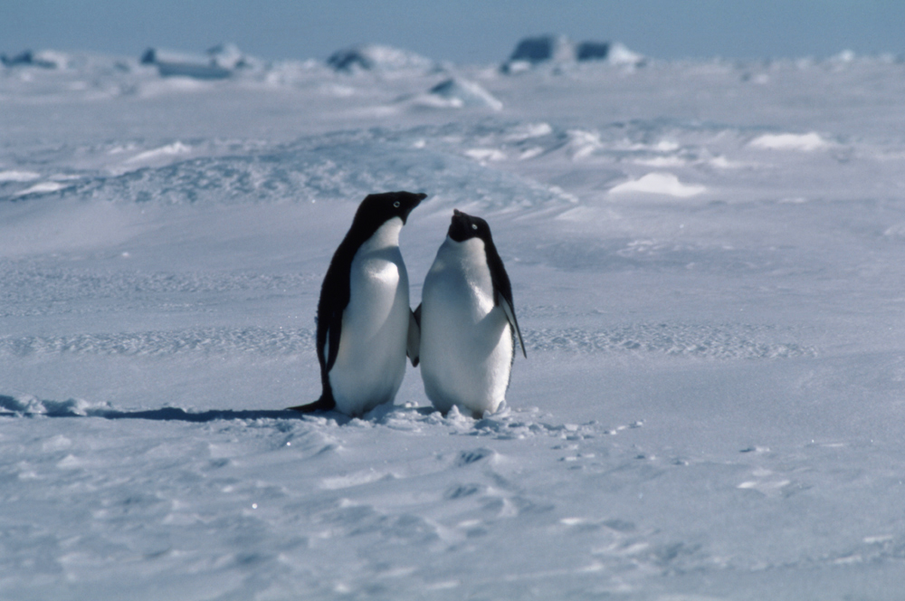
Antarctica Project
What threats are there to Antarctica and what opportunities?
What happens in Antarctica Today?
What is it like there?
What should we do with Antarctica In the future?
Who goes there and why?

Slide 3
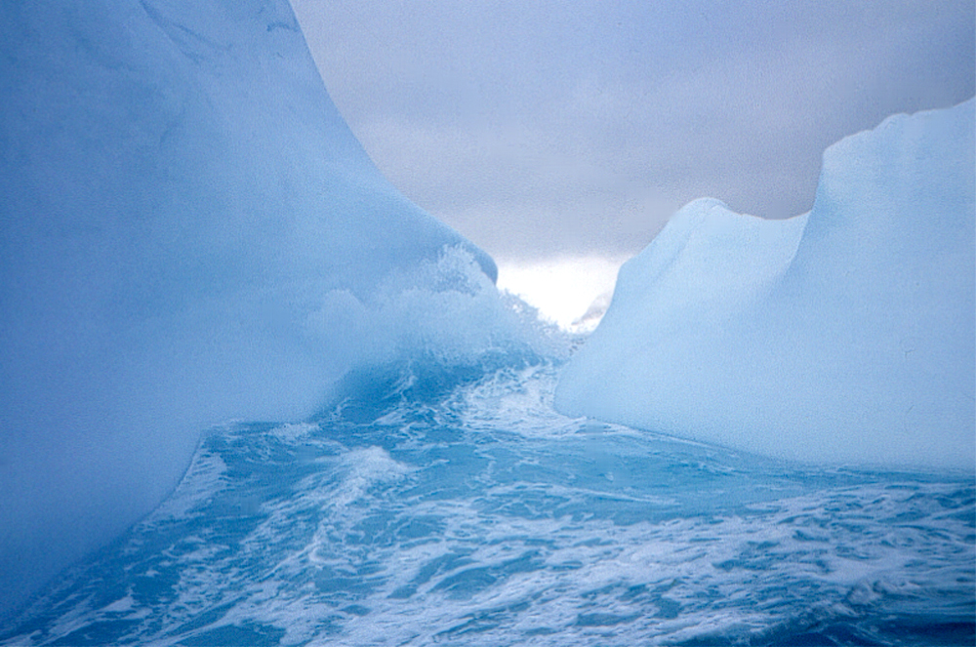
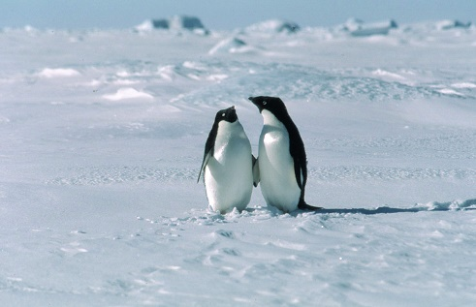
Your report on Antarctica should cover:
What is Antarctica like?
How is Antarctica used by people?
What are the effects of these uses on the ecosystem?
How can these pressures be managed?
What are the aims of the Antarctic Treaty?
What do different group of people think about the way Antarctica is managed?
What do you think?
Keep to the Penguin Plan!

Slide 4
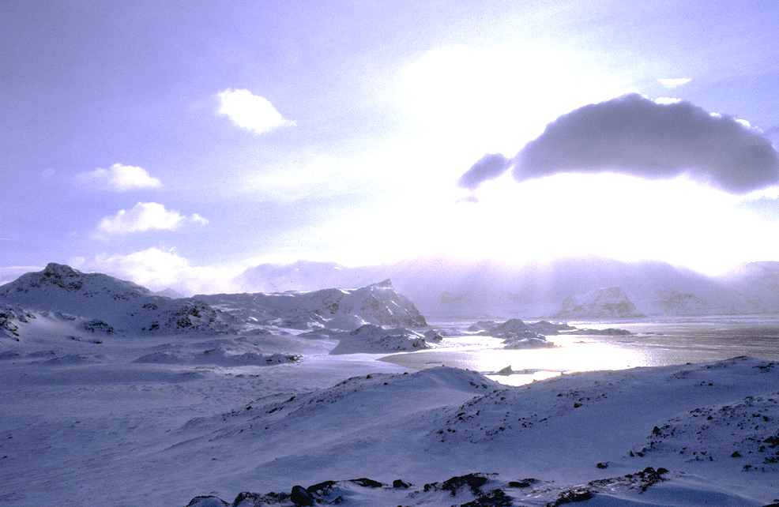
What is Antarctica like?
We are going to watch a few short movies
As you watch think about why this is called ‘the white continent’
Try and describe the landscape you see
You need to think about location, climate, landscape. A map would be great and so would some photos
How can I describe this place?
Antarctica is the world’s last great wilderness

Slide 5
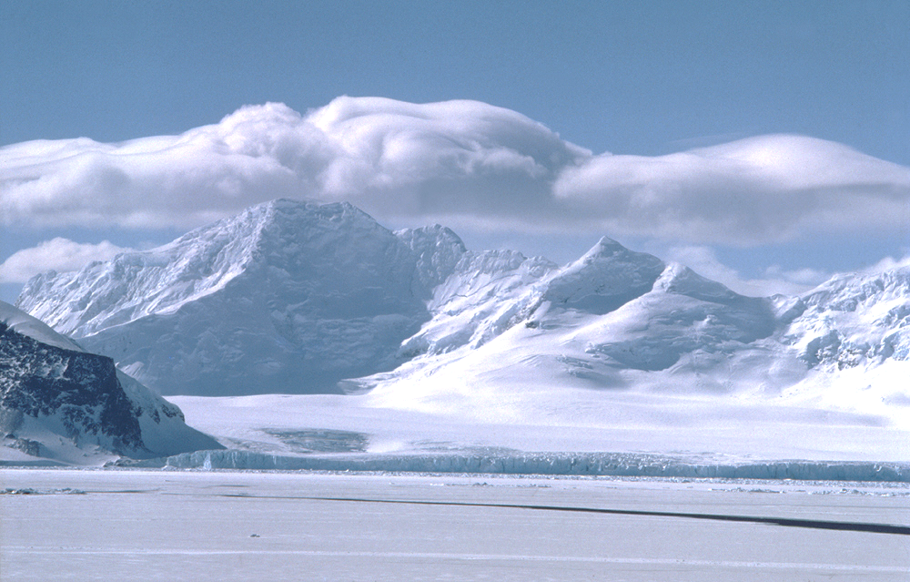
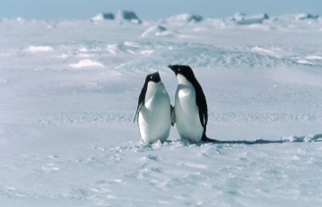
What is Antarctica like?
Use a world map and a close up map of the continent
Describe the location of Antarctica.
What are the key features of Antarctica?
How big is the continent?
What is the landscape like? What else lives there?
Describe what you have just seen on the movies
What is the climate like?
Why is the climate like this?
Don’t forget to give the map a title and scale and a N point!!
Draw a climate graph and describe what it shows. What else can you say about the climate?
Did you know Antarctica is a desert?
Now try and explain why this is such a special place

Slide 6
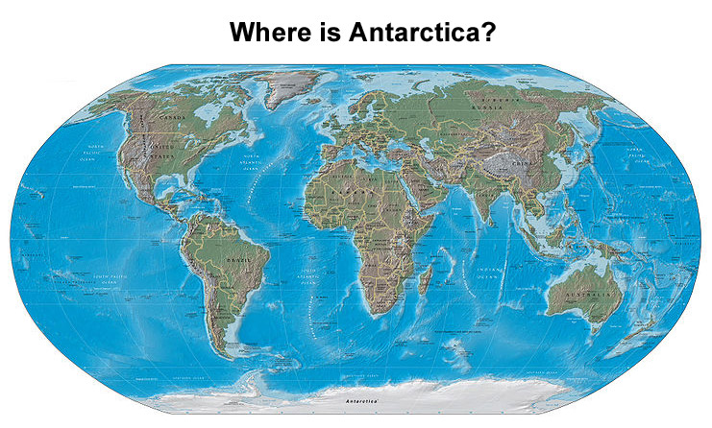
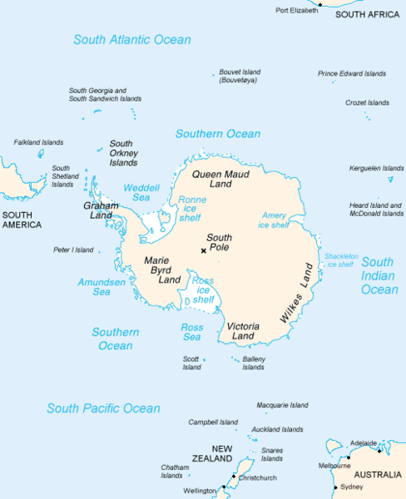
Locating Antarctica
Remember distance and direction!

Slide 7
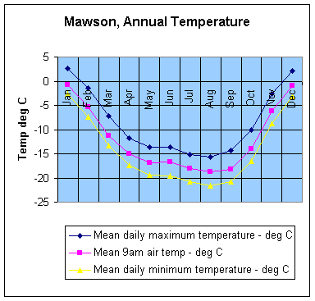
The Antarctic Climate
Now draw a graph of your own. Remember a bar chart for precipitation and a line graph for temperature
Describe what the graph shows. Include facts and figures
How does this compare with the climate in your country? Look in the atlas
McMurdo

Slide 8
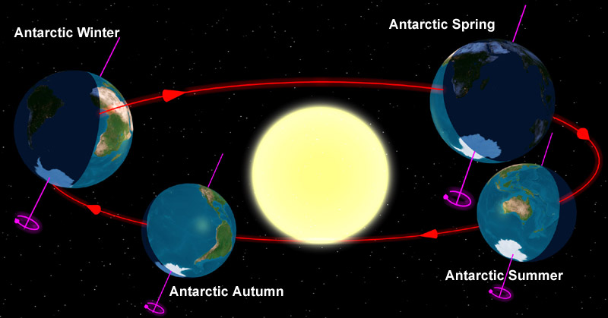
Why is Antarctica so cold?
Sunlight strikes the earth straight on (at a right angle) at the equator and then the angle gets more acute as you move away from the equator towards the poles. This means that at the poles the available sunlight and heat is spread over a greater area. The tilt of the earth as the seasons go by make this effect even greater in the winter.
Antarctica is also the highest continent. Temperature falls as altitude increases. Antarctica is a landmass and so apart from the coasts is not affected by sea temperatures which stop it getting quite so cold for so long as in the Arctic.
Why is it so cold?
This image used courtesy of Tauʻolunga under creative commons licence

Slide 9
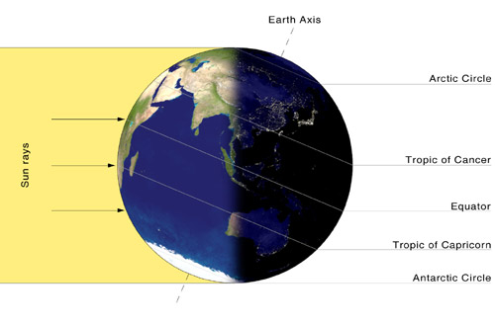
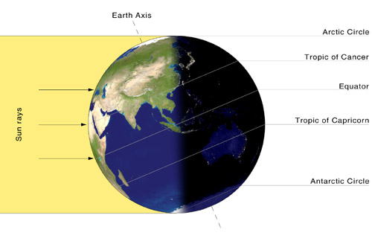
Antarctic Summer
Left - In the Southern (austral) summer, the continent of Antarctica is facing the sun and gets more energy. That part of the continent that is inside the Antarctic Circle has some time of 24 hour light, where the sun never dips below the horizon.
Right - In the Southern (austral) winter, the continent of Antarctica is facing away from the sun and gets less energy. That part of the continent that is inside the Antarctic Circle has some time of 24 hour darkness, where the sun never rises above the horizon.
Antarctic Winter
These images used courtesy of Przemyslaw "Blueshade" Idzkiewicz under creative commons Attribution ShareAlike 2.0 License

Slide 10
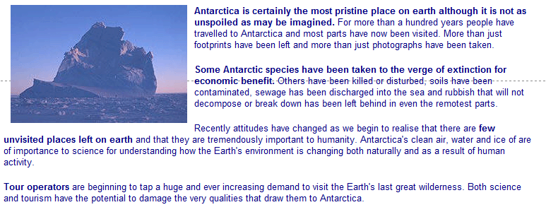
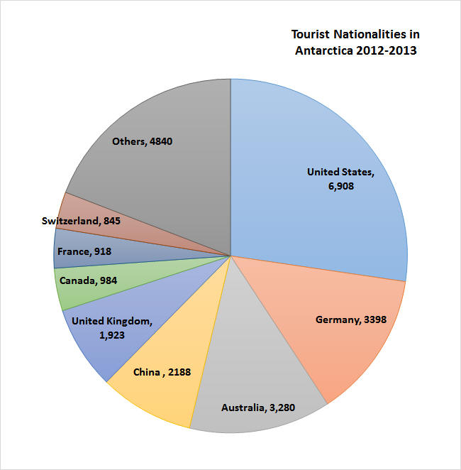
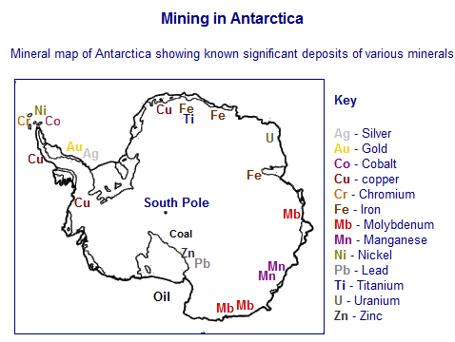

Slide 11
How is Antarctica used by people?
Whaling and fishing
Don’t forget the tourists!
Scientists
Territorial claims
Mining
Oh, and what about Global Warming?
The hole in the Ozone layer?
Find out facts about each of these uses. Write a short paragraph about each one. Don’t forget to include facts and figures. Some pictures would be good

Slide 12
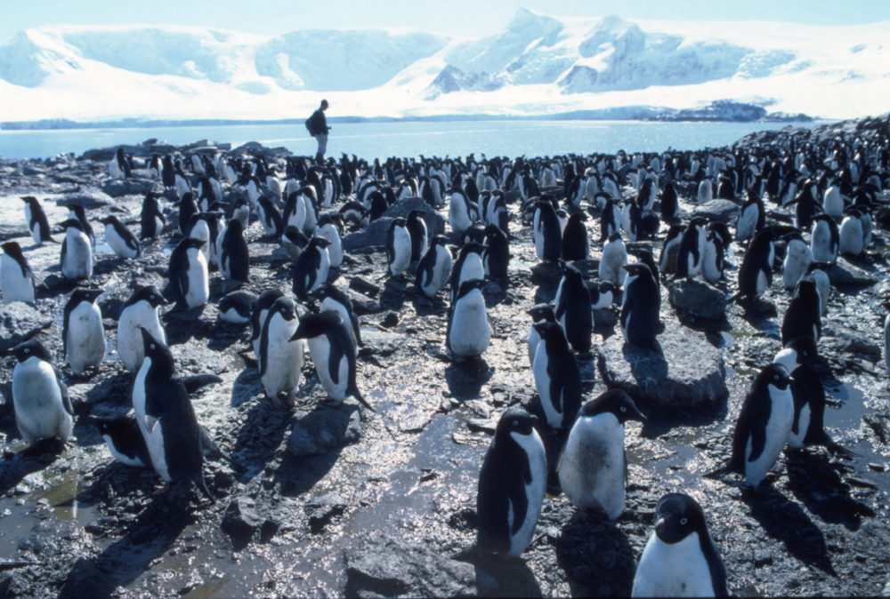
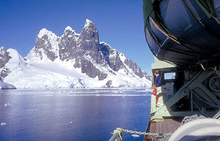
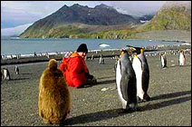
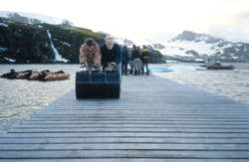
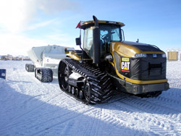
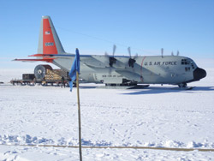
Threats to Antarctica
Scientists could make a mistake, I mean – look at him!
Look Mum a Human!
I think he’s a tourist
There’s another one over there taking pictures look
Exactly - like contaminating Lake Vostok
I gets my photo taken lots coz I is well pretty
Don’t be silly dear there’s no such thing
That could never be repaired again
What about Global Warming?
No more ice
No more tummy sledging
Nesting places harder to find
Mining for minerals could be seriously bad news!
What happen if they start to fall out over owns Antarctica?
I don’t want them catching all our fish
Catching our krill would be worse

Slide 13
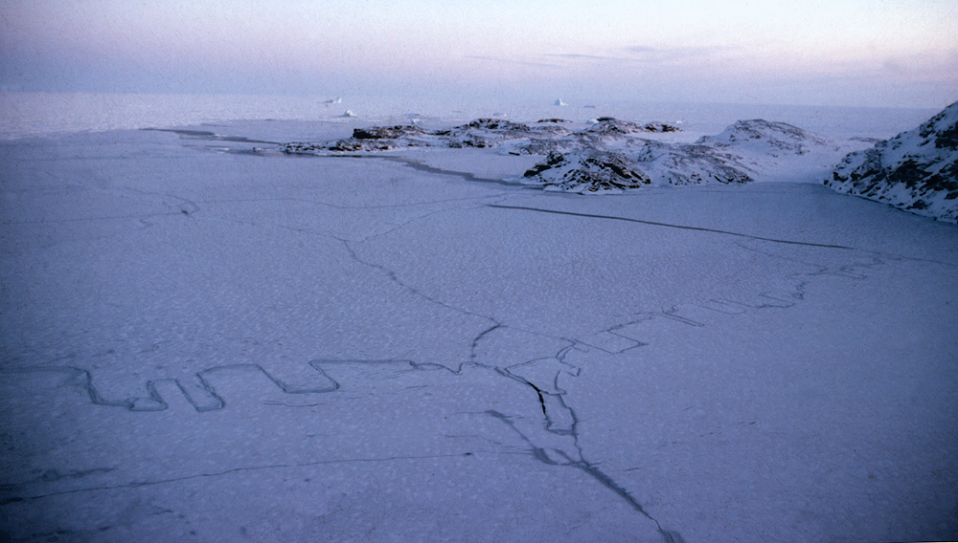
What effects do these uses have on Antarctica?
I’d better revise this and think about consumers producers, herbivores, carnivores etc.
Who's eating who?
To get the marks here you have to talk about the ecosystem

Slide 14
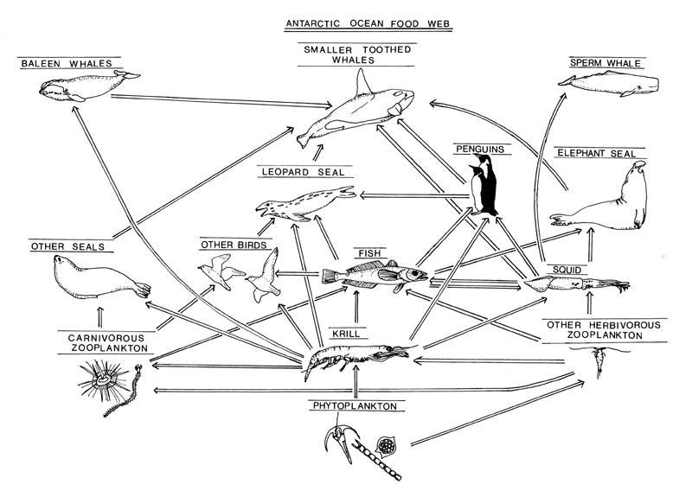
Where do we fit in?
Describe how the food web is affected by people…………. Remember if the krill dies then the whole food chain is affected

Slide 15
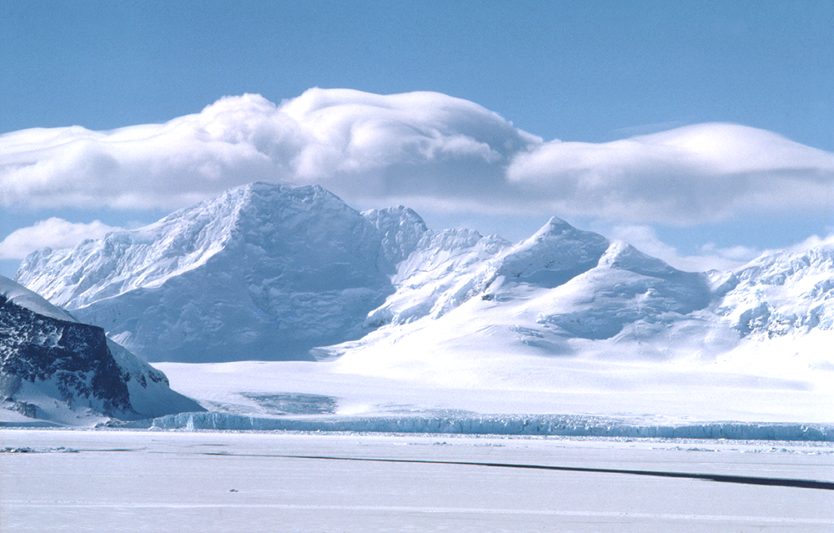
Antarctica has a fragile ecosystem
Mainly because a lot of the marine life relies on krill, which is at the bottom of the food chain. If the number of krill was to decline, this could have knock-on-effects on the other creatures that depend on krill for their survival.
The amount of plankton (producer) blooms would increase as the primary consumer has been removed.
Plankton absorbs carbon dioxide and the Southern Seas act as a carbon sink. This may help to reduce the greenhouse effect.

Slide 16
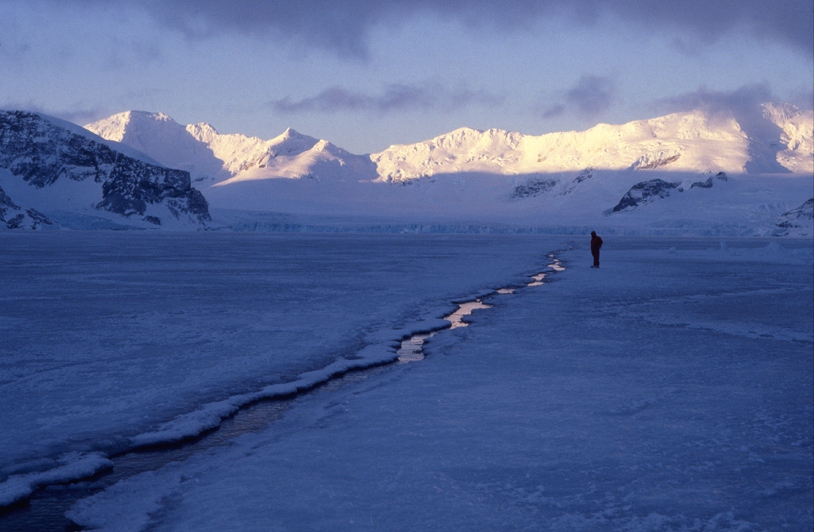
How can the pressures on Antarctica be managed?
All Agreed?
Without an international agreement like the Antarctic Treaty there would be a free-for-all in Antarctica – anybody could do or take what they want.
Come up with a list of five rules that you agree are the bare minimum for any Treaty that decides what goes on in Antarctica.
Use this word bank for useful words to include in your five rules:
Ban | Quota | Limit | Introduce | Prohibit | Prevent | Protect | Reduce | Improve | Enhance | Monitor
“It is in the interest of all mankind that Antarctica shall continue to be used forever for peaceful purposes and shall not become the scene or object of international discord” The Antarctic Treaty, 1961
Just to get you thinking!

Slide 17
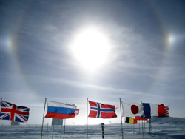
The Antarctic Treaty
Claims to own parts of Antarctica are not allowed
No military activity is allowed
Some materials aren’t even allowed to go there e.g. polystyrene
All rubbish must be taken away from Antarctica
Any proposals for using Antarctica have to be investigated. If they will damage the environment they are not allowed!
Mining is banned at the moment
Testing nuclear weapons and dumping nuclear waste is banned
Fishing is carefully controlled
The Treaty says Antarctica is a good place for scientific research. Countries who conduct research in Antarctica have to share their results with other members of the treaty

Slide 18
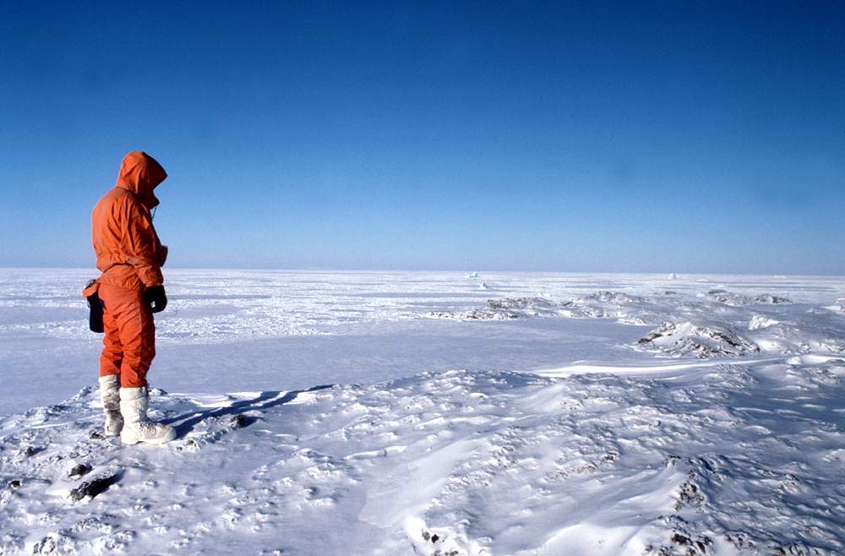
The 1961 Antarctic Treaty Covers 5 Main Areas
No military use shall be made of Antarctica, though military personnel and equipment may be used for peaceful purposes.
There will be complete freedom of scientific investigation.
Antarctic Treaty Nations will exchange plans for their scientific programmes, scientific data will be freely available and scientists will be exchanged between expeditions where practical.
No activities under the Treaty will affect claims to sovereignty of any part of Antarctica made by any nation. All territorial claims are put aside for the duration of the Treaty.
Nuclear explosions and nuclear waste disposal are banned from Antarctica.

Slide 19
We could encourage people all over the world to do something about global warming
What about turning it into a world park?
We could ban fishing and Whaling
Can you think of any other ways we could manage Antarctica?
We could limit the number of tourists
What are the good and bad things about these ideas?

Slide 20
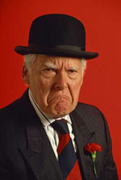
What are the different viewpoints about Antarctica and the way it should be used?
Discovering Antarctica - Which view of the future?
Sidney Suit doesn’t really care about what happens to us and our home!
Laura Leaf has a different view!

Slide 21
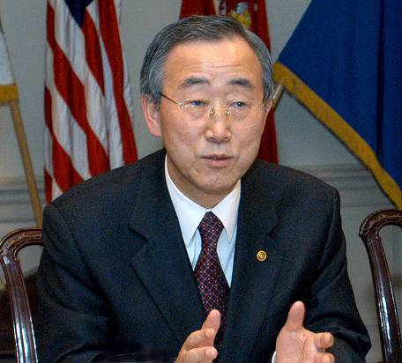
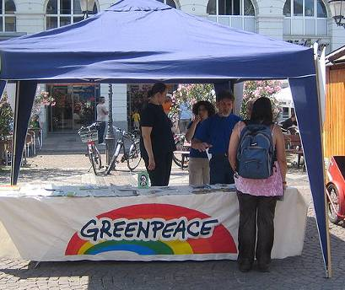
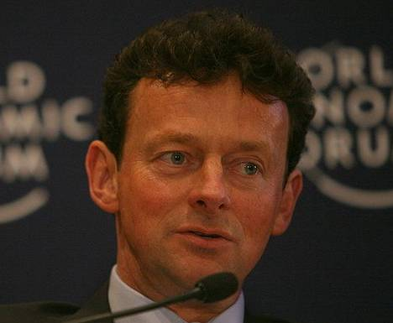
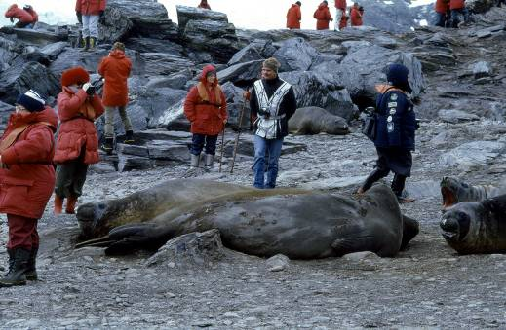
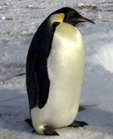
Different people have different views
You must explain why they hold the view they have
Greenpeace…. An environmental pressure group
Ban Ki Moon
United Nations Secretary General
Hands off Antarctica!
Tourists visiting Antarctica
Tony Hayward…. Boss of the big oil company BP
This image used courtesy of Russakavia under creative commons Attribution ShareAlike 2.0 License

Slide 22
What do you think?
Why do you think that?
What is the future for Antarctica?

Slide 23
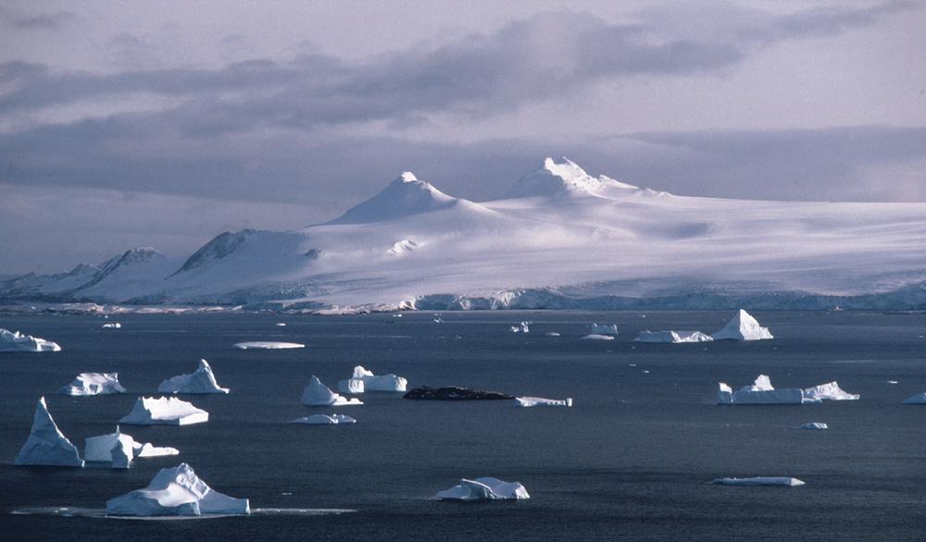
What makes Antarctica a fragile environment?
How should Antarctica be managed to protect the environment?
Is Antarctica under threat? Why?
Which are the most immediately vulnerable parts of Antarctica? What are they at risk from
How have the activities of those countries with research bases in Antarctica affected the environment there?

Slide 24
Think you’ve finished?
Have you followed the plan?
Have you explained everything?
Now check your work
Have you checked your spelling?
Does it look like a proper magazine?
Have you included lots of facts and figures?

