Slide 1
Antarctic Sledging Biscuits
Copyright: Material on these pages is copyright Paul Ward / CoolAntarctica.com. It may be used as a presentation or printed for personal or public performance as long as it is not for direct or indirect commercial use (no pay to view, no use behind a paywall). It may be altered or modified, but not made publically available or transmitted to others in original or modified form without the written permission of Paul Ward / CoolAntarctica.com. Don’t even think about trying to sell this free resource.
This copyright notice must appear wherever this material is used. Any queries please email

Slide 2
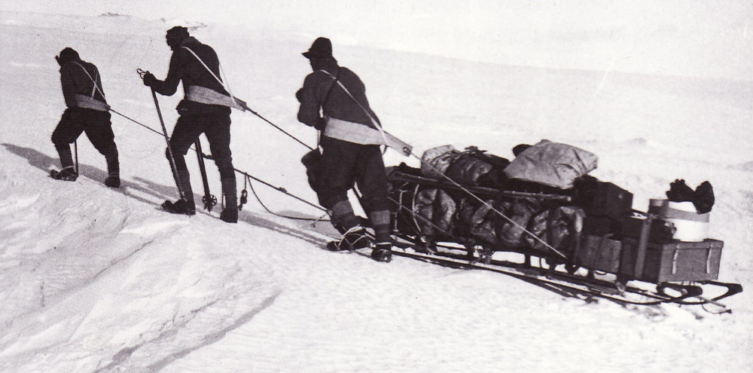
Sledging biscuits in Antarctica are one of the two foods that Antarctic exploration was built on, (the other is pemmican) they are still in use today, eaten by people who are working away from bases in Antarctica as a dietary staple.

Slide 3
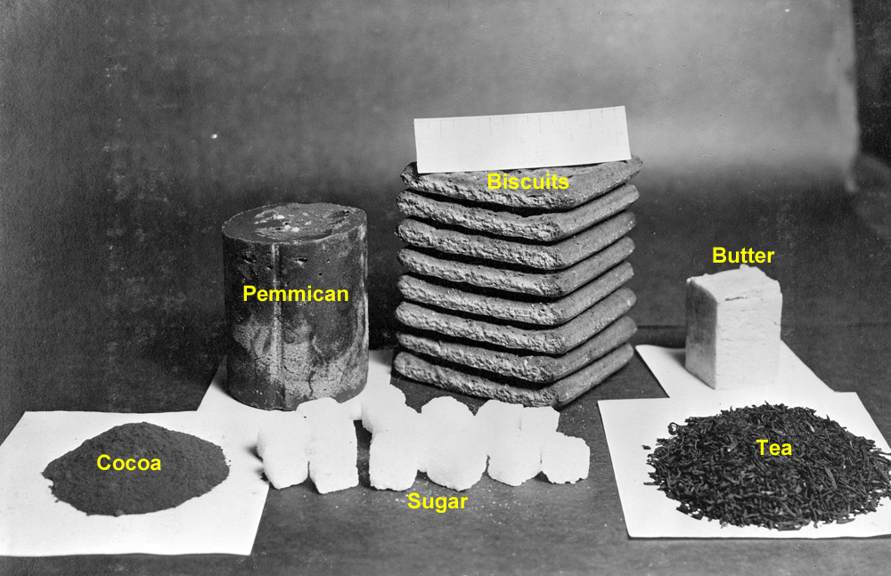
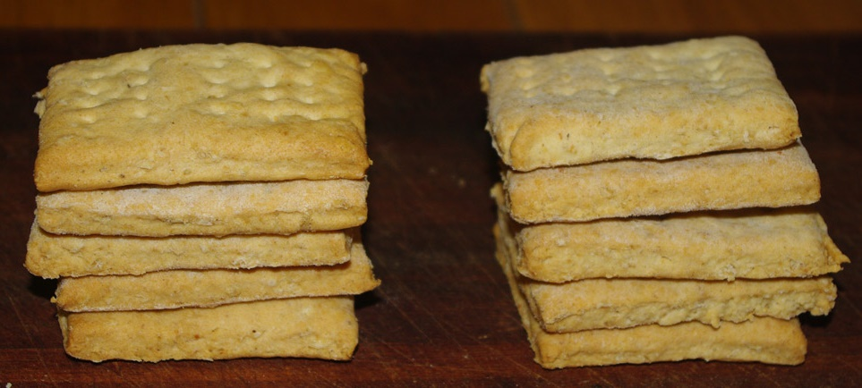
They are derived from hardtack or “ships biscuits”. A simple, physically resilient, nutritious, long lasting, compact food stuff that is easy to make. It takes the place of bread as the standard carbohydrate source when away from base.
Antarctic sledging rations in 1912
Sledging biscuits 2015

Slide 4
The basic recipe is very simple
150g plain white flour
½ tsp baking soda
½ tsp salt
30g butter
50ml cold water
Antarctic explorers would modify this in various ways by using wholemeal instead of white flour, by adding oats or by leaving out the baking powder for instance.

Slide 5
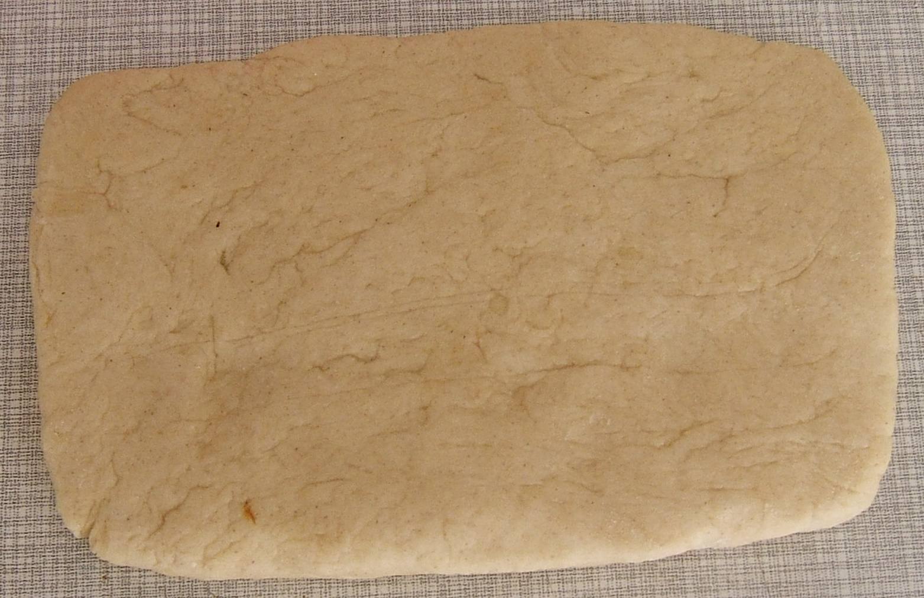
Mix the ingredients together in a bowl, add a little water to start, add more if needed to make a soft but not sticky dough.
Roll it out to about half an inch or 1cm thick.

Slide 6
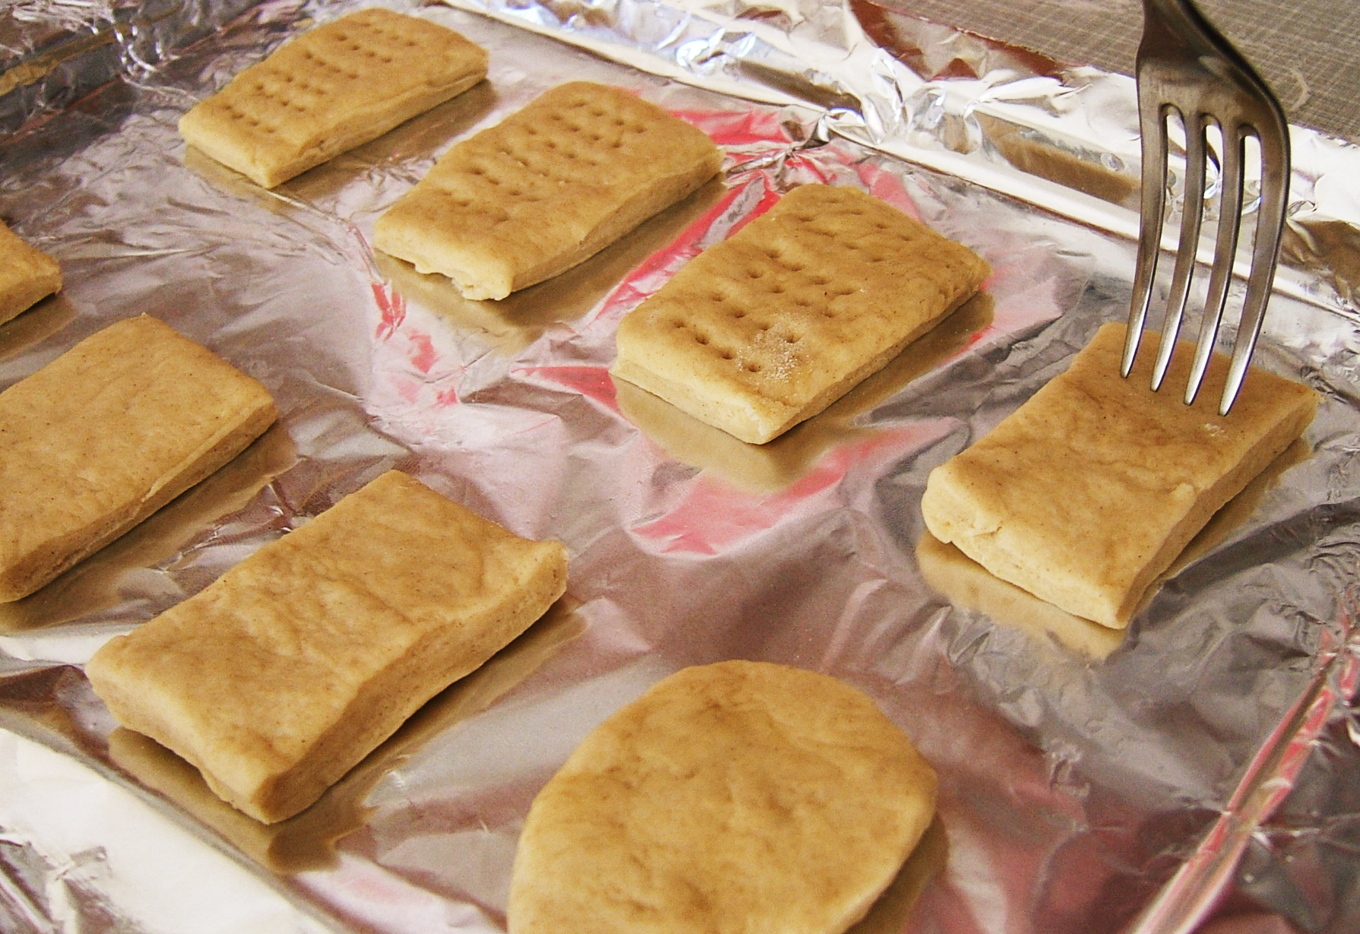
Cut the dough into eight equal sized pieces, place on a baking sheet and prick each one gently with a fork 5 times

Slide 7
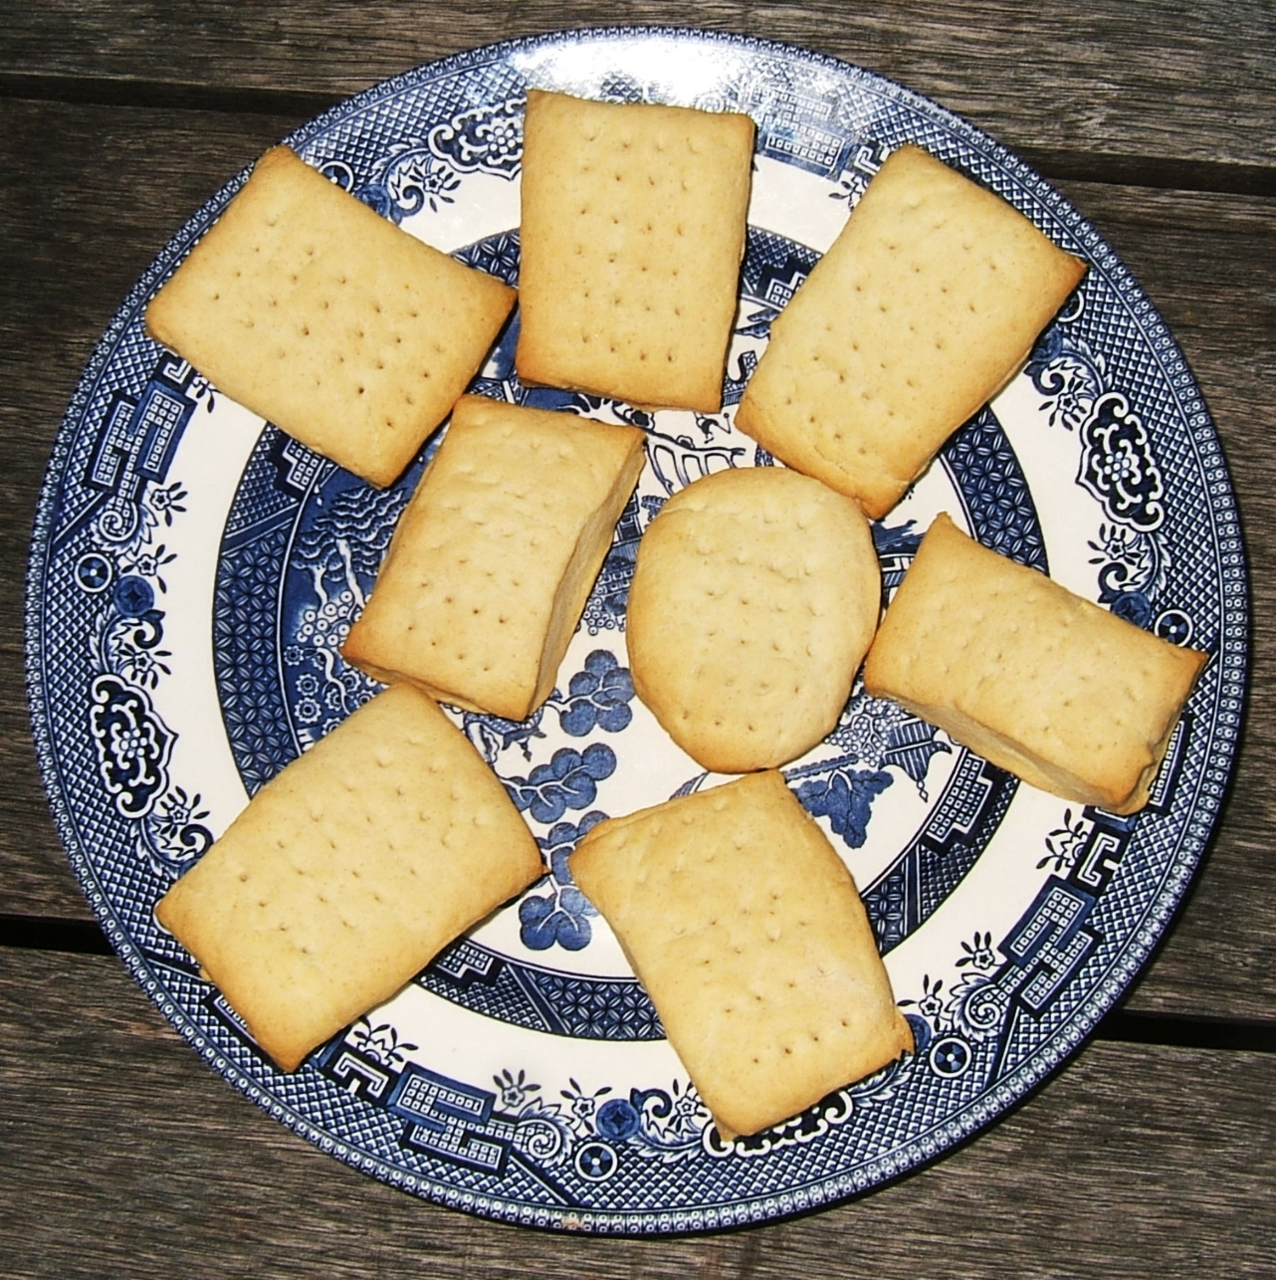
Bake for about 20 mins at 190°C or until the biscuits are a pale golden colour. If you added baking powder they will rise a little.

Slide 8
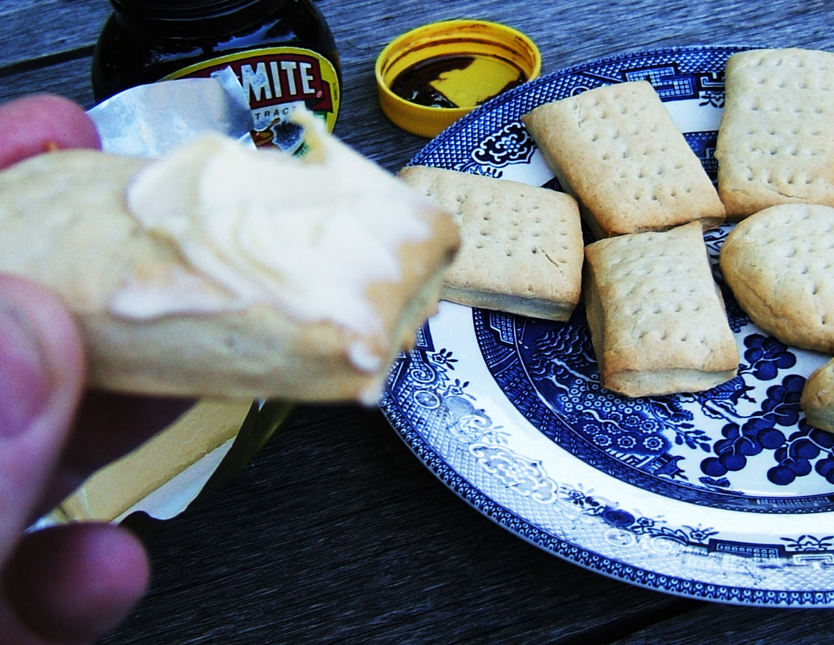
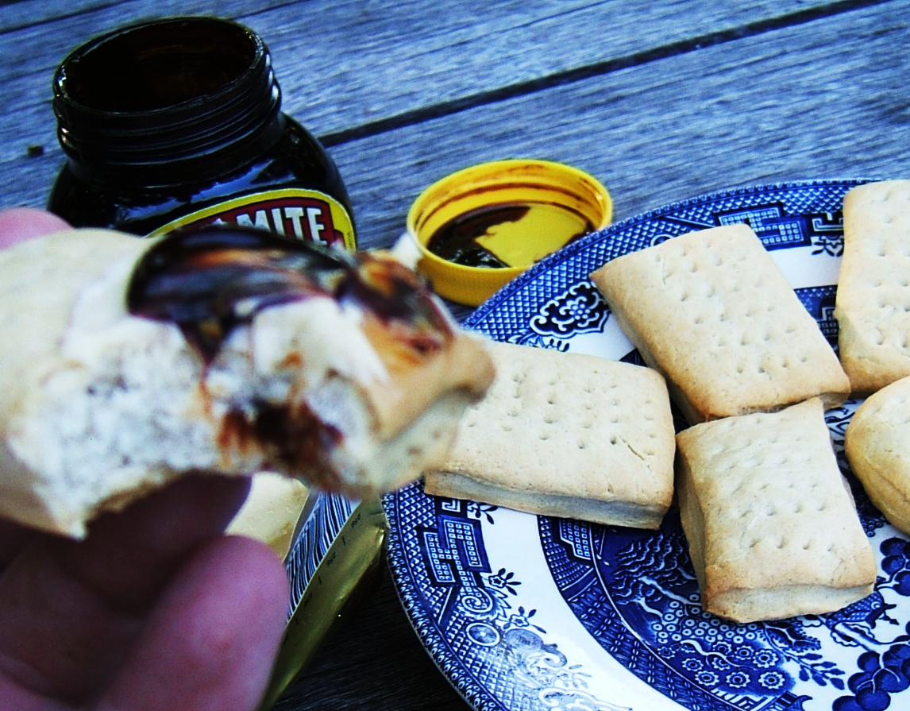
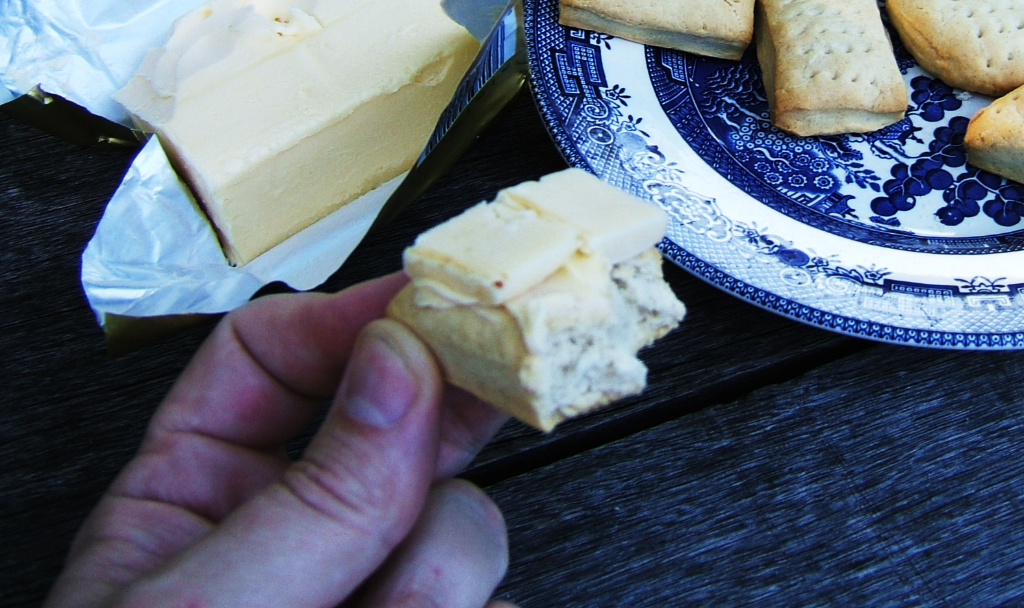
These are eaten when away from the main base in place of bread, with butter on its own, with butter + marmite, with cheese or in any way you would eat bread

Slide 9
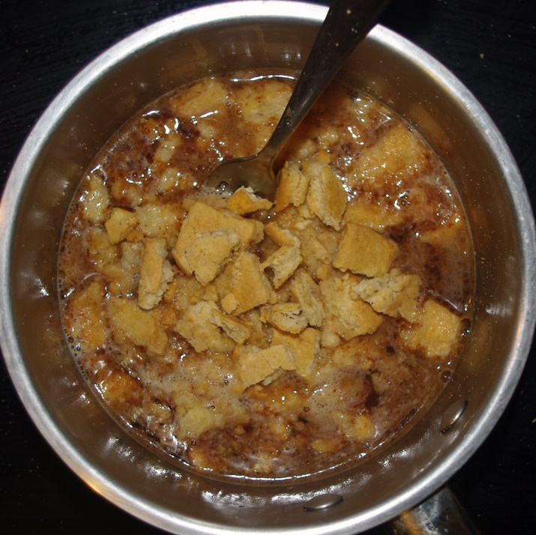
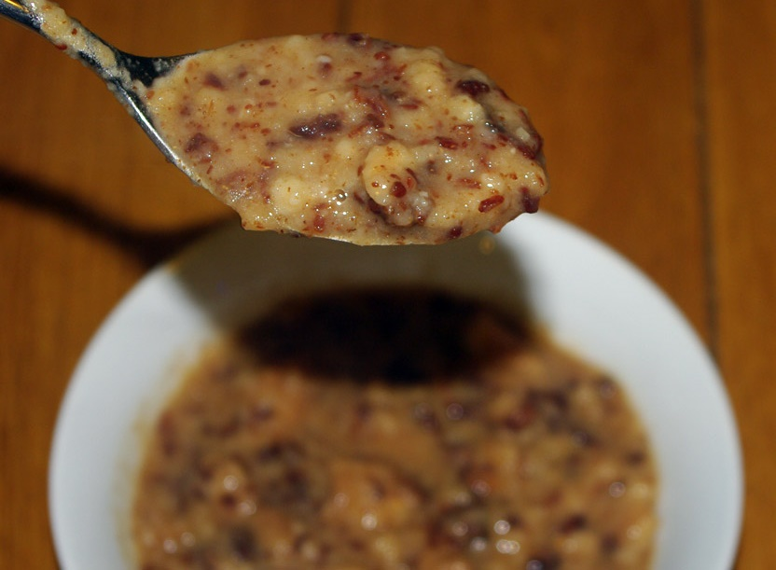
100 years ago, sledging biscuits were also broken up into a pan of melted snow and pemmican (meat jerky finely ground and mixed with clarified fat) to make a stew called “hoosh” which tastes far better than it looks and is very high in energy.

Slide 10
Alternative ways to make sledging biscuits
Flour + Salt | Baking soda | Butter | Other
white (120g) | yes | yes | oats (30g)
white (120g) | yes | no | oats (30g)
white | yes | yes | no
white | yes | no | no
white (120g) | no | yes | oats (30g)
white (120g) | no | no | oats (30g)
white | no | yes | no
white | no | no | no
wholemeal (120g) | yes | yes | oats (30g)
wholemeal (120g) | yes | no | oats (30g)
wholemeal | yes | yes | no
wholemeal | yes | no | no
wholemeal (120g) | no | yes | oats (30g)
wholemeal (120g) | no | no | oats (30g)
wholemeal | no | yes | no
wholemeal | no | no | no

Slide 11
Questions
Why are sledging biscuits used rather than bread? – 3 reasons
What is the point of using wholemeal rather than plain white flour?
What is the value of adding oats to the mixture?
Why are high energy foods needed in the Antarctic?

